Slide 1
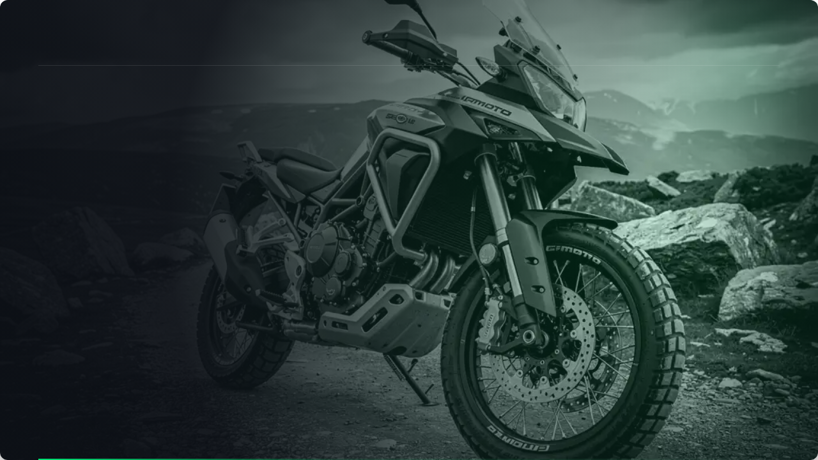
CORPORATE PRESENTATION
MOTORCYCLES • TECHNOLOGY • PARTNERSHIP
MULTI-BRAND SUPPLIER AND MANUFACTURER OF MOTORCYCLES
Motorcycles • ATVs • Snowmobiles • Spare parts • Equipment

Slide 2


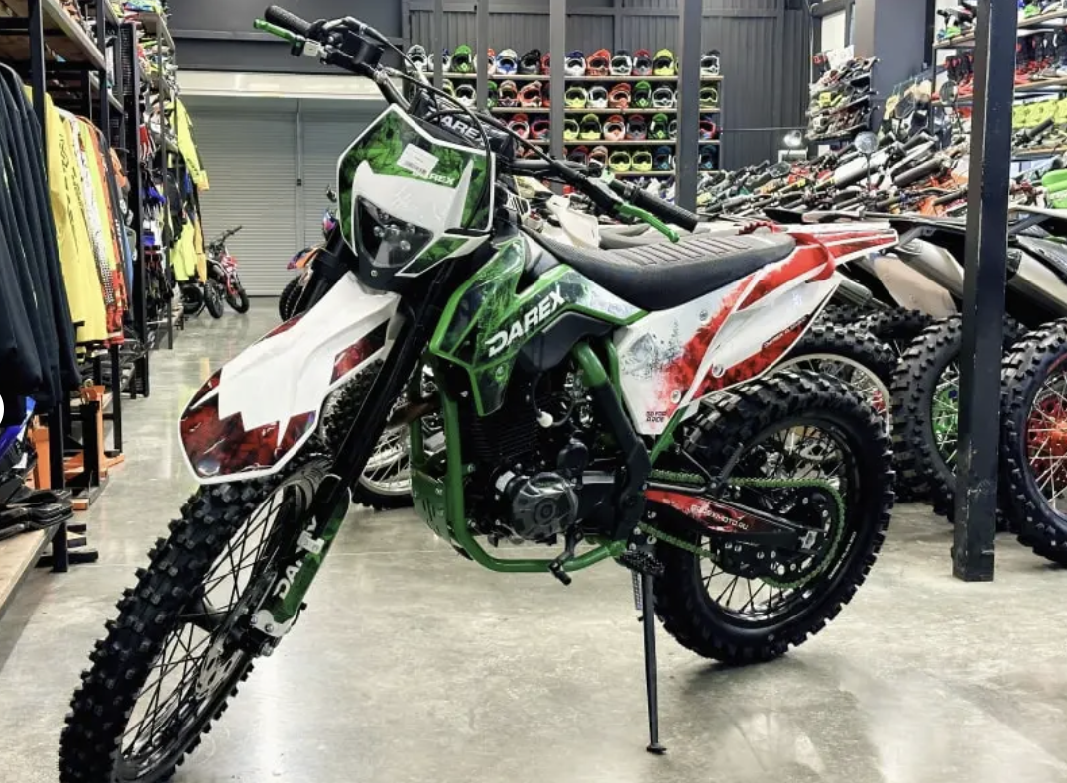

DAREX: A FULL-CYCLE COMPANY
Trade, service and production ecosystem
DAREX combines the distribution of motorcycles, an extensive retail and service infrastructure, work with the world's leading factories and the systematic development of its own production in Russia.
We work with all key categories: enduros, pit bikes, road motorcycles, ATVs, snowmobiles, towing vehicles, scooters, as well as original components and equipment.
7+
145K
Years of confident work in the market and cooperation with key brands
Subscribers in social networks (YouTube, VK, TG) are the leaders in the media coverage of the industry

Slide 3














NETWORK SCALE AND INFRASTRUCTURE
10 BRANCHES
9 branches are already actively functioning, the 10th is preparing to open. It is planned to open 3 more regional hubs.
Motor halls
Motorcycle service network
Uniform standard
Spacious showrooms with a full range of equipment in stock. Test drives and professional advice before buying.
Specialized service areas in each city: pre-sale preparation, regular maintenance, warranty repair and tuning.
Recognizable entrance groups, unified brand identity DAREX MOTO and high customer service regulations.

Slide 4


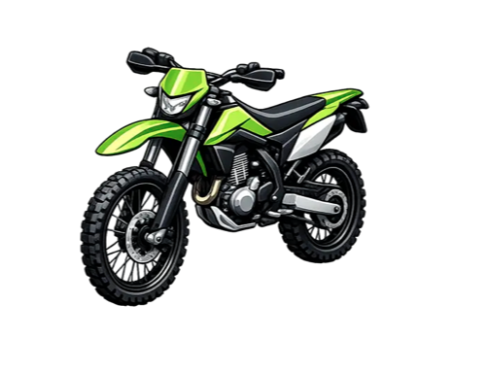
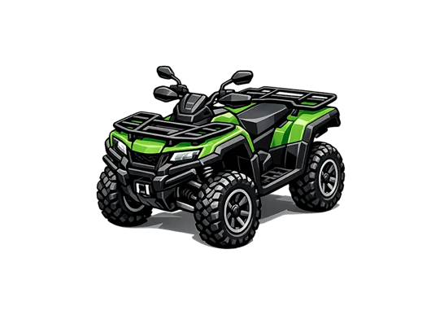
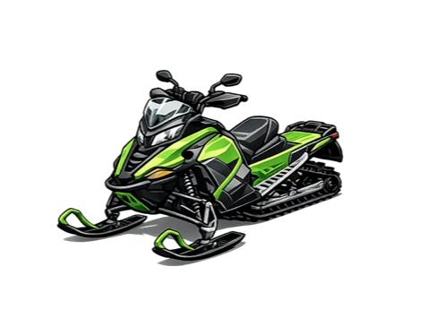
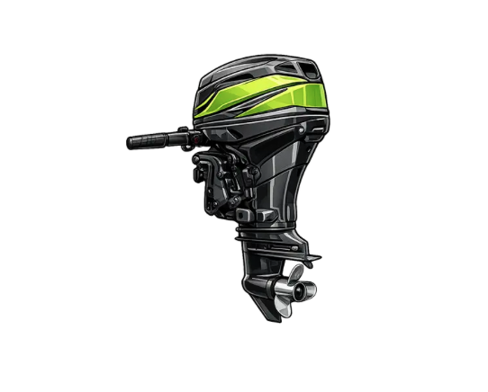
WIDE RANGE OF POWERSPORTS
Motorcycles
Quad Engineering
Winter equipment
Parts & Equipment
Enduros, pit bikes, road bikes and sports bikes. Volumes of 125-300 cm³ and above.
Utilitarian and sports ATVs, teenage ATVs and Side-By-Side Vehicles (buggies).
Reliable snowmobiles, snowplows, motorized towing vehicles for hunting and recreation.
2,540+ stock items of spare parts, certified helmets, protection, uniform and tuning.

Slide 5















MULTI-BRAND PORTFOLIO
Different brands — different market segments
DAREX forms a comprehensive product offer for dealers and wholesale partners, covering all price categories - from affordable solutions to premium sports equipment.
DAREX flagship vector
Its own brand DAREX occupies a key place in the portfolio, providing increased margins and exclusive conditions for strategic partners.

Slide 6






PRODUCTION AND LOCALIZATION
PROJECT GOAL: Localization of motorcycles in the Russian Federation with a phased increase in the share of domestic components (PP No719).
Production Base
WMI and Status
Certification
CA development
Custom Nodes
The international manufacturer's code WMI NAMI, the right of official production of the vehicle was obtained.
Readiness of samples for testing VTA and PSM of categories L3 (moto) and L7 (ATVs).
Design documentation for localization, selection of Russian supplier plants.
Production of own frames, plastic, seats and assembly according to strict PP No719 criteria.
Contracts for the supply of car kits, registration of the DAREX brand, launch of sales.

Slide 7

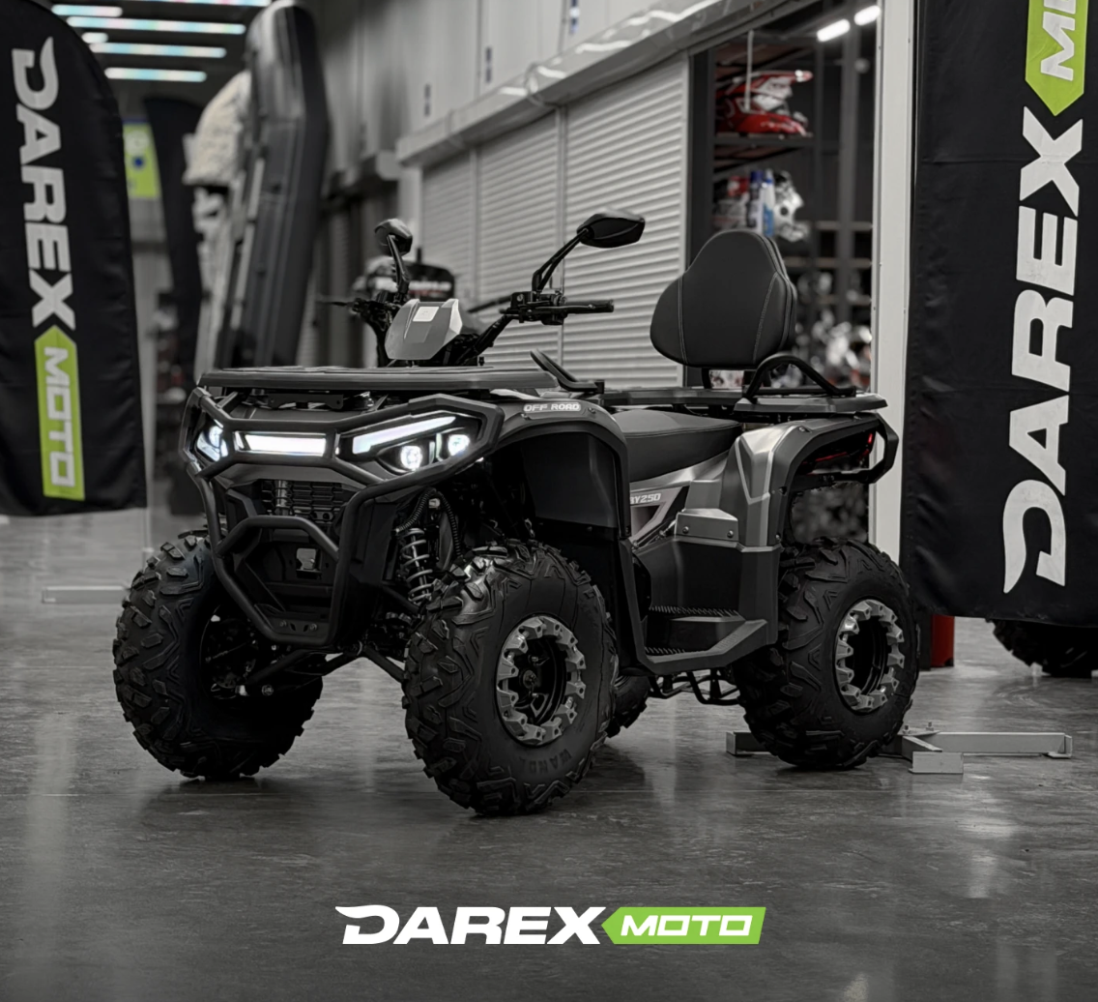
DAREX PRODUCT LINE
Own L3, L7 and Snow platforms
Chromium-molybdenum steel:
High-strength frames of our own design with reinforced geometry.
Reliable engines:
125-300 cm³ for L3 enduro, 150-200+ cm³ for ATV, 378 cm³ with a variator for snowmobiles.
Modern electrics:
LED optics, lithium batteries 12V/3Ah, electric starter, digital instrument panel.
Mechanics and chassis:
Adjustable suspension, disc hydraulics, winches and tow bars in the base.

Slide 8


THE COMPLETE DAREX ECOSYSTEM
Full Cycle Interaction: Selection → Purchase → Operation → Service → Spare Parts
01. Showrooms
02. Motorcycle services
03. Spare parts
04. Equipment
Flagship points with a live exposition of equipment, a test drive and a selection of equipment.
Authorized service, qualified mechanics, routine maintenance and warranty support.
2,540+ items of original spare parts and consumables in our own warehouse.
Helmets, motorcycle boots, goggles, gloves, body protection and waterproof clothing for active riding.

Slide 9






PARTNERSHIPS AND NEW MARKETS
Wholesale deliveries
Dealer contracts
Distribution
Direct deliveries of motorcycles, spare parts and accessories at special wholesale prices.
Marketing, warranty and product support for regional retail chains.
Exclusive conditions for large national and regional distributors of equipment.
Technological cooperation according to PP No719
We invite universities, engineering startups and certified manufacturers of components (frames, plastic, suspensions, electronics, telematics) for joint localization and reverse engineering.

Slide 10



LET'S START A JOINT DIALOGUE
We are ready to discuss the supply of motorcycles, the development of a dealer network in your region, the production of equipment under the DAREX brand and technological partnership.
WHOLESALE DEPARTMENT AND DISTRIBUTION
PRODUCTION AND LOCALIZATION
+7 (800) 300-73-06
Ilnar Sabirov — General Director
zabota@darex-moto.ru
Konstantin Lykov — Project Manager
darexmoto.ru
+7 (917) 058-57-87

