Slide 1
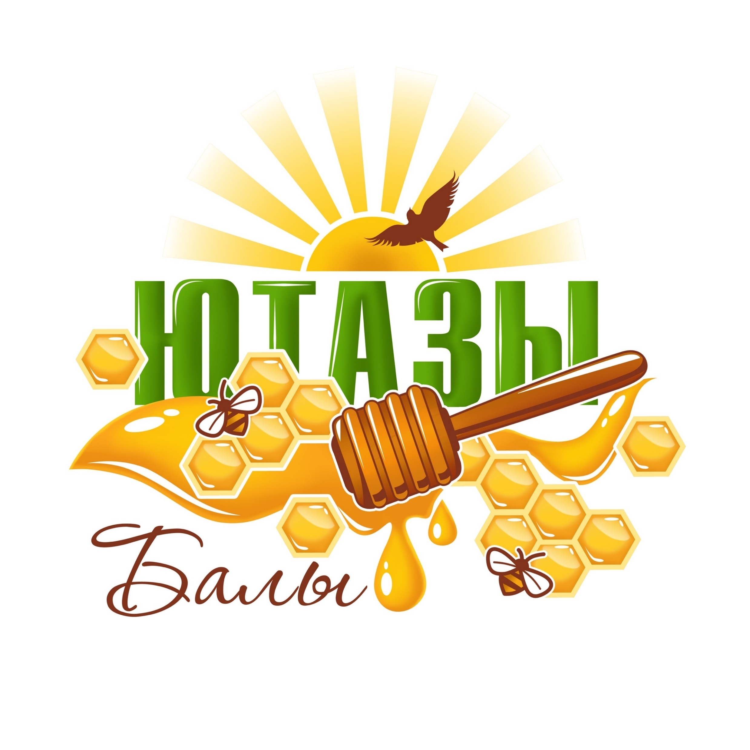
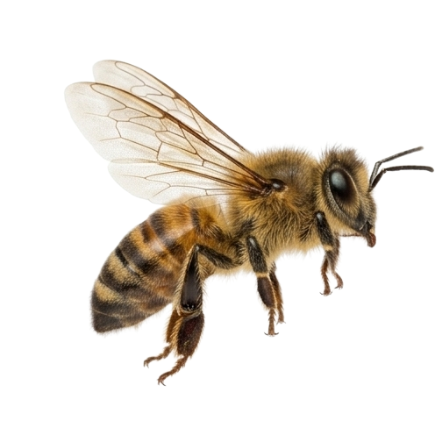
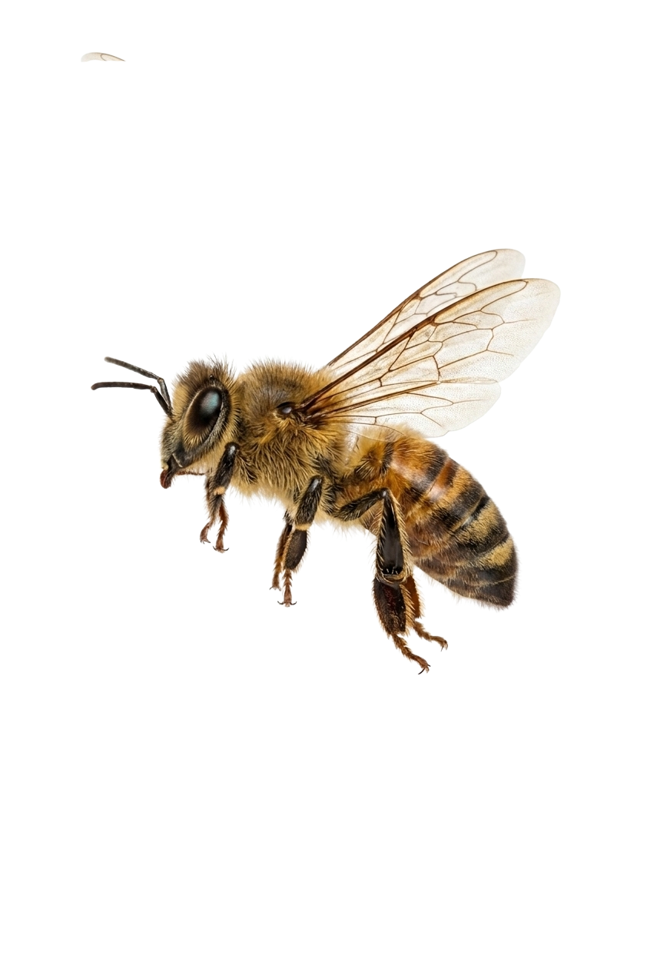
Genuine Honey. The Gold Standard
of Quality, Recognized by the Market

Slide 2
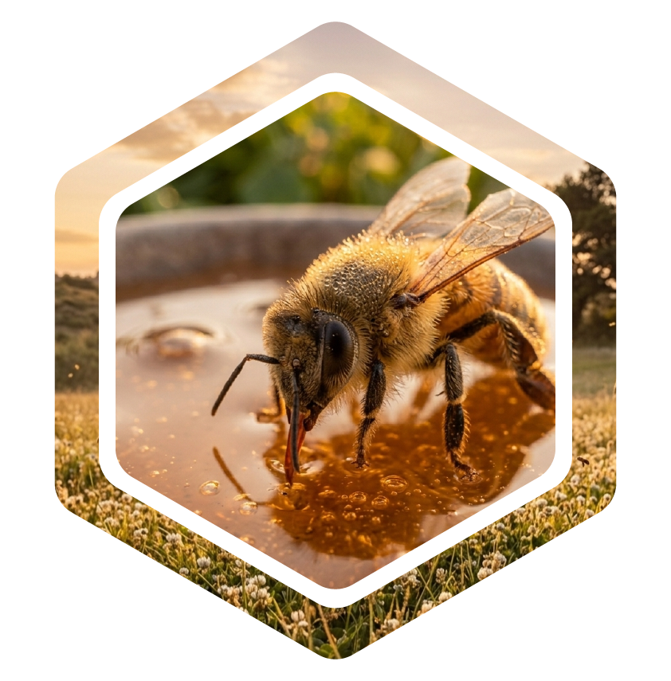
From the very heart
of Tatarstan — with
love for our craft
Our gold standard is born in the Yutazinsky District, where pristine nature meets time-honored traditions.
We create a rich palette of the purest honey flavors — from delicate linden to noble wildflower. This is a living product that delights retail customers, meets rigorous business standards, and is officially recognized as a quality benchmark by the leadership of the Republic of Tatarstan

Slide 3

The face of the brand and keeper of traditions
Gulchachak Mustafina — founder of the brand, whose dedication and uncompromising approach to quality build the reputation of “Yutazy Baly”.
By blending centuries-old beekeeping traditions with modern business standards, she has created a product that stands as a benchmark of honest flavor and has earned the unconditional trust of partners and customers

Slide 4




The philosophy of a clean brand
Absolute naturalness
We guarantee 100% product purity, with no antibiotics, sugar, or chemical additives
Maximum natural benefits
Gentle harvesting techniques fully preserve the living power, vitamins, and biological properties of honey, propolis, and bee bread
Eco-responsibility and development
We preserve the ecological balance of the region and develop agrotourism, opening the beauty and traditions
of Tatarstan beekeeping
to everyone

Slide 5


Export potential and quality
standards
Official control
Expertise from the Republican Veterinary Laboratory of Tatarstan has confirmed that our honey strictly complies with GOST standards
Stability of supply
Professional management of the apiary
in the village of Kryash-Bulyak and wintering bees
in a dedicated facility ensure the survival of strong colonies and stable production volumes

Slide 6
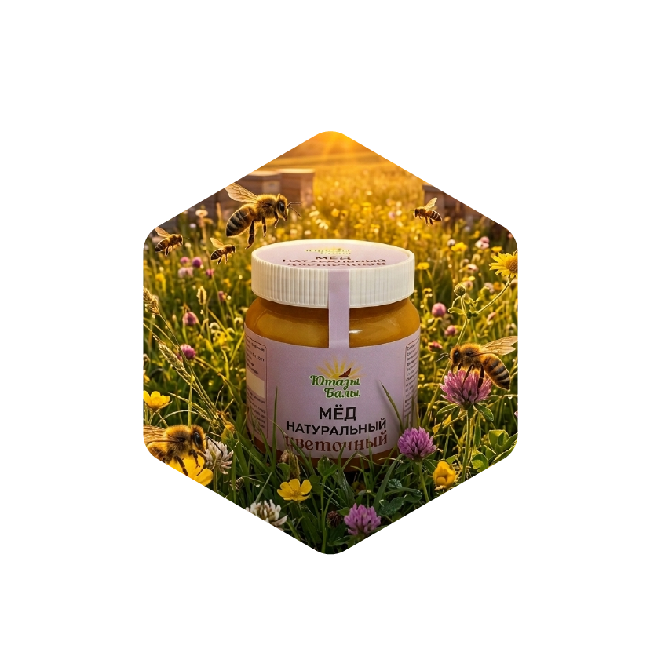
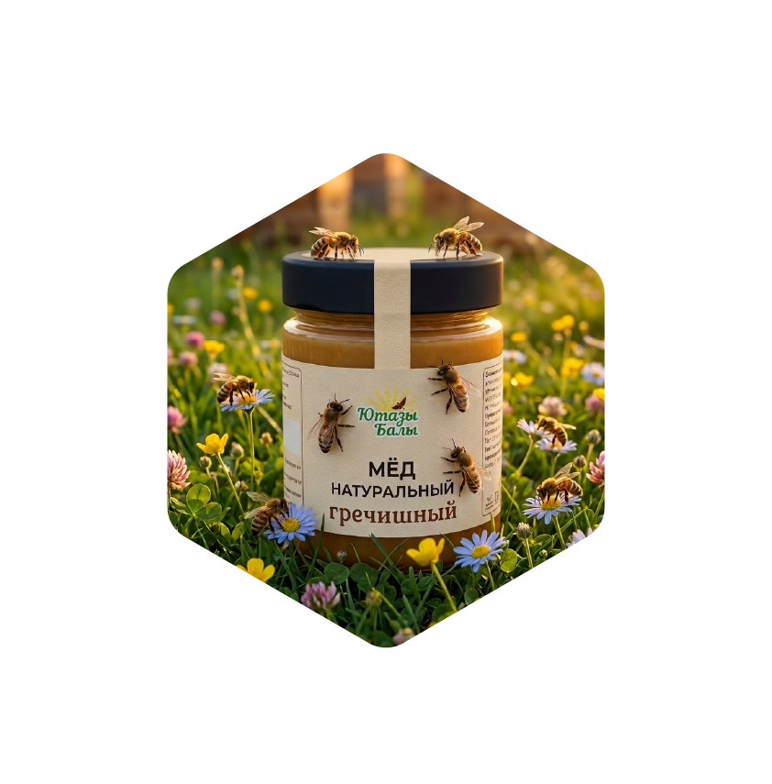
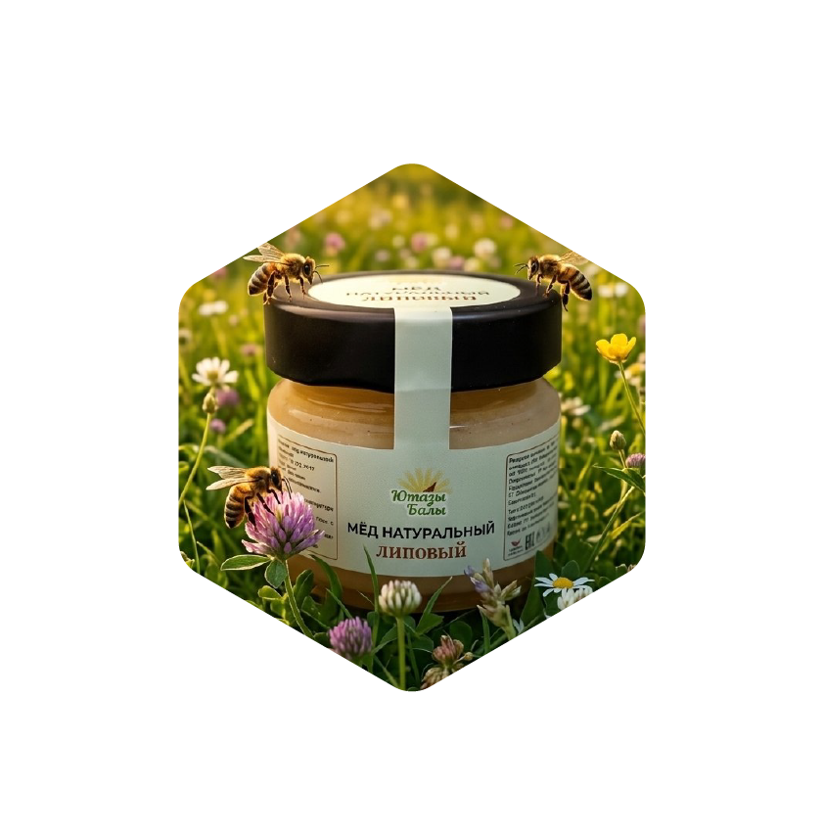
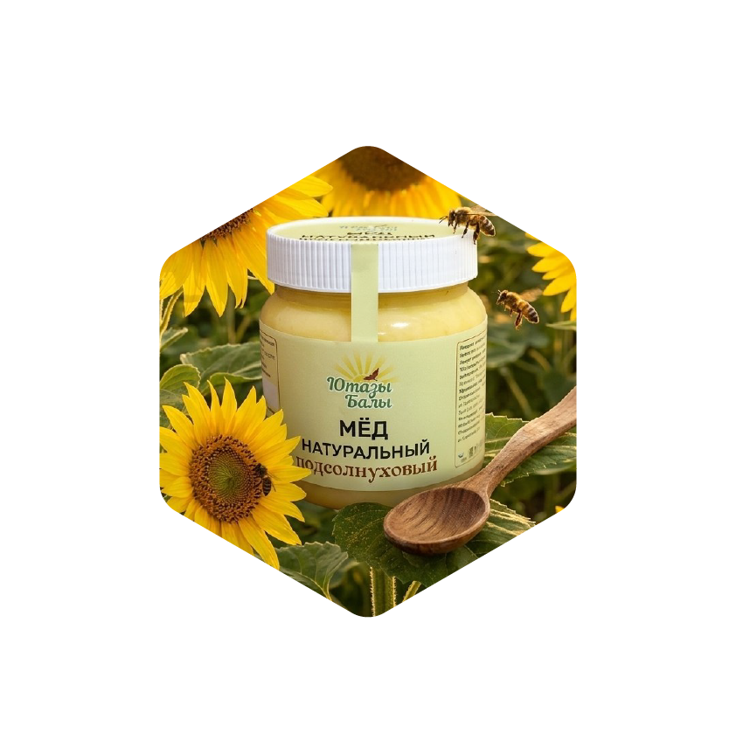
A natural pharmacy for every day
Natural honey tailored to any retail customer preference and business partner need
Floral
The aroma of meadow wildflowers
Buckwheat
Dark, rich, intense flavor
Linden
Classic light
honey
Sunflower
Bright, sunny
energy

Slide 7
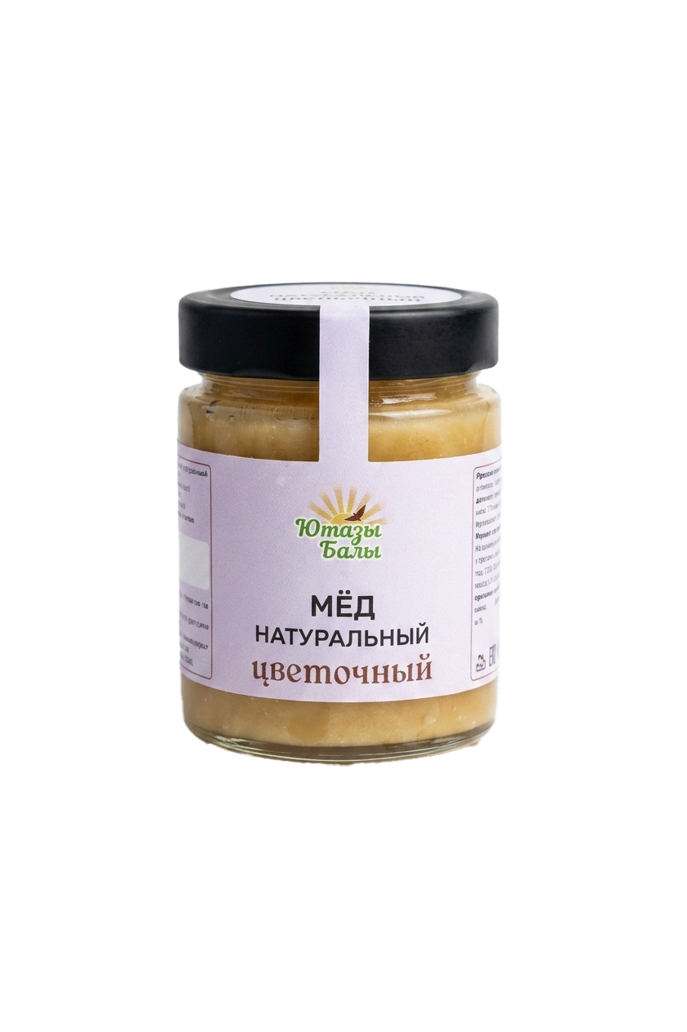
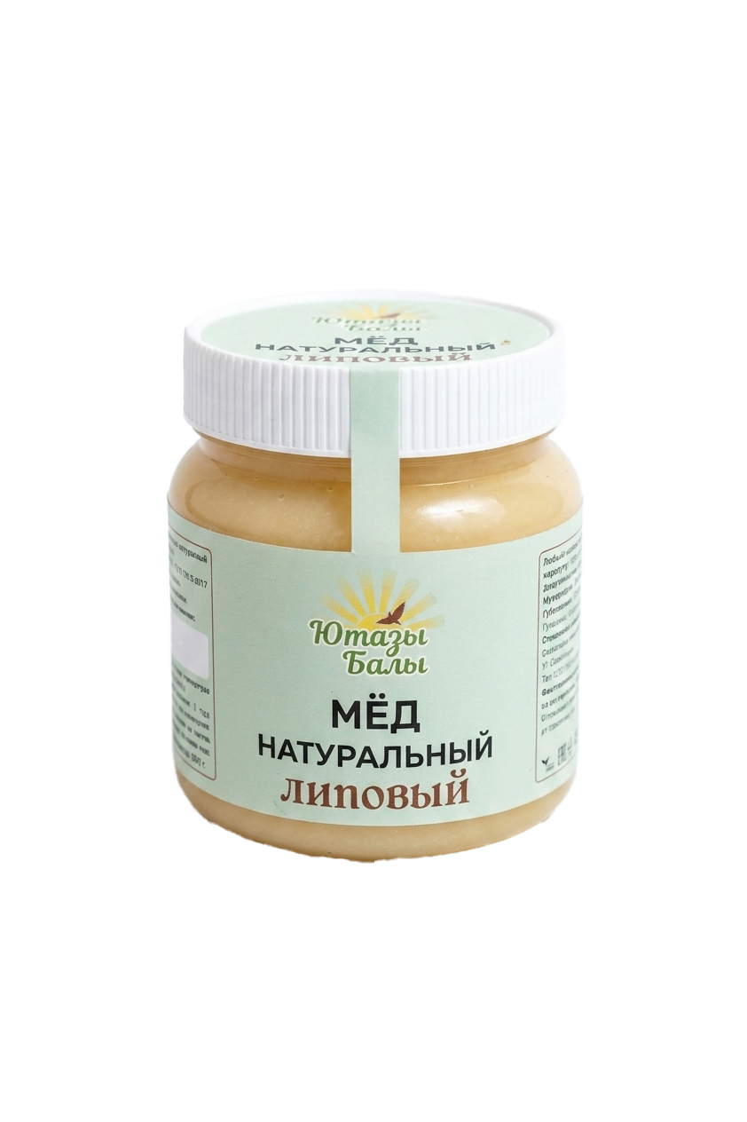

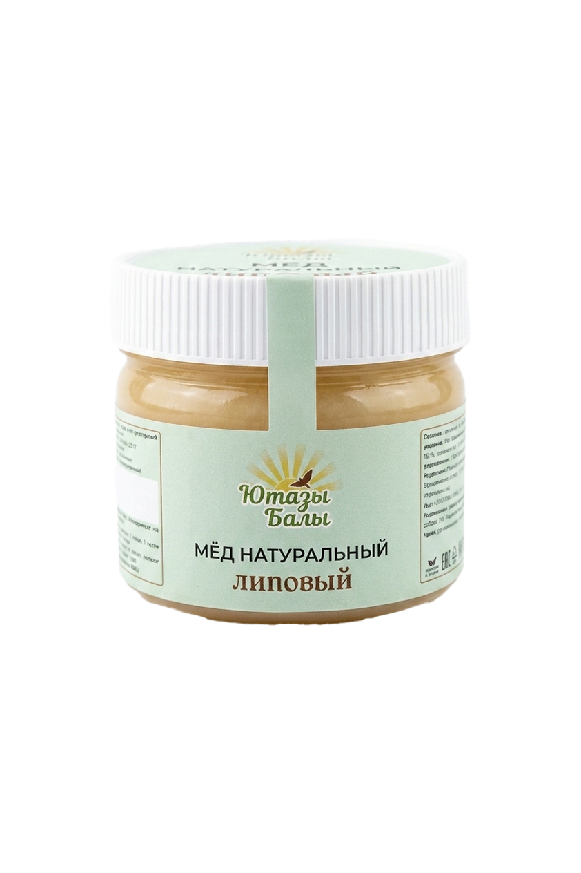
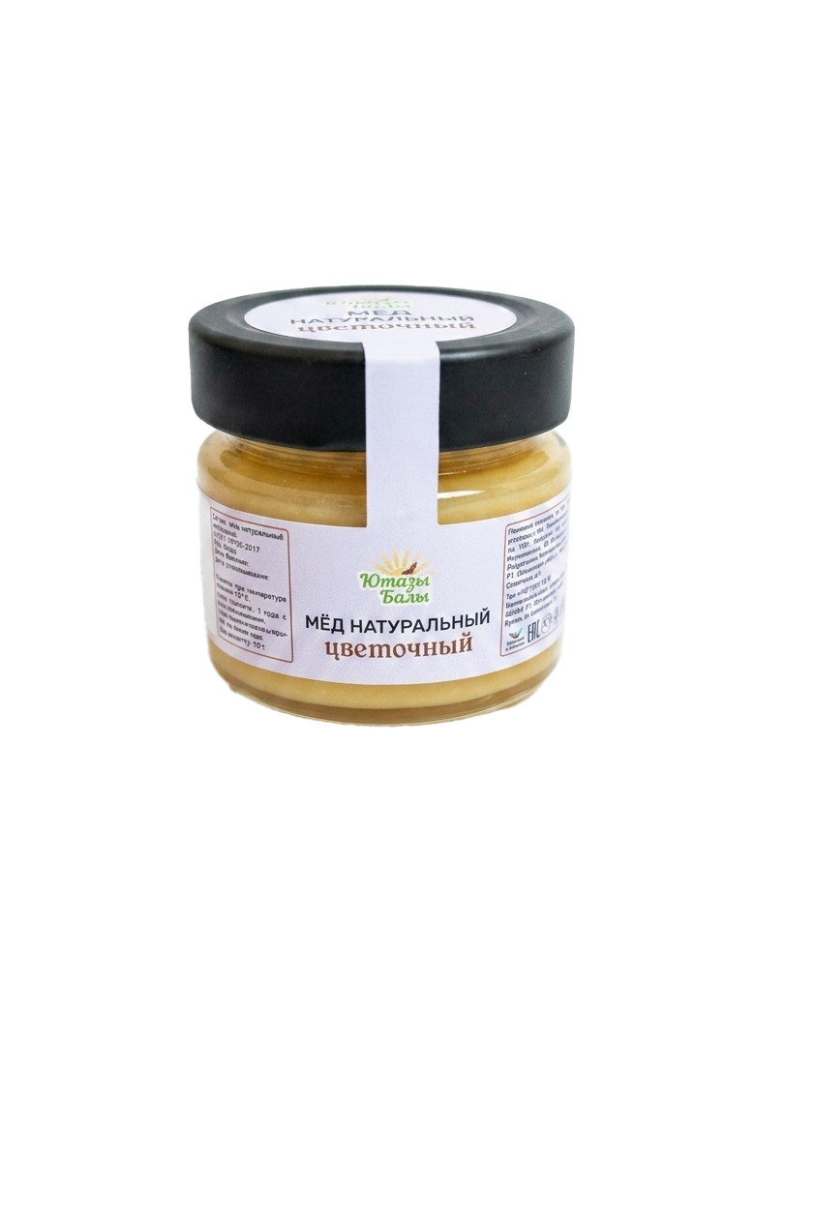
Packaging specifications and size options
for the export line
140 g
330 g
800 g
420 g
Glass jar
Plastic jar

Slide 8

Caring for what matters most
“Yutazy Baly” products are crafted
to support daily health, energy, and longevity

Slide 9



The art of a heartfelt gift
Premium solutions for corporate
and personal gifting
Wooden chests
Artisanal handmade pieces
for prestigious, distinguished presents
Tea sets
Authentic Tatar tea and premium nuts paired
with our honey
Beeswax candles
Natural, fragrant wax that conveys the warmth and coziness of a living flame

Slide 10
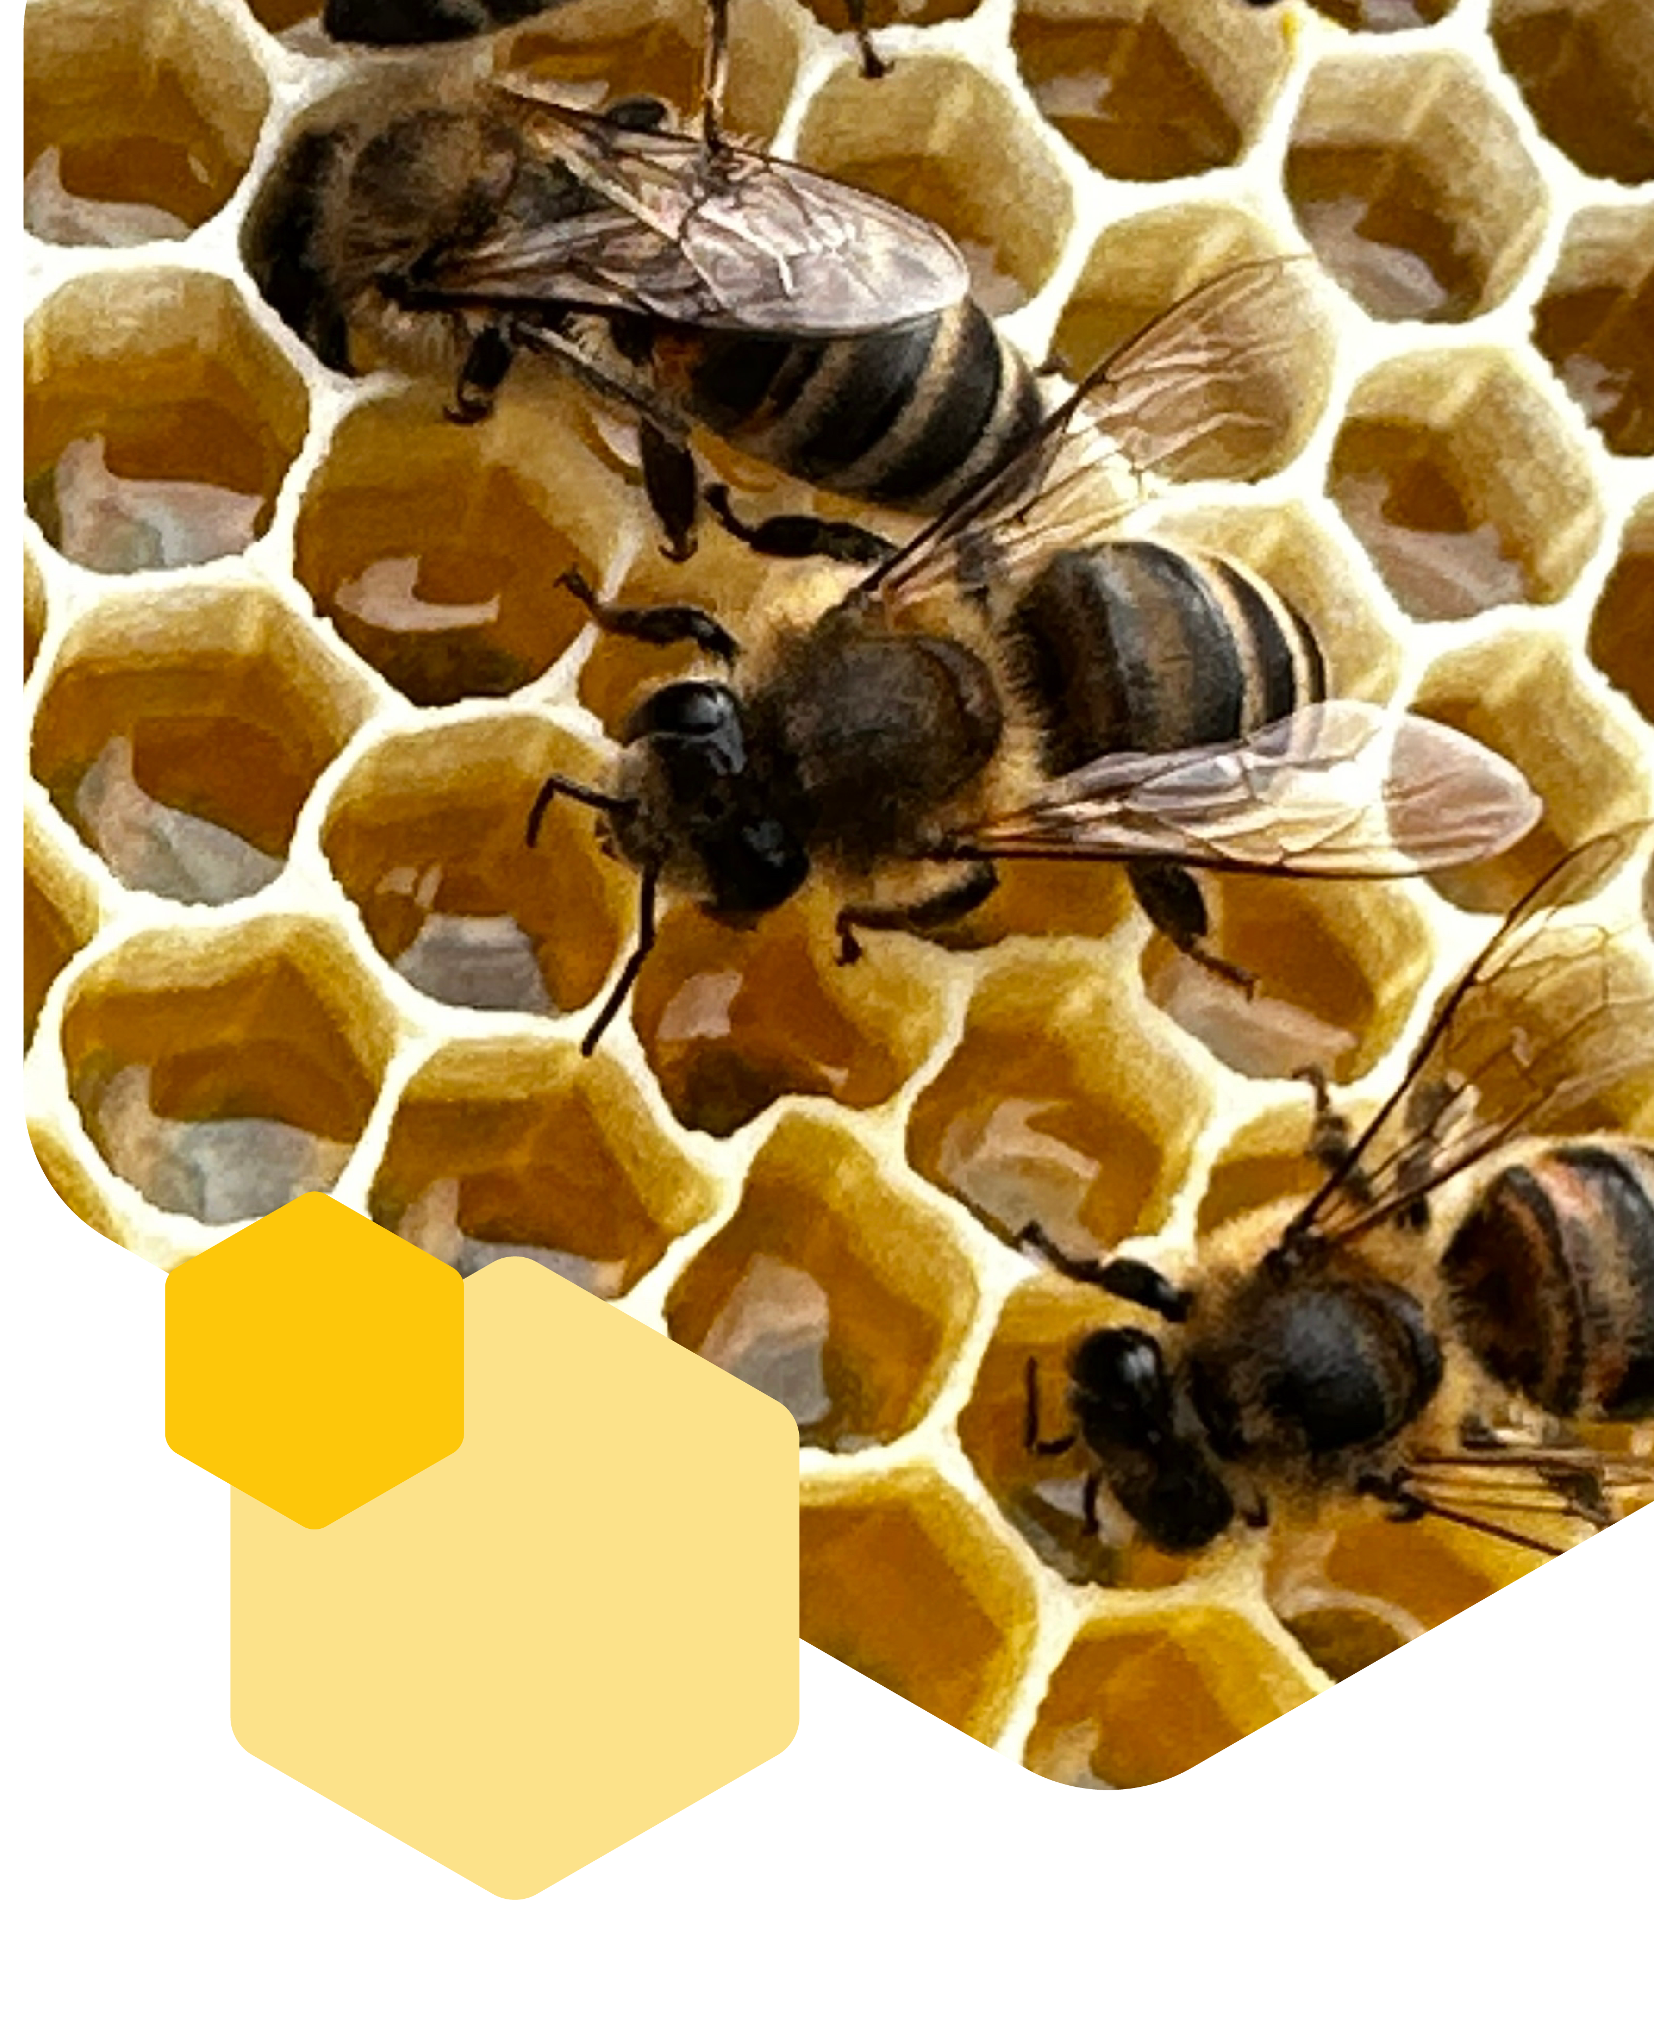
Comb Honey:
Pristine Purity
Honey in wooden frames — the quality benchmark
and the foundation of all our products.
Hermetically sealed by the bees themselves,
comb honey reaches the customer in its original
form — with no human intervention whatsoever.
It is from such ripe, benefit-filled combs
that we gently extract the honey for our jars,
fully preserving its natural structure, aroma, and purity

Slide 11
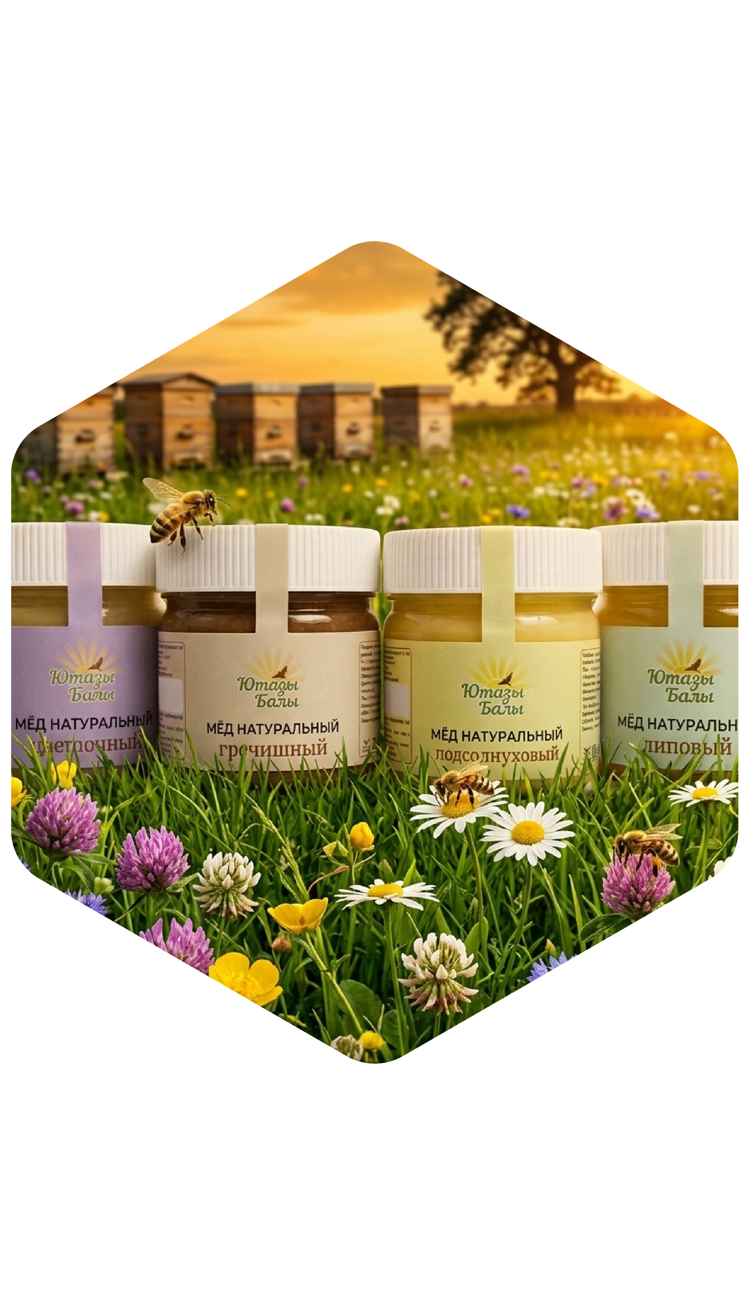
Uncompromising Quality
Traceability of every batch, a rich palette of flavors,
and the availability of exclusive comb honey all attest
to the high standard of our production.
Impeccable product quality and rigorous control
at every stage

Slide 12



Start your day
with nature's elixir
"Yutazy Baly" — a pure source of vital energy and the key
to consumers' perfect well-being.
Natural honey from the heart of Tatarstan, delivering goodness
and health every single day
+7 (917) 861 83-50
vk.com/jutaza_bali

