Slide 1
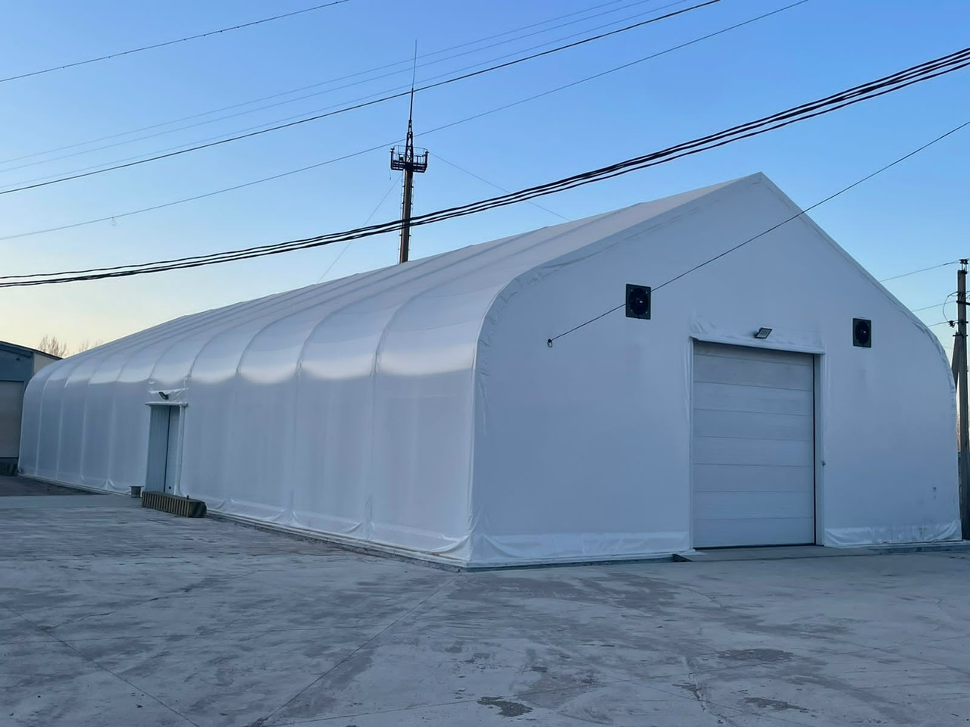

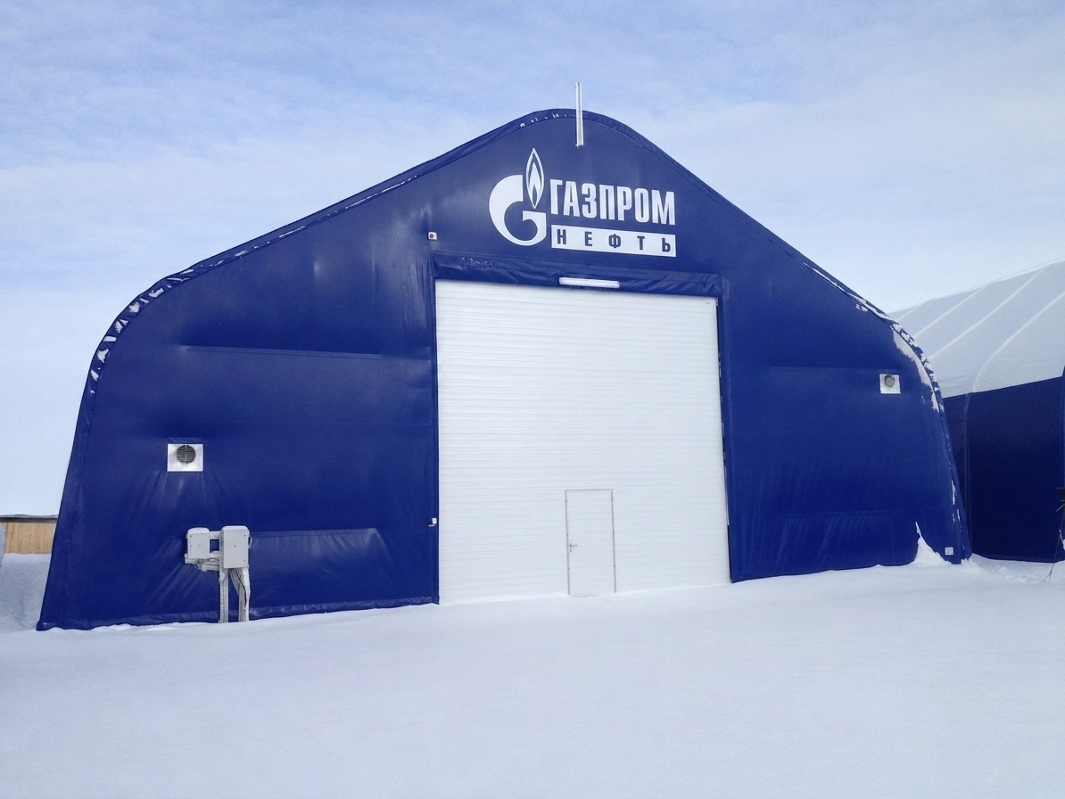
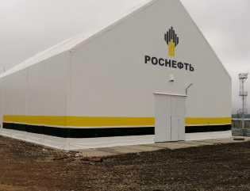
Rapidly Erected
Warehouses and
Pavilions – Turnkey
• Design • Manufacturing • Installation
8-800-100-6108
tent-angar.com

Slide 2
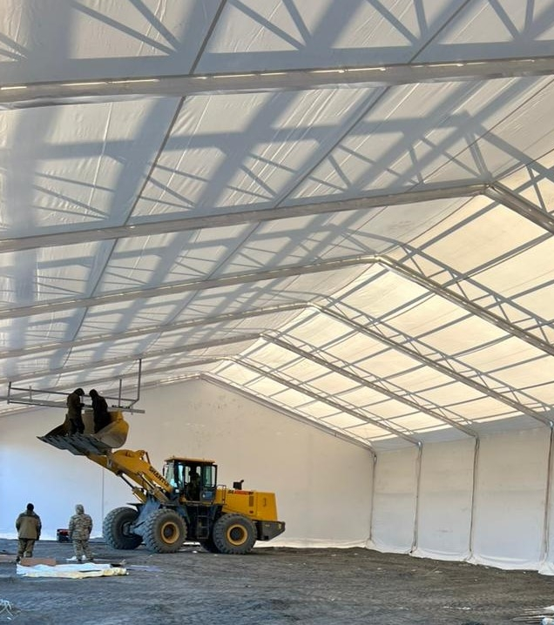
Technostroy-Service – a reliable partner in construction
Technostroy-Service builds frame-and-fabric warehouses all over Russia. We are one of the leading manufacturers of rapidly erected structures made of corrugated sheeting, fabric materials, and sandwich panels. We offer a full cycle of services: design, manufacturing, installation, and warranty support. We work in any climate and take into account all customer wishes.
In-house metal structure manufacturing
Premium-class
fabric materials
Сварочное, окрасочное и отрезное оборудование полного цикла — контроль качества на каждом этапе
LEISTER equipment, FERRARI, SIOEN, Ivanoiskozh fabrics – only trusted suppliers
National resource
All services are performed in our own production facility or by mobile teams. We work
throughout Russia and CIS countries

Slide 3

15 years of experience – results in numbers
15
236
260K
Years in the market
Structures built
m² total area
Solid reputation and accumulated expertise in construction
Projects completed across Russia and CIS countries
Total area of all structures erected
Installation speed
Budget savings
From 10 to 30 days depending on the project size – no quality loss
Up to 50% cheaper compared to permanent construction of similar facilities
We don't just build warehouses – we create spaces for your business to grow.

Slide 4
5 main structure types – for any task
Each structure type is designed to solve specific needs – from storage to sports facilities.
1
Classic
Sharp ridge and straight walls. Span up to 30 m without internal supports. Classic solution for warehouses and manufacturing.
2
Modern
Smooth corners ensure easy snow shedding and a contemporary look.
3
Arched roof + straight walls
Maximum usable volume with standard width. Optimal for large equipment storage.
4
Polygonal
Made of I-beams. Width 6–18 m, wall height 2–5 m. Robust design for industrial needs.
5
Arched (semicircular)
Self-cleaning, economical. Spans 9–24 m, height 4.5–12 m. Fast installation without internal supports.

Slide 5
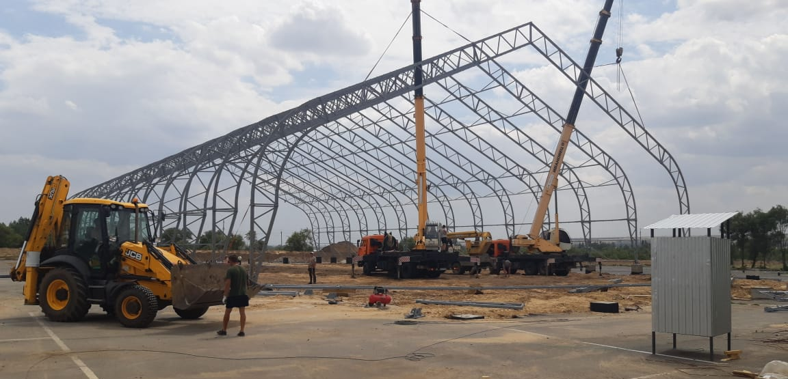
What is a rapidly erected warehouse?
It is a demountable structure based on a metal frame installed on a foundation. Enclosing structures – fabric, corrugated sheeting, or sandwich panels – are mounted over the frame. This system makes it possible to erect large facilities in record time without extensive earthworks or complex approvals.
Sandwich panels
High energy efficiency and rigidity
– ideal for heated facilities
Corrugated sheeting
Reliable protection and durability for industrial
and storage premises
Fabric material
⚡ Installation from 10 days
🏗️ Service life up to 50 years
Light weight, mobility, and natural light transmission
– optimal for agriculture
📋 No complex approvals required

Slide 6
Advanced services – full turnkey cycle
Laser metal cutting
Shot blasting surface preparation
Protective coating application
High precision, complex geometries, any cross-sections – modern equipment ensures perfect cuts
Priming and painting for long service life in any Russian climate
Removal of scale, rust, and old paint down to bare metal – the basis for a durable coating
Design of metal structures
Ventilation in warehouses
Wind and snow load calculations
Tailored to your task: warehouses, storage, pavilions, sports facilities – full documentation package
Calculation and installation of air exchange systems to create an optimal indoor climate
Structure adaptation to the construction region in compliance with SNiP and GOST requirements
Installation of metal structures
Professional erection of frames of any complexity, including supervisory installation with step‑by‑step control

Slide 7
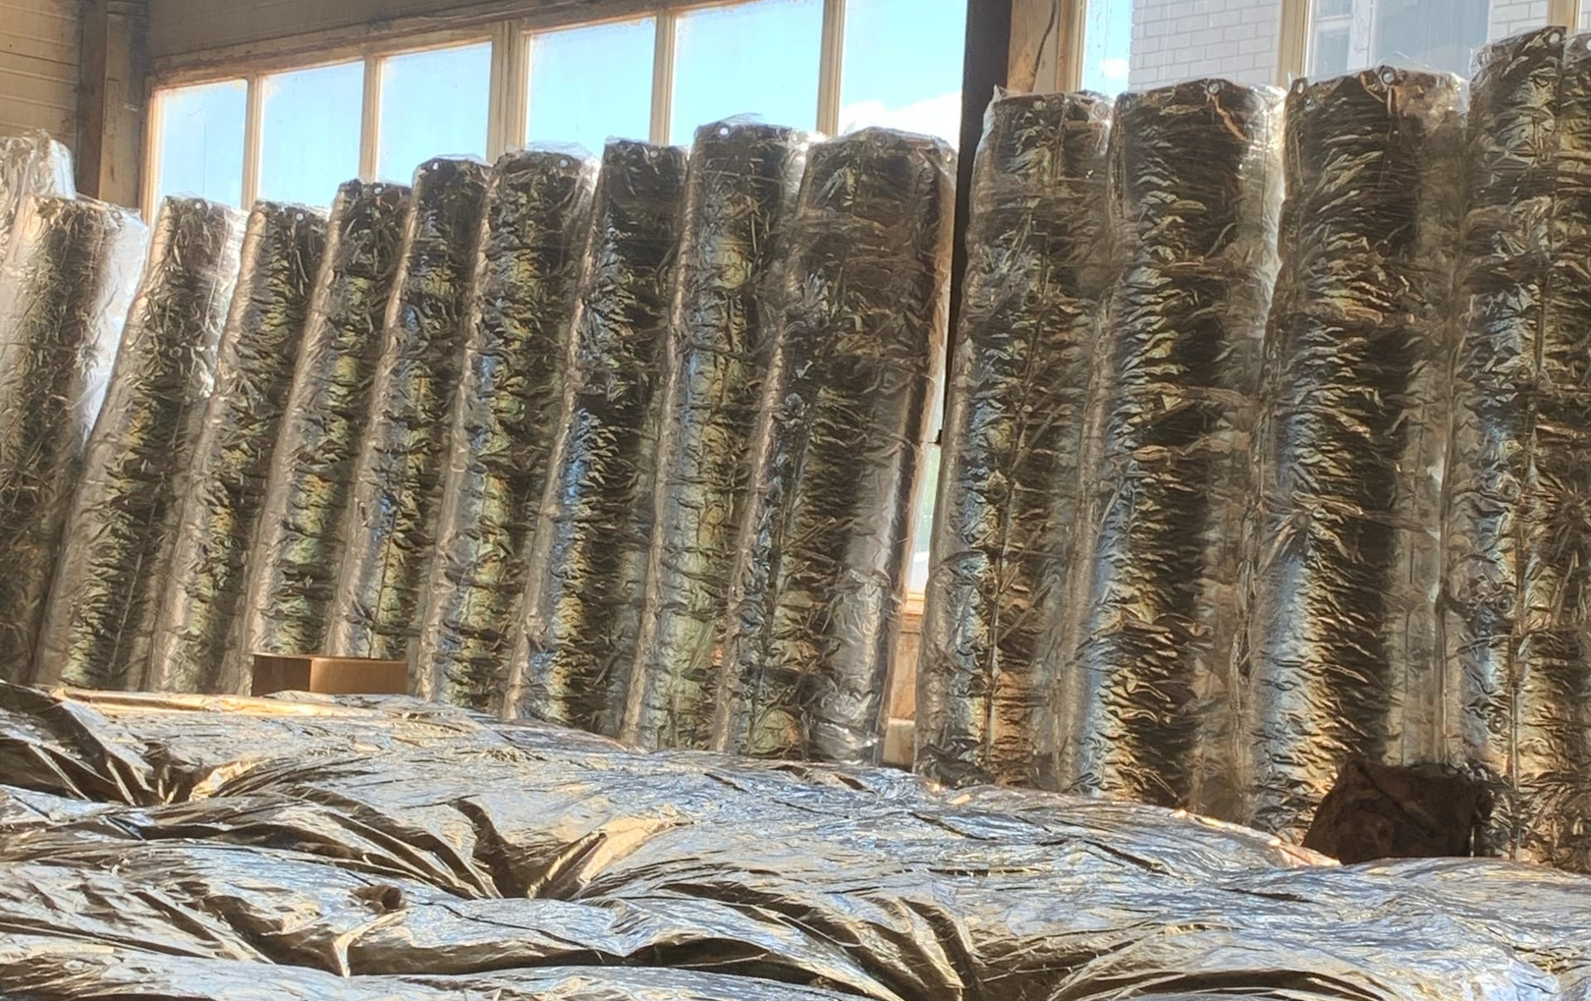
TECHNOLUX roll-type thermal insulation mats
Mineral wool mats with a foil layer provide high-quality thermal insulation for frame‑and‑fabric warehouses, buildings, pipelines, and equipment.
Tight surface contact significantly reduces heat loss and creates comfortable indoor conditions all year round.
🔥 Heat and sound insulation
💧 Moisture and corrosion protection
High performance against heat loss and external noise
The foil layer creates a reliable barrier against moisture
🌟 Flexibility
📦 Lightweight
and safe
Easily conforms to any surface shape without gaps
Dense, non‑hazardous material with low thermal conductivity

Slide 8
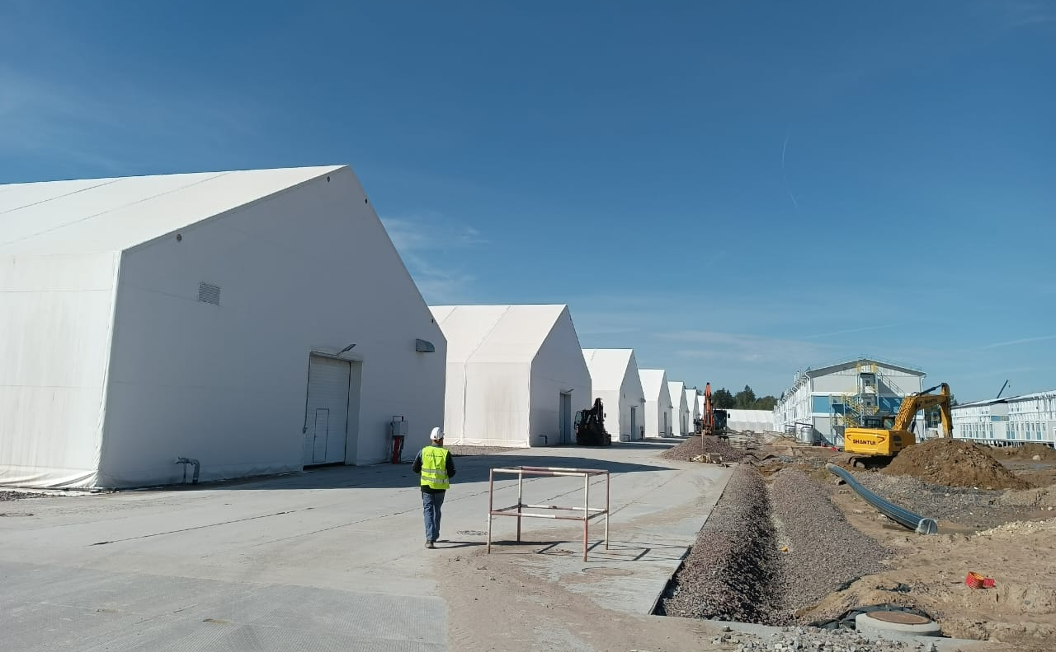
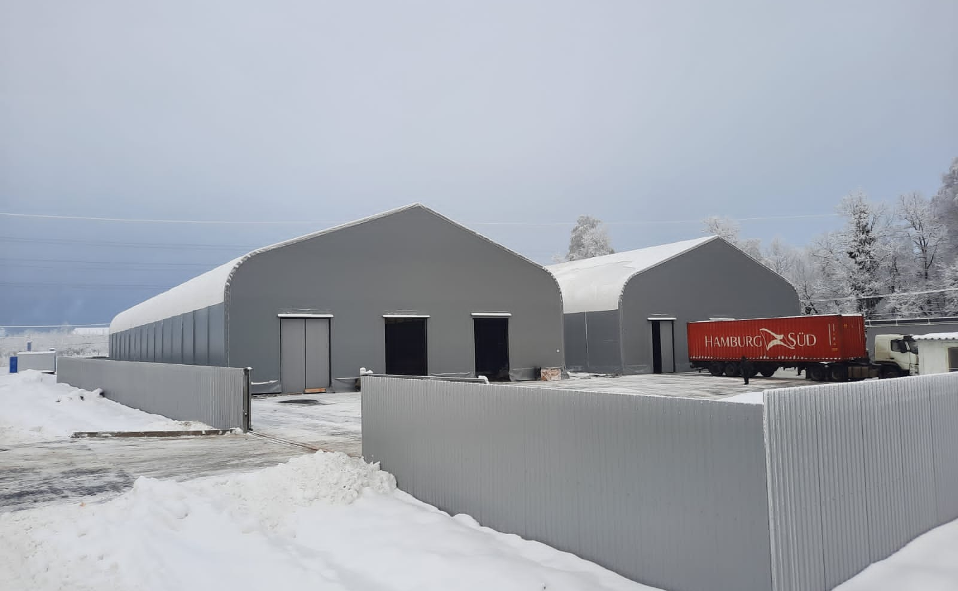
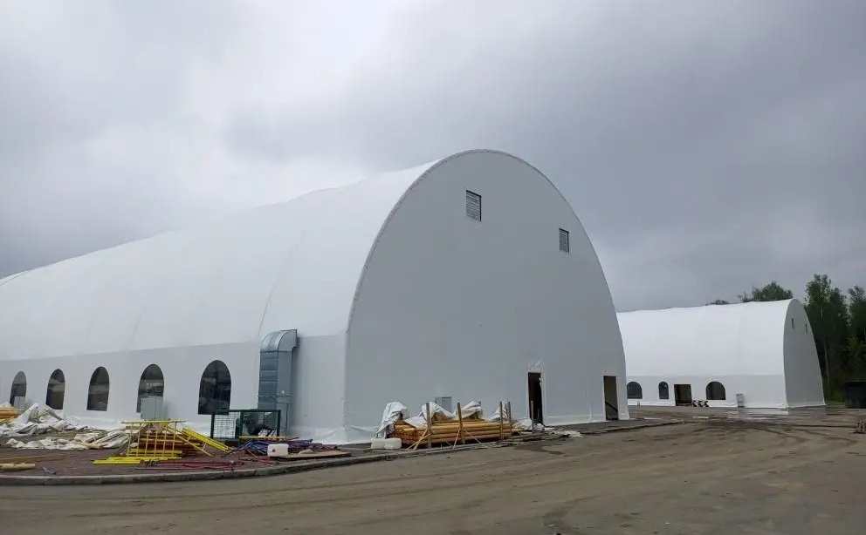
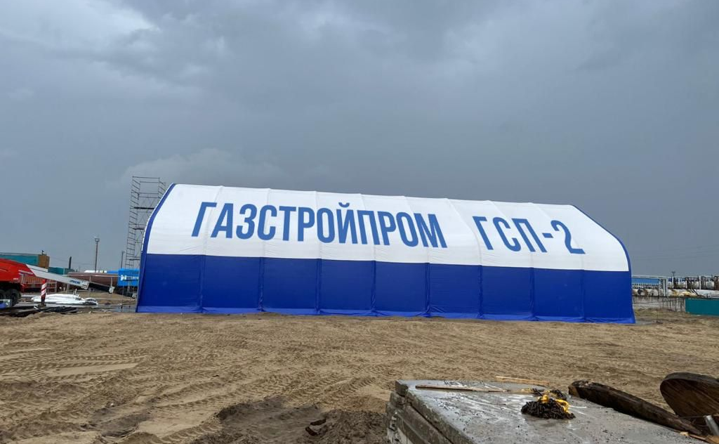
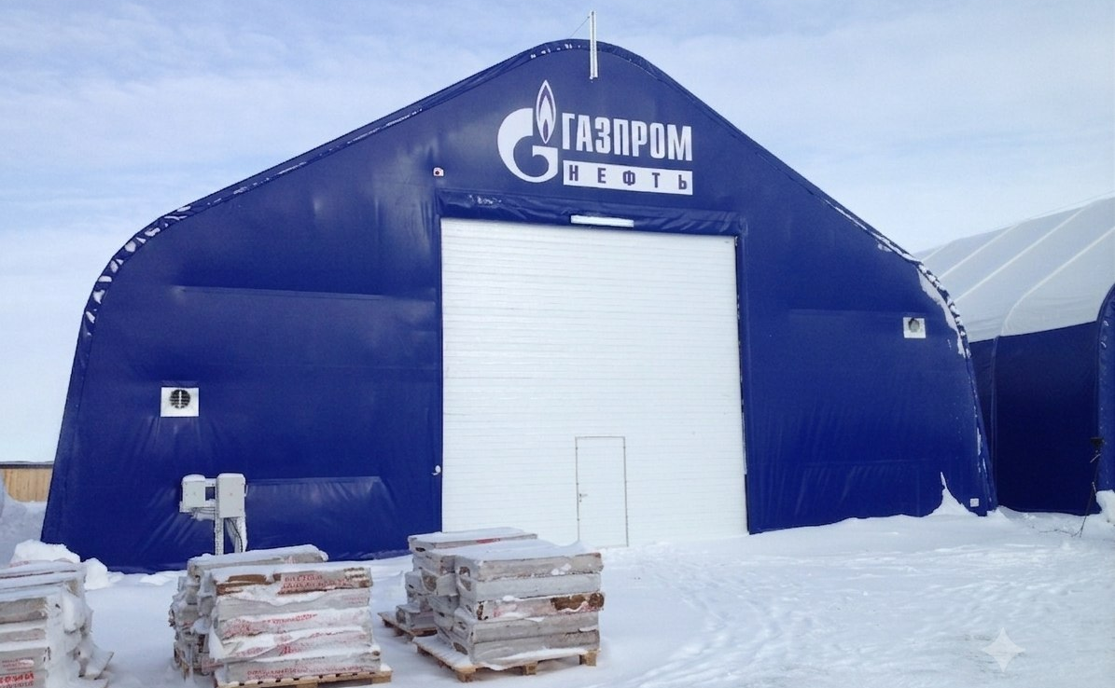
Our Experience in Action
Notes:
• Начните с главного заголовка — качество и безопасность — это наш приоритет
• Подчеркните, что вся продукция соответствует ГОСТ и СНиП — это не просто обещание, это стандарты, которые мы соблюдаем на практике
• Упомяните, что используем только сертифицированные материалы — это гарантирует надежность на каждом этапе
• Раскройте три ключевых момента:
ГОСТ: все металлоконструкции и материалы обязательно сертифицированы
СНиП: проектирование и монтаж следуют строительным нормам без исключений
Гарантия: мы отвечаем за качество своей работы и поставляемых конструкций
• Подчеркните, что это не просто слова — это подтверждено документами и сертификатами, которые видны на слайде

Slide 9
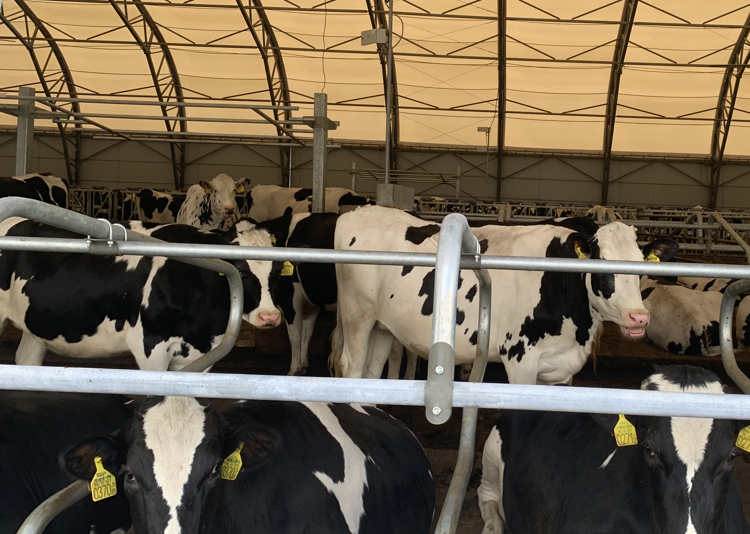
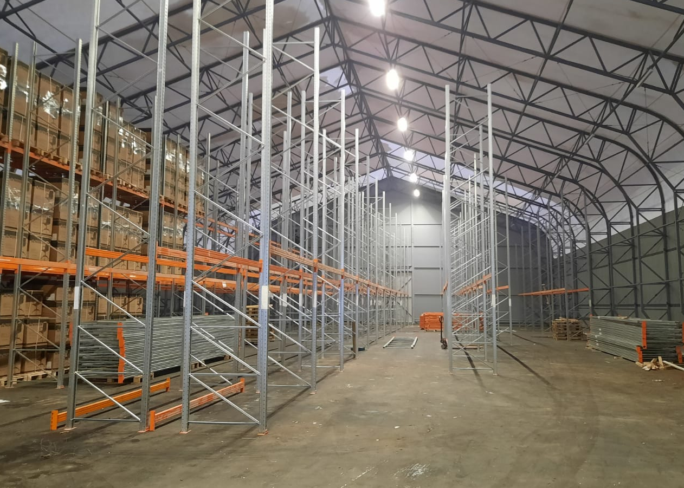
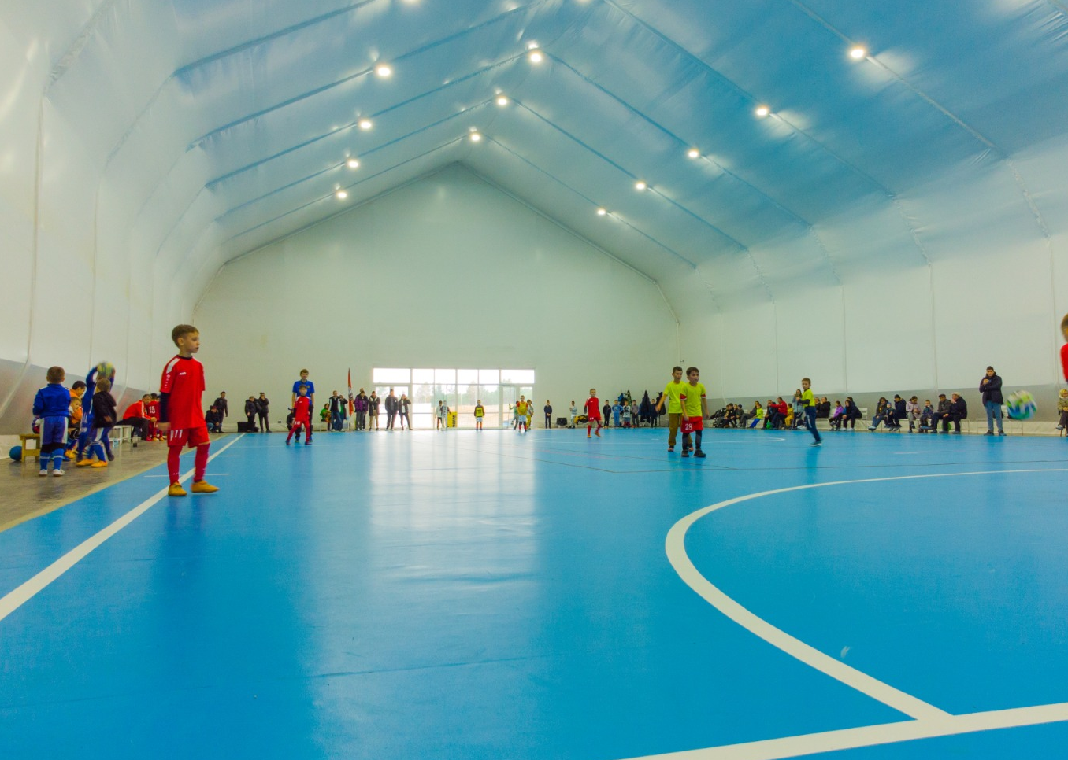
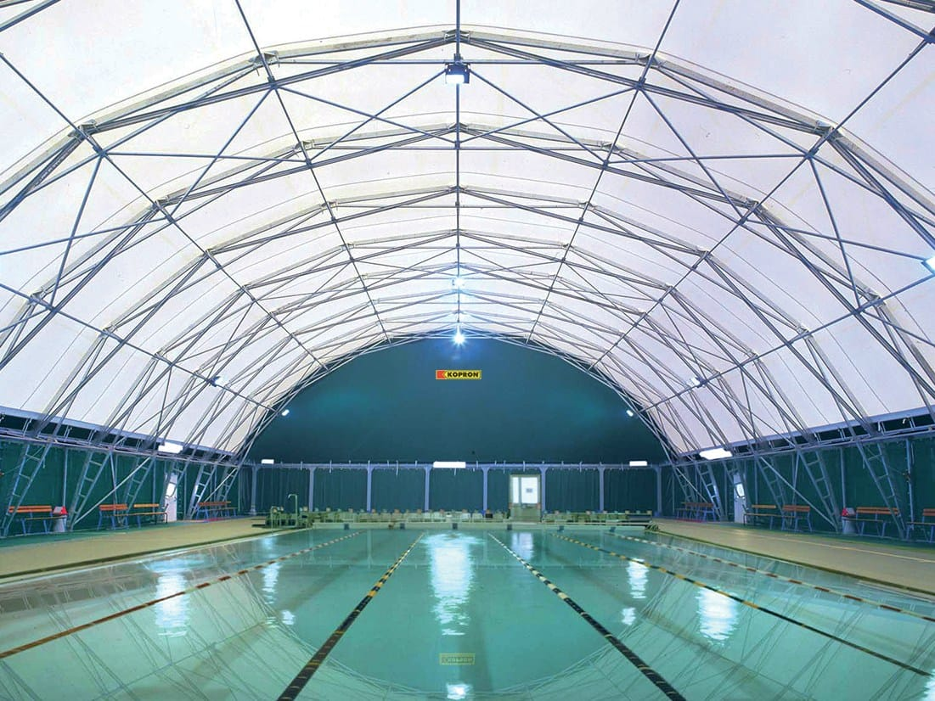
236 structures built across Russia
Total area of completed projects – 260,000 m². We operate in any region of the Russian Federation and CIS countries, ensuring a uniform quality standard regardless of project location.
Agricultural
facilities
Storage complexes
Sports facilities
Logistics terminals and industrial storage facilities with zoning capability
Covered areas, riding arenas, and training halls for sports
clubs and educational institutions
Warehouses for crop storage, livestock housing, and equipment storage – from 500 to 5,000 m²

Slide 10
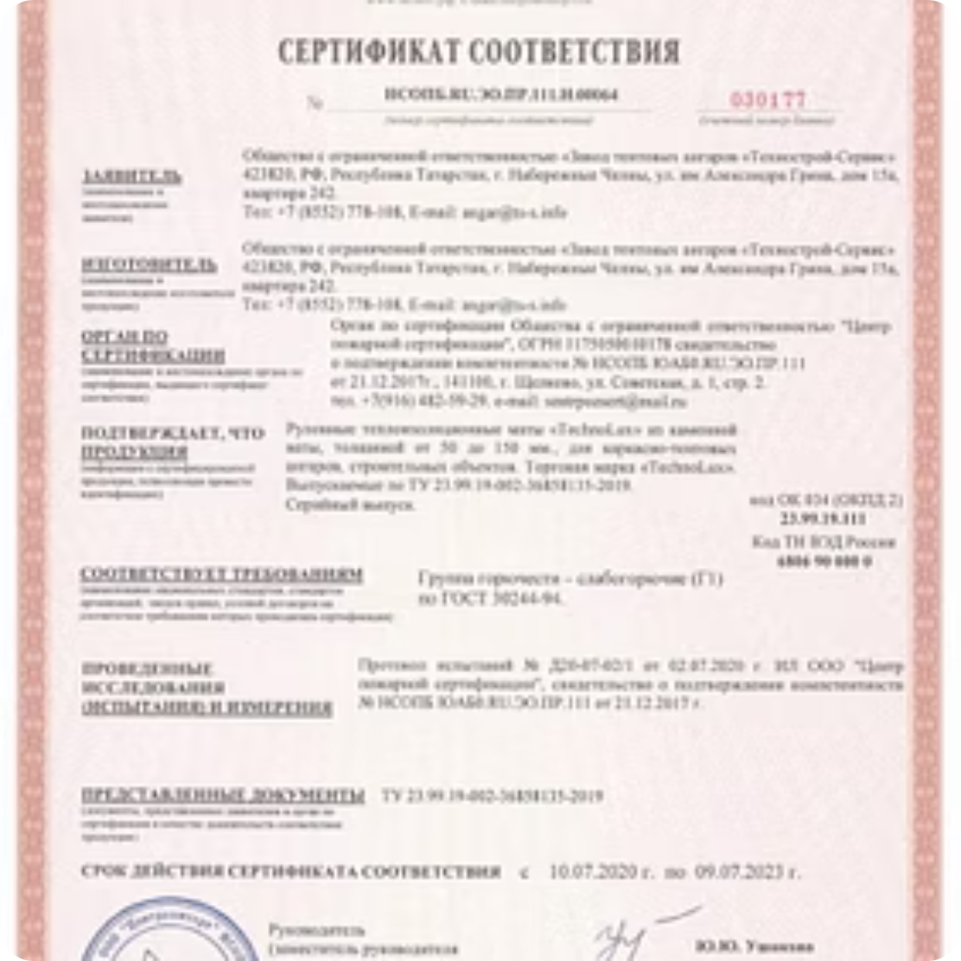
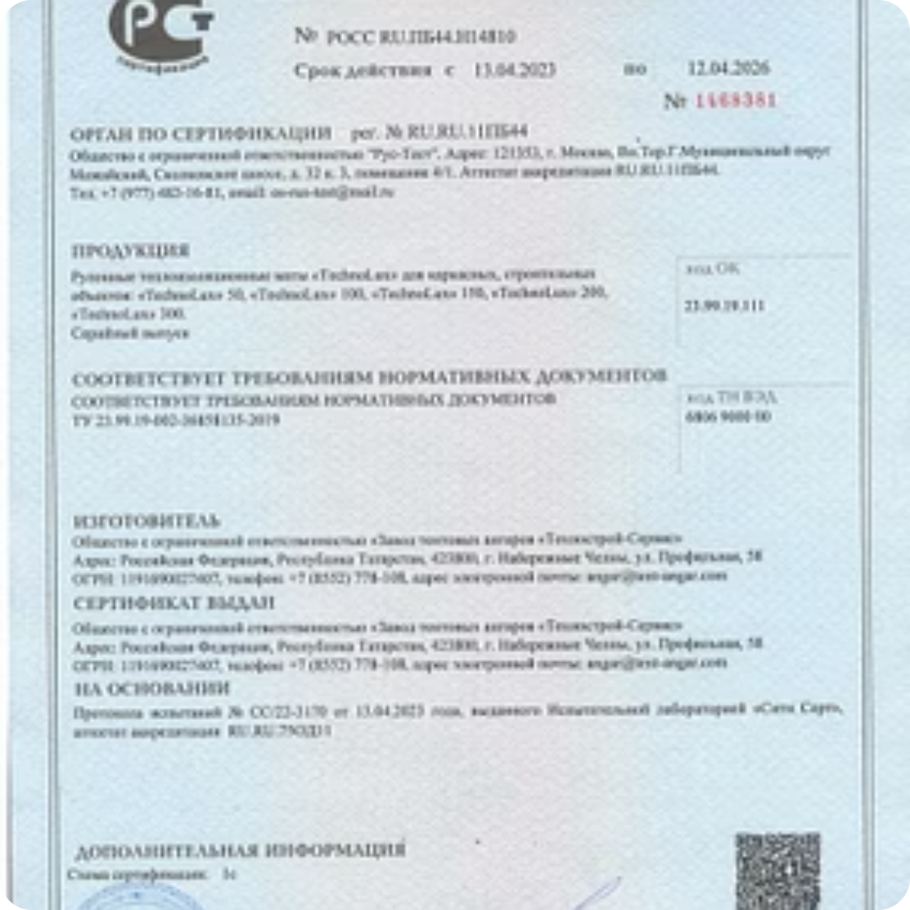
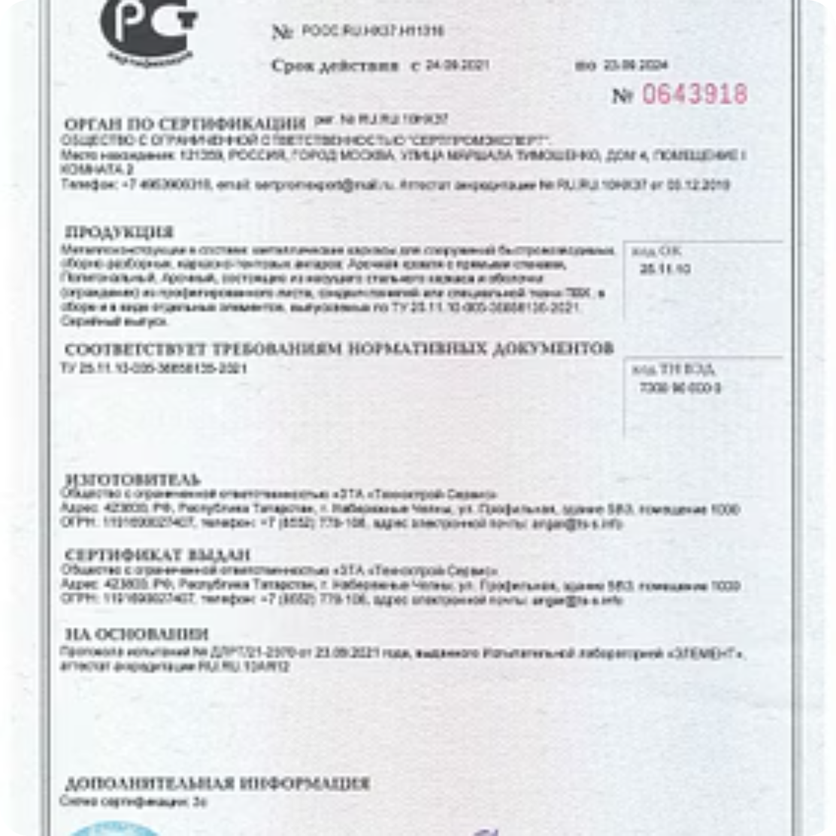
Quality and safety confirmed
All products and technologies of Technostroy-Service are certified.
Notes:
• Начните с главного заголовка — качество и безопасность — это наш приоритет
• Подчеркните, что вся продукция соответствует ГОСТ и СНиП — это не просто обещание, это стандарты, которые мы соблюдаем на практике
• Упомяните, что используем только сертифицированные материалы — это гарантирует надежность на каждом этапе
• Раскройте три ключевых момента:
ГОСТ: все металлоконструкции и материалы обязательно сертифицированы
СНиП: проектирование и монтаж следуют строительным нормам без исключений
Гарантия: мы отвечаем за качество своей работы и поставляемых конструкций
• Подчеркните, что это не просто слова — это подтверждено документами и сертификатами, которые видны на слайде

Slide 11

We will calculate your project cost in 1 day
Contact us – our specialists will prepare a cost estimate, select the optimal structure, and answer all your questions. Build quickly, reliably, and cost‑effectively with Technostroy-Service!
Phone
Email
Website
8-800-100-6108
Toll‑free within Russia
angar@tent-angar.com
Response within one business day
tent-angar.com
Project catalog and cost calculator
Technostroy-Service – your reliable partner in rapidly erected structures across Russia. 15 years of experience, 236 facilities, 260,000 m²
– and we are just getting started.
Photos and videos of all projects are available in the "Our Work" section on tent-angar.com and in the company's video blog.

