Slide 1


MEDICAL CONSUMABLE SYSTEMS LLC
Russian Manufacturer of Precision Sterile Medical Devices
Specializing in Class III / Critical-Risk Devices for Hemostasis
Supporting Advanced Surgical, Endoscopic, and Cardiac Procedures

Slide 2


COMPANY'S MISSION
Prompt supply of Russian surgical departments with modern hemostasis products. Eliminating the critical dependence of medical institutions on imported supplies by providing high-quality domestic alternatives

Slide 3







High-precision manufacturing
of medical devices
Full compatibility
with instruments
from other manufacturers
OUR
ADVANTAGES
Unique Production Technologies
Localization of production
in the Russian Federation
Advanced packaging
for product integrity
Certified Quality Management System
(ISO 13485 сompliant)

Slide 4
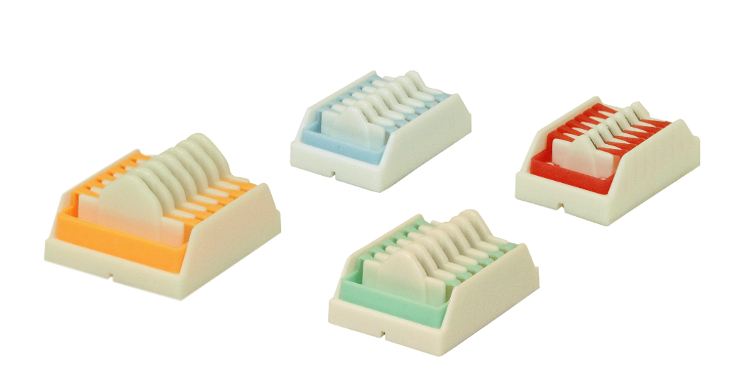
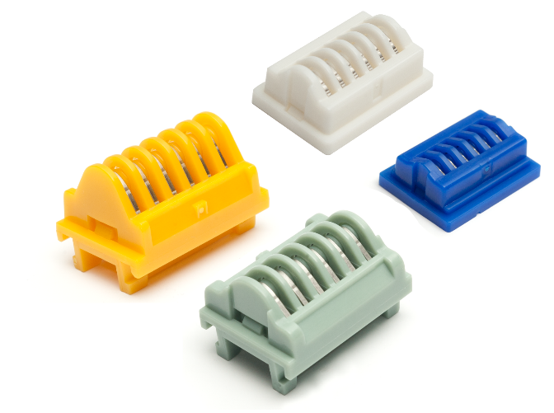
PRODUCTS:
Surgical Implantable
Titanium Clips
Designed for rapid and secure ligation
of ducts and vessels, and for effective hemostasis.
Over 30 standard sizes for vessels and ducts
with diameters from 0.1 to 7.5 mm.
Fields of application:
Cardiac surgery
Endoscopic surgery
Oncology
Vascular surgery
Market demand in the Russian Federation:
980,000 packs per year
Market demand in the EAEU:
345,000 packs per year.
Competitors:
Ethicon J&J, USA
Aesculap, Germany
Grena, United Kingdom
Peter Surgical, France
Volkmann, Germany

Slide 5
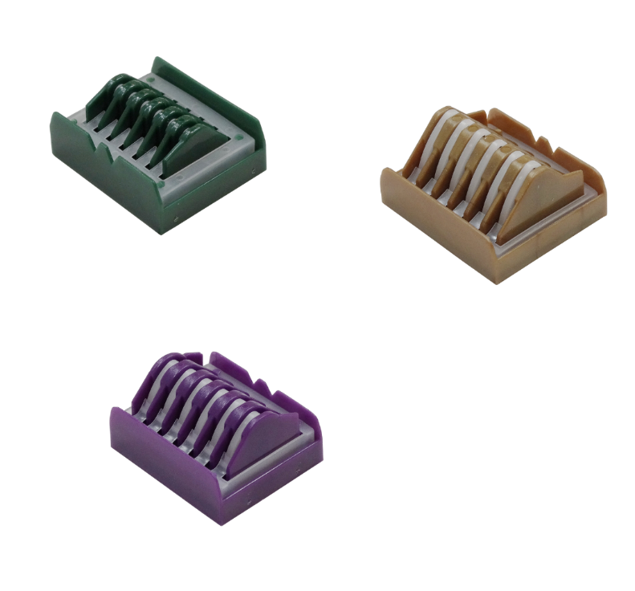
PRODUCTS
Surgical Implantable
Polymer Clips
For rapid and secure ligation of ducts and vessels, and for effective hemostasis.
Innovative jaw design ensures highly effective hemostasis, even for large vessels.
Allows for repositioning.
More than 30 standard sizes for vessels and tissues with diameters from 2.0 to 22.0 mm.
Fields of application:
Oncology
Vascular Surgery
Endoscopic Surgery
Market demand in the Russian Federation:
540,000 packs per year
Market demand in the EAEU:
280,000 packs per year.
Competitors:
Grena, United Kingdom
Week, USA
Volkmann, Germany

Slide 6
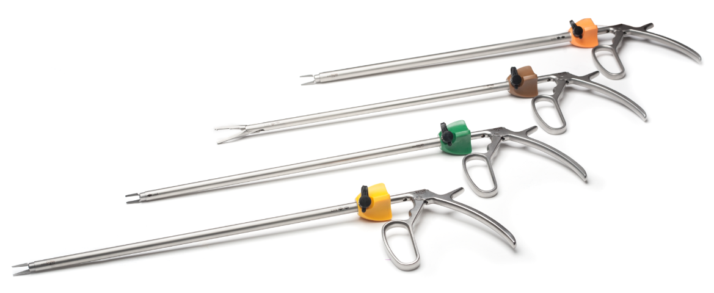
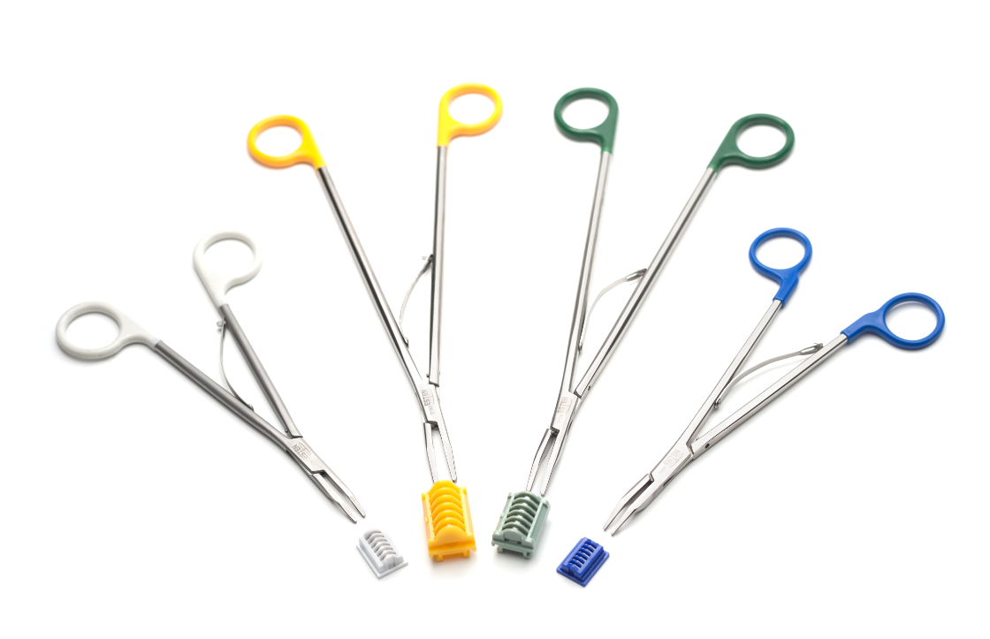
PRODUCTS
Clip Appliers
For use in open and endoscopic surgery.
Reliable hemostasis and duct ligation, even in hard-to-reach areas.
Durable and reliable design for extended service life.
Competitors
Ethicon J&J, USA
Aesculap, Germany
Grena, United Kingdom
Peter Surgical, France
Volkmann, Germany
Week, USA

Slide 7
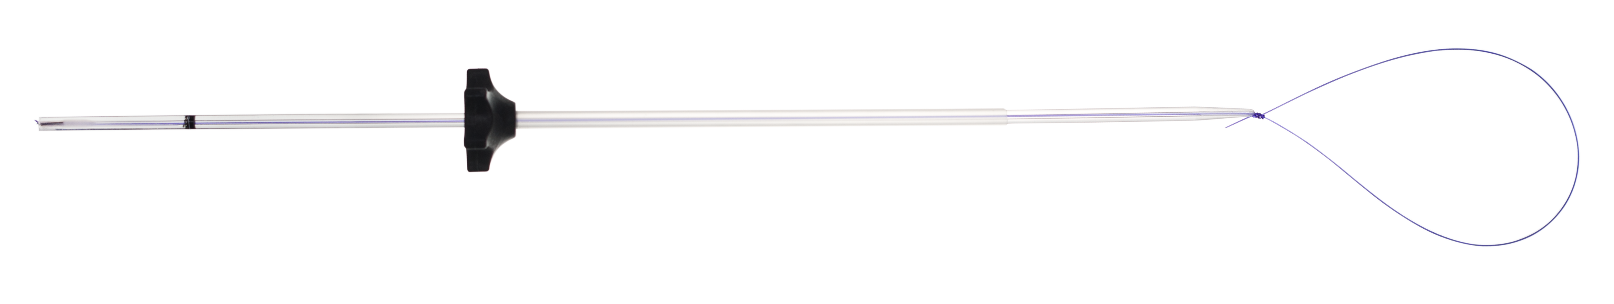
PRODUCTS
Reduces surgical procedure time
by 20–40 minutes due to a pre-formed sliding suture loop.
Particularly convenient for use
in pediatric and emergency surgery.
Suture Delivery Systems
Ready-to-use, sterile, fully-functional kit for hemostasis and ligation of ducts and structures.
Enables the use of suture material in confined access conditions during endoscopic surgery.
Available in multiple configurations to suit surgeon preferences and specific clinical requirements.
Facilitates the transition from open surgical techniques to minimally invasive procedures while maintaining effective hemostasis.
Market demand in the Russian Federation:
50 000 kits per year
Market demand in the EAEU:
20 000 kits per year
Competitors
Ethicon J&J, USA
Karl Storz, Germany
Medtronic (Covidien), USA

Slide 8
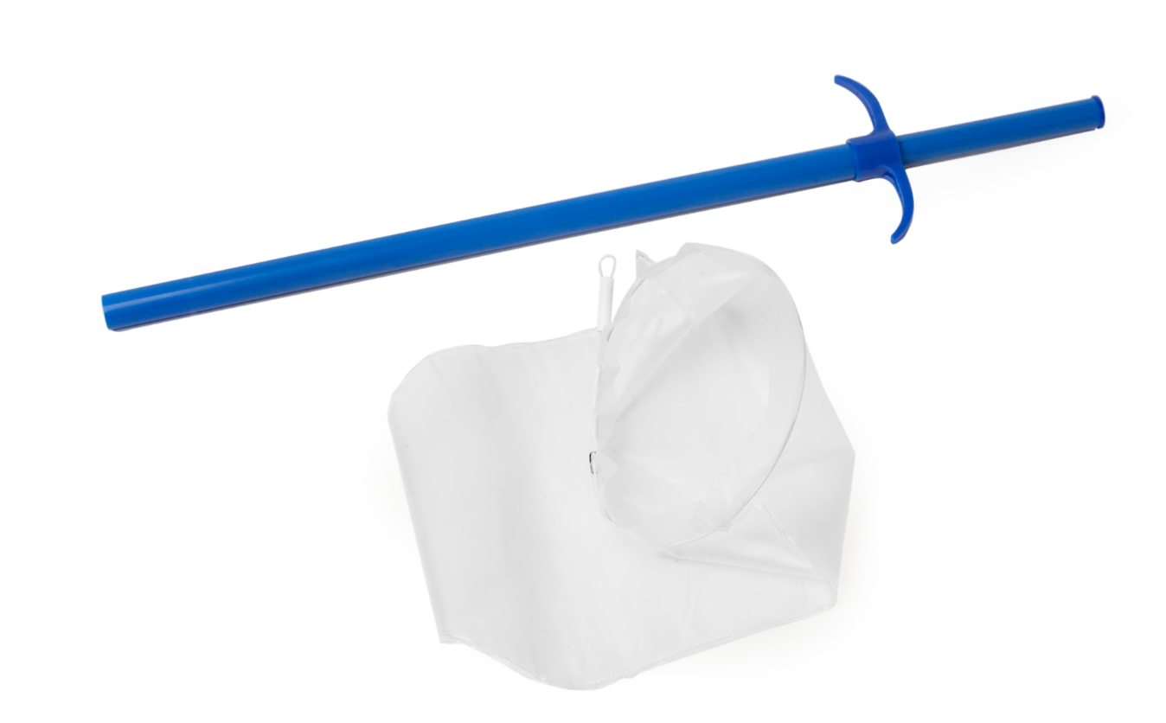
PRODUCTS
Specimen Retrieval Systems
Used for the extraction of biological specimens, organs, or tissues from a patient's body in endoscopic surgery.
Widely used in oncology, gynecology, urology,
and abdominal surgery.
A range of sizes and various structural features enable the device to be used in a wide range of surgical procedures.
The manufacturing material ensures maximum strength, significantly reducing the risk of bag rupture and preventing contamination of healthy tissues.
Market demand in the Russian Federation:
60,000 kits per year.
Market demand in the EAEU:
32,000 kits per year.
Competitors
Ethicon J&J, USA
Karl Storz, Germany
Medtronic (Covidien), USA
Grena, United Kingdom
Volkmann, Germany

Slide 9

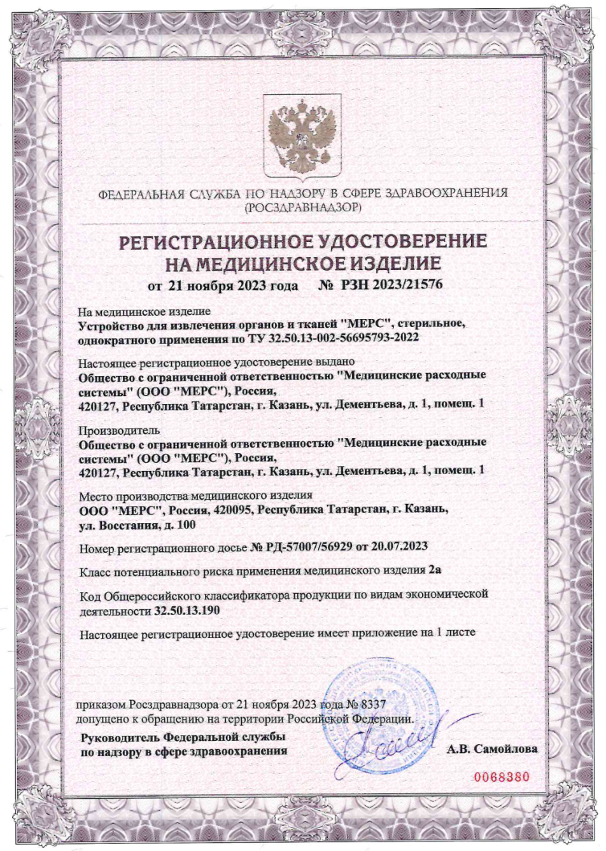
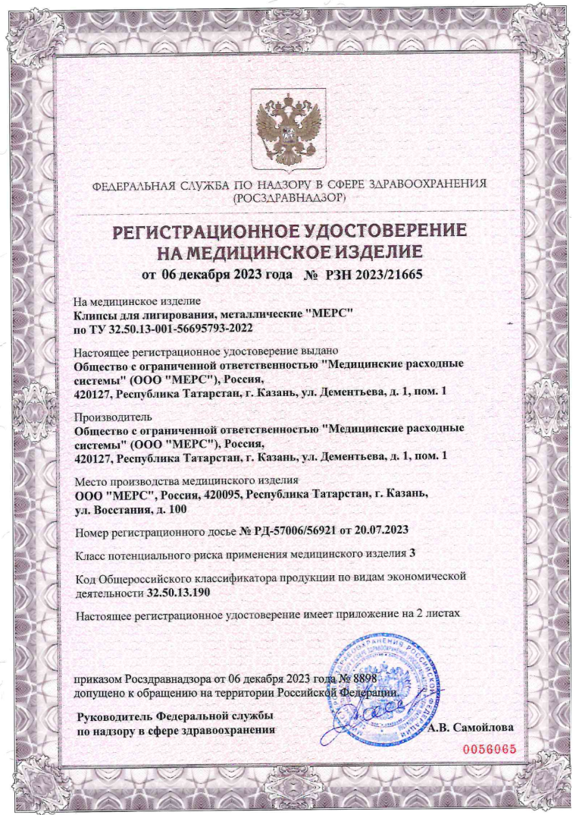
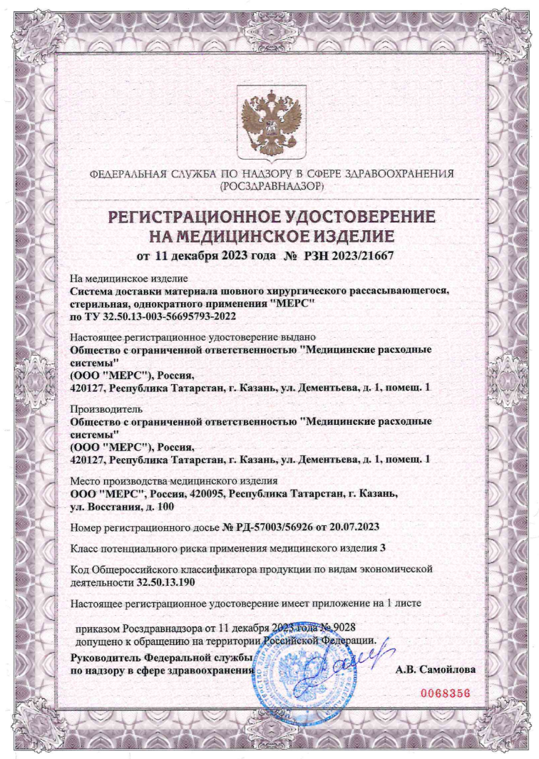
THE COMPANY'S
QUALITY MANAGEMENT SYSTEM
Certified by accredited centers in accordance with ISO 13485:2016
(GOST R ISO 13485-2017), covering the entire product life cycle.
The implemented Quality Management System (QMS) enables us to:
Ensure control and transparency at every stage of production;
Promptly identify potential risks and vulnerabilities;
Maintain robust post-market surveillance and feedback with product consumers;
Prevent the use of non-conforming raw materials;
Enhance operational efficiency and cost-effectiveness.
Our process-oriented approach and clearly defined internal procedures contribute to achieving planned results with maximum precision, optimizing time,
and reducing financial expenditure.
The company places significant emphasis on product design and development, focusing on addressing user needs and continuously enhancing product usability.
All manufactured products undergo comprehensive technical, toxicological, and clinical testing, and are officially registered with Roszdravnadzor (RZN) of the Russian Federation.

Slide 10
CONTACT INFORMATION
Export sales specialist
Karina Khadieva
+7 903 388 1746 (Russia)
export@ooomers.ru

