Slide 1
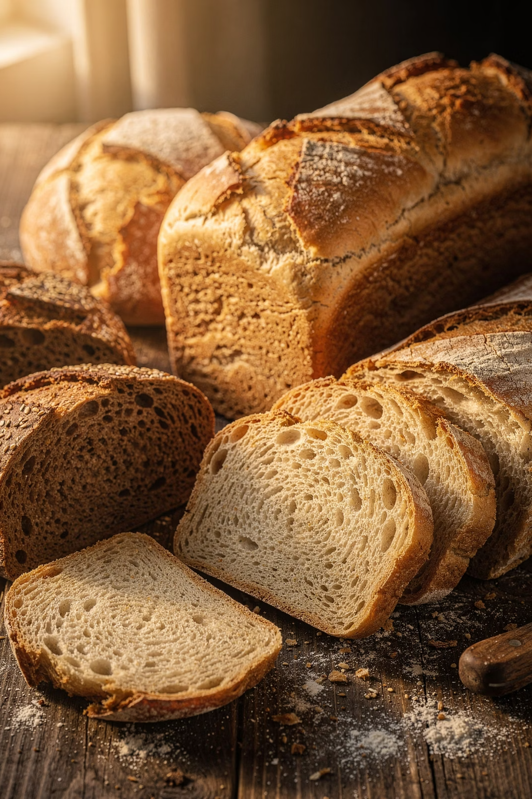
LLC "Bulgar"
Export of food ingredients and bakery products
Dry bread kvass
Traditional product made from rye-wheat bread
Bread crumbs
Made from fresh first-grade wheat bread
📍 Republic of Tatarstan, Russia | 🚛 Manufacturer and exporter of food products
Natural bread raw materials for the food industry and distribution

Slide 2
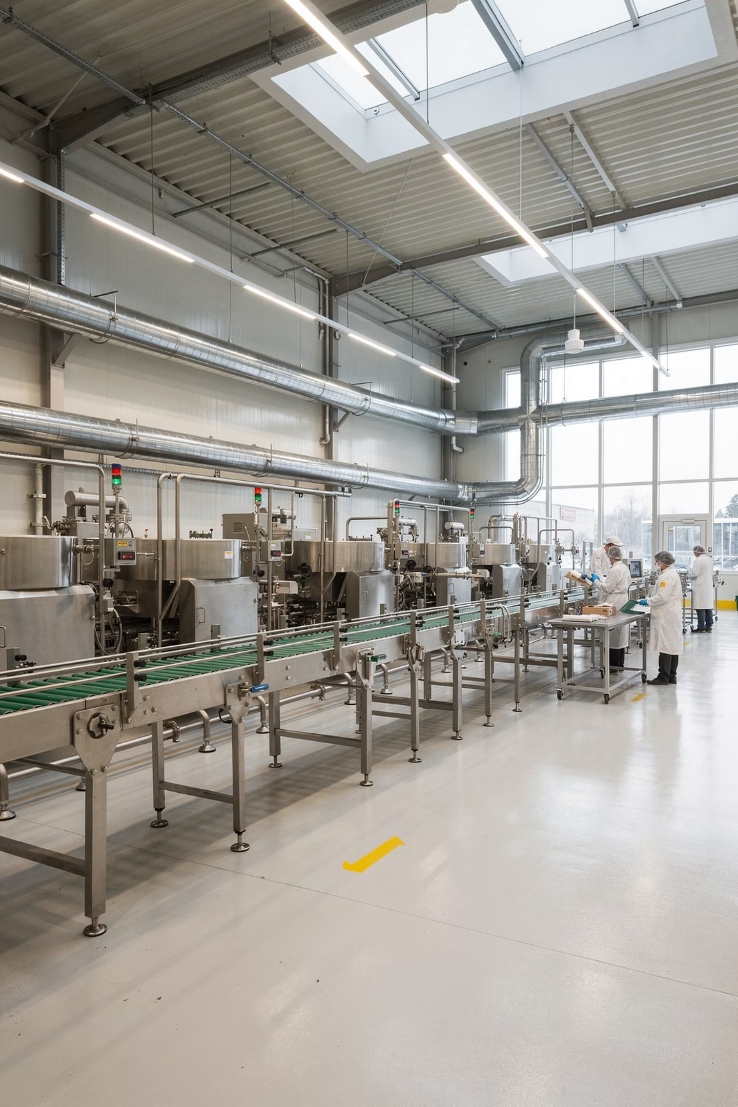

About LLC "Bulgar"
LLC "Bulgar" is a Russian manufacturer of food ingredients based on bread raw materials. The company specializes in producing dry bread kvass, bread crumbs, and supplying products for the food industry and distributors.
Production Experience
Our Principles
Dry bread kvass — since 2018
Bread crumbs — since 2020
Natural raw materials
Geography
Consistent quality
📍 Republic of Tatarstan, Russia
Long-term partnership
Export orientation

Slide 3
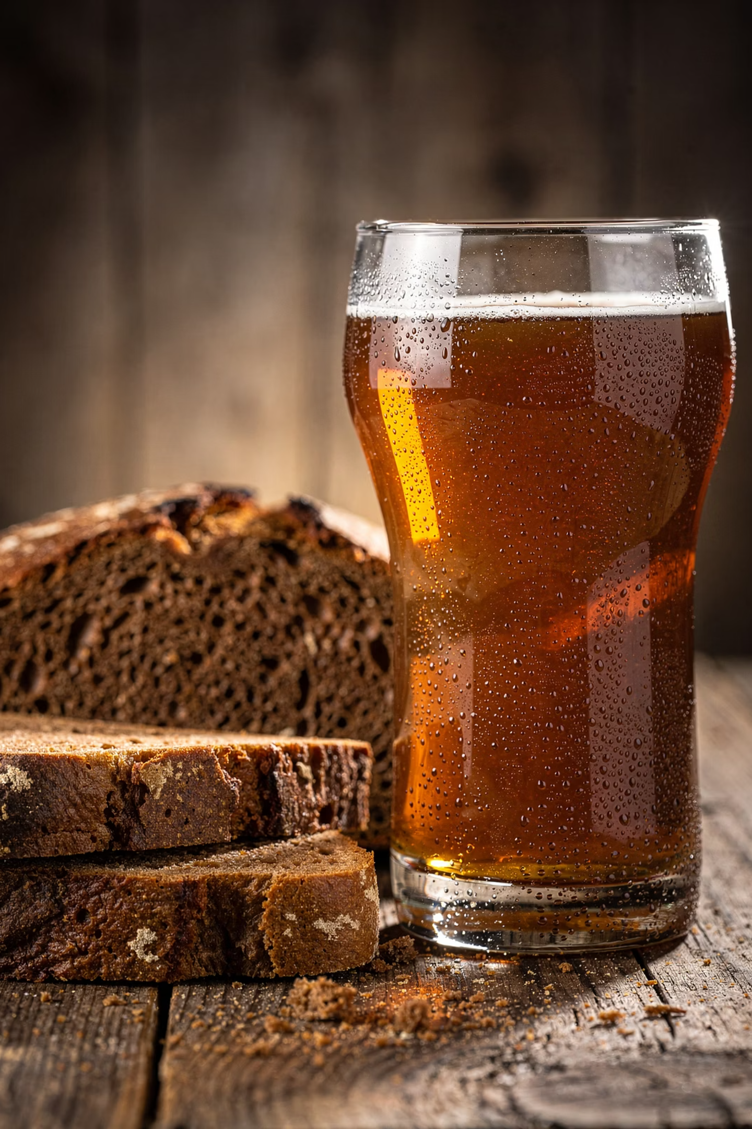
Dry Bread Kvass
Traditional dry bread kvass is produced from fresh rye-wheat bread with the addition of aromatic rye malt.
Applications
Specifications
📦 Three-layer paper bags of 25 kg
⏱ Shelf life: 12 months
Beverages
💰 Export price: 1 157,53 USD / ton
Food Industry
HoReCa
Fermentation

Slide 4
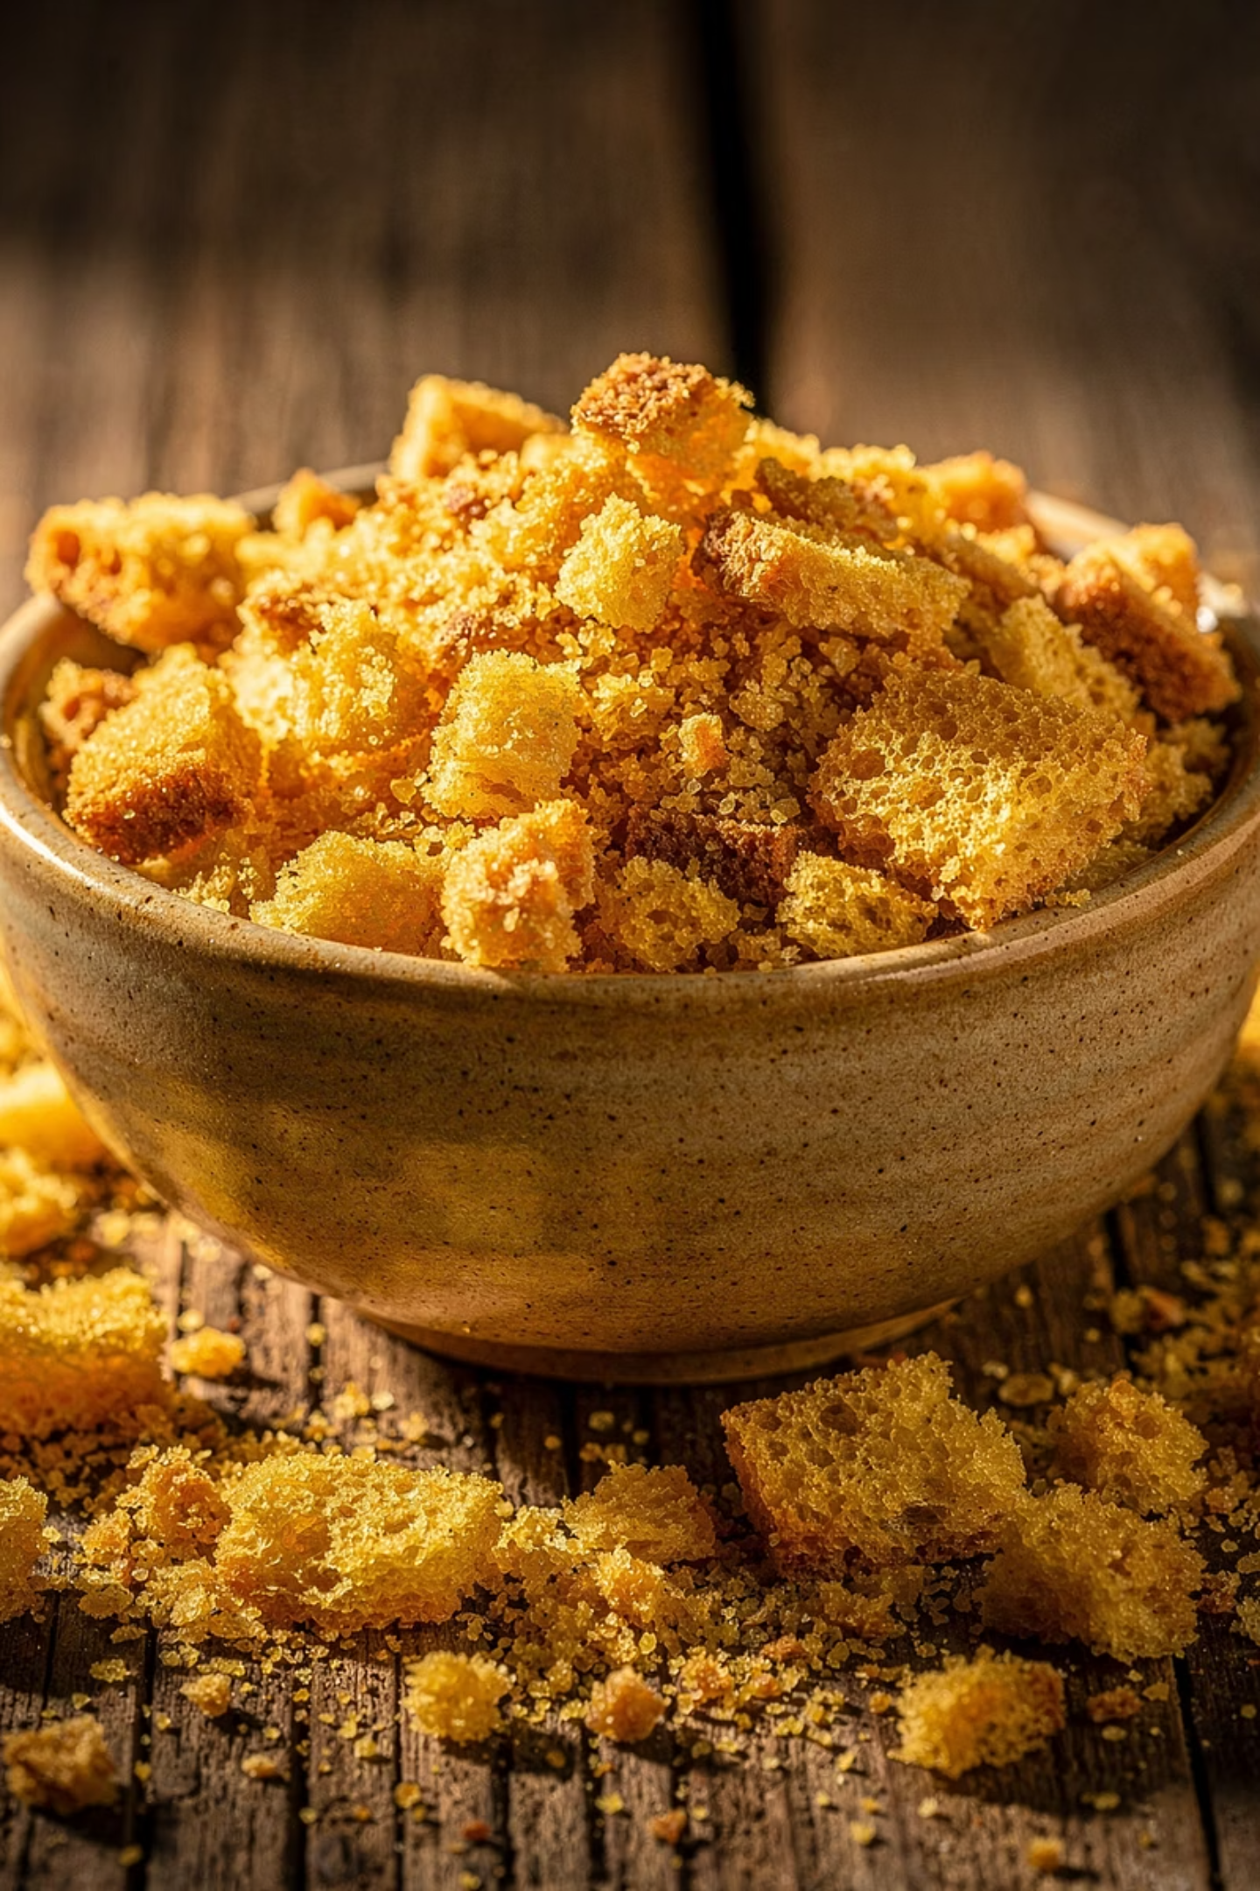
Bread Crumbs
Bread crumbs are made from fresh first-grade wheat bread — an ideal ingredient for a wide range of food production applications.
Areas of Application
Specifications
📦 Three-layer paper bags, 25 kg
⏱ Shelf life: 6 months
Meat Industry
💰 Export price: 1 157,53 USD / ton
Semi-finished products and ready-made items
Fast Food and Restaurants
Restaurant sector and fast-food chains
Frozen Foods
Production of frozen semi-finished products

Slide 5
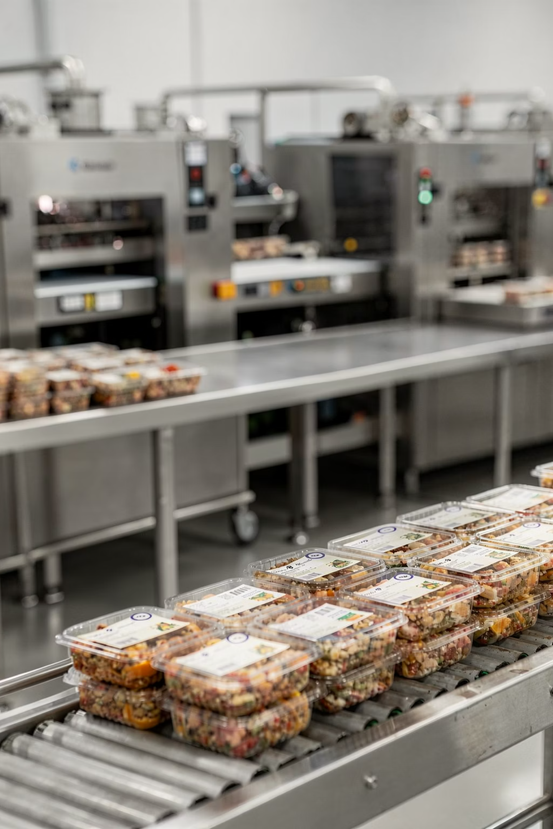

Production and Quality
Production Advantages
Product Certification
In-house food production
Breadcrumbs
EAEU Declaration of Conformity
N RU Д-RU.РА01.В.24156/22
Valid until 19.01.2027
Raw material quality control
Recipe consistency
Dry Bread Kvass
EAEU Declaration of Conformity
N RU Д-RU.РА03.В.84808/24
Valid until 22.04.2029
Warehouse near production
Quality Control
Use of fresh bread raw material
Compliance with storage standards
Stable production batches

Slide 6
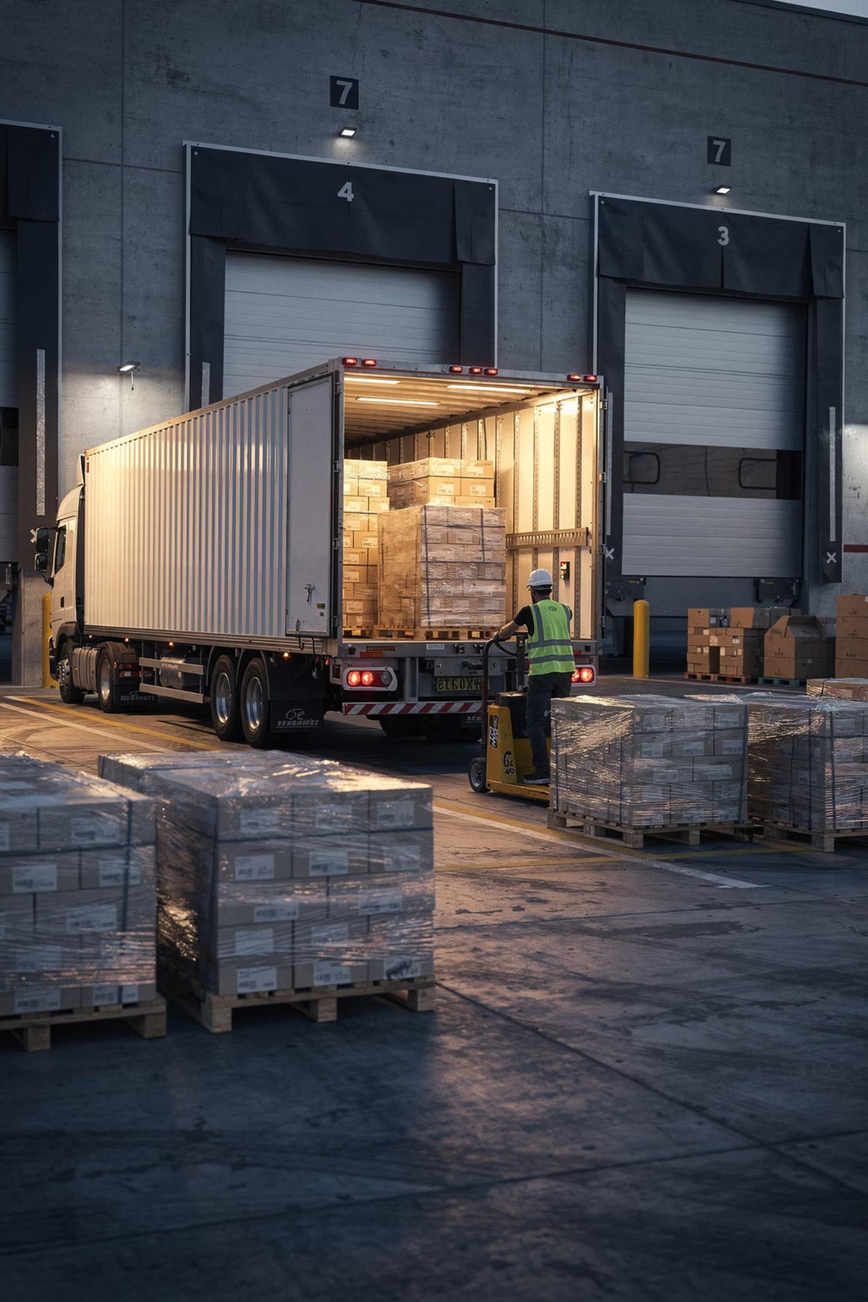
Export Deliveries
10т
Minimum order
Minimum volume per shipment
30т
Per month
Production capacity
4
Shipments
Up to 4 shipments per month
15
Days
Lead time after order confirmation
Cooperation formats
Regular deliveries
Long-term contracts
Distribution supply
B2B cooperation

Slide 7
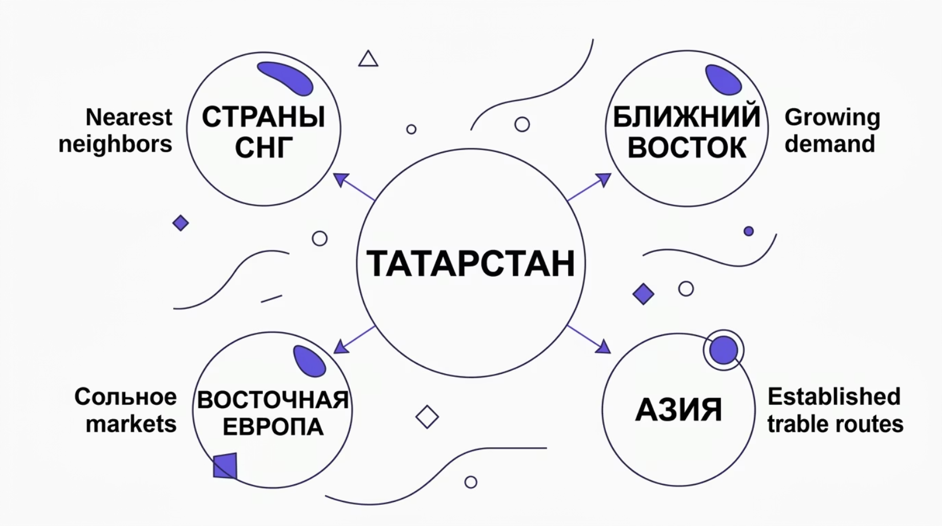

Logistical Advantages
Production Location
Possible Export Directions
📍 6 km from Federal Highway M7
📍 40 km from the city of Izhevsk
Advantages
Convenient road logistics
Optimal delivery times
Access to export transport routes

Slide 8

Commercial Terms
Payment Terms
1
2
100% Prepayment
50% / 50%
For first shipments — full prepayment to ensure a reliable partnership
50% prepayment and 50% upon receipt of goods — standard terms
3
Deferral up to 14 days
For long-term partners — flexible terms with payment deferral
Additional Services
Storage Consultations
Export Support
Flexible Terms for Regular Clients

Slide 9
Why Partners Choose LLC "Bulgar"
Natural Raw Materials
Consistent Quality
Only fresh grain-based raw materials without artificial additives
Quality control at every stage of production
Export Ready
Competitive Pricing
Certified products ready for international shipments
Favorable prices with high product quality
Convenient Logistics
Flexible Terms
Close to federal highways and transport routes
Individual approach for importers, distributors, and manufacturers
Our Clients
Importers
Distributors
Food Manufacturers
HoReCa
Retail Chains

Slide 10


Contact Information
LLC "Bulgar"
Sales Manager
Open to International Cooperation
👤 Musin Artyom
We are ready to consider any partnership format — from one-time shipments to long-term contracts. Contact us to discuss the terms and receive a commercial offer.
📞 +7 (963) 030-03-30
📧 a.f.musin@gmail.com
📍 Republic of Tatarstan, Russia
To receive a price list and product samples — write or call our manager.
Dry Bread Kvass
1 157,53 USD / t
Bread Crumbs
1 157,53 USD / t

