Slide 1
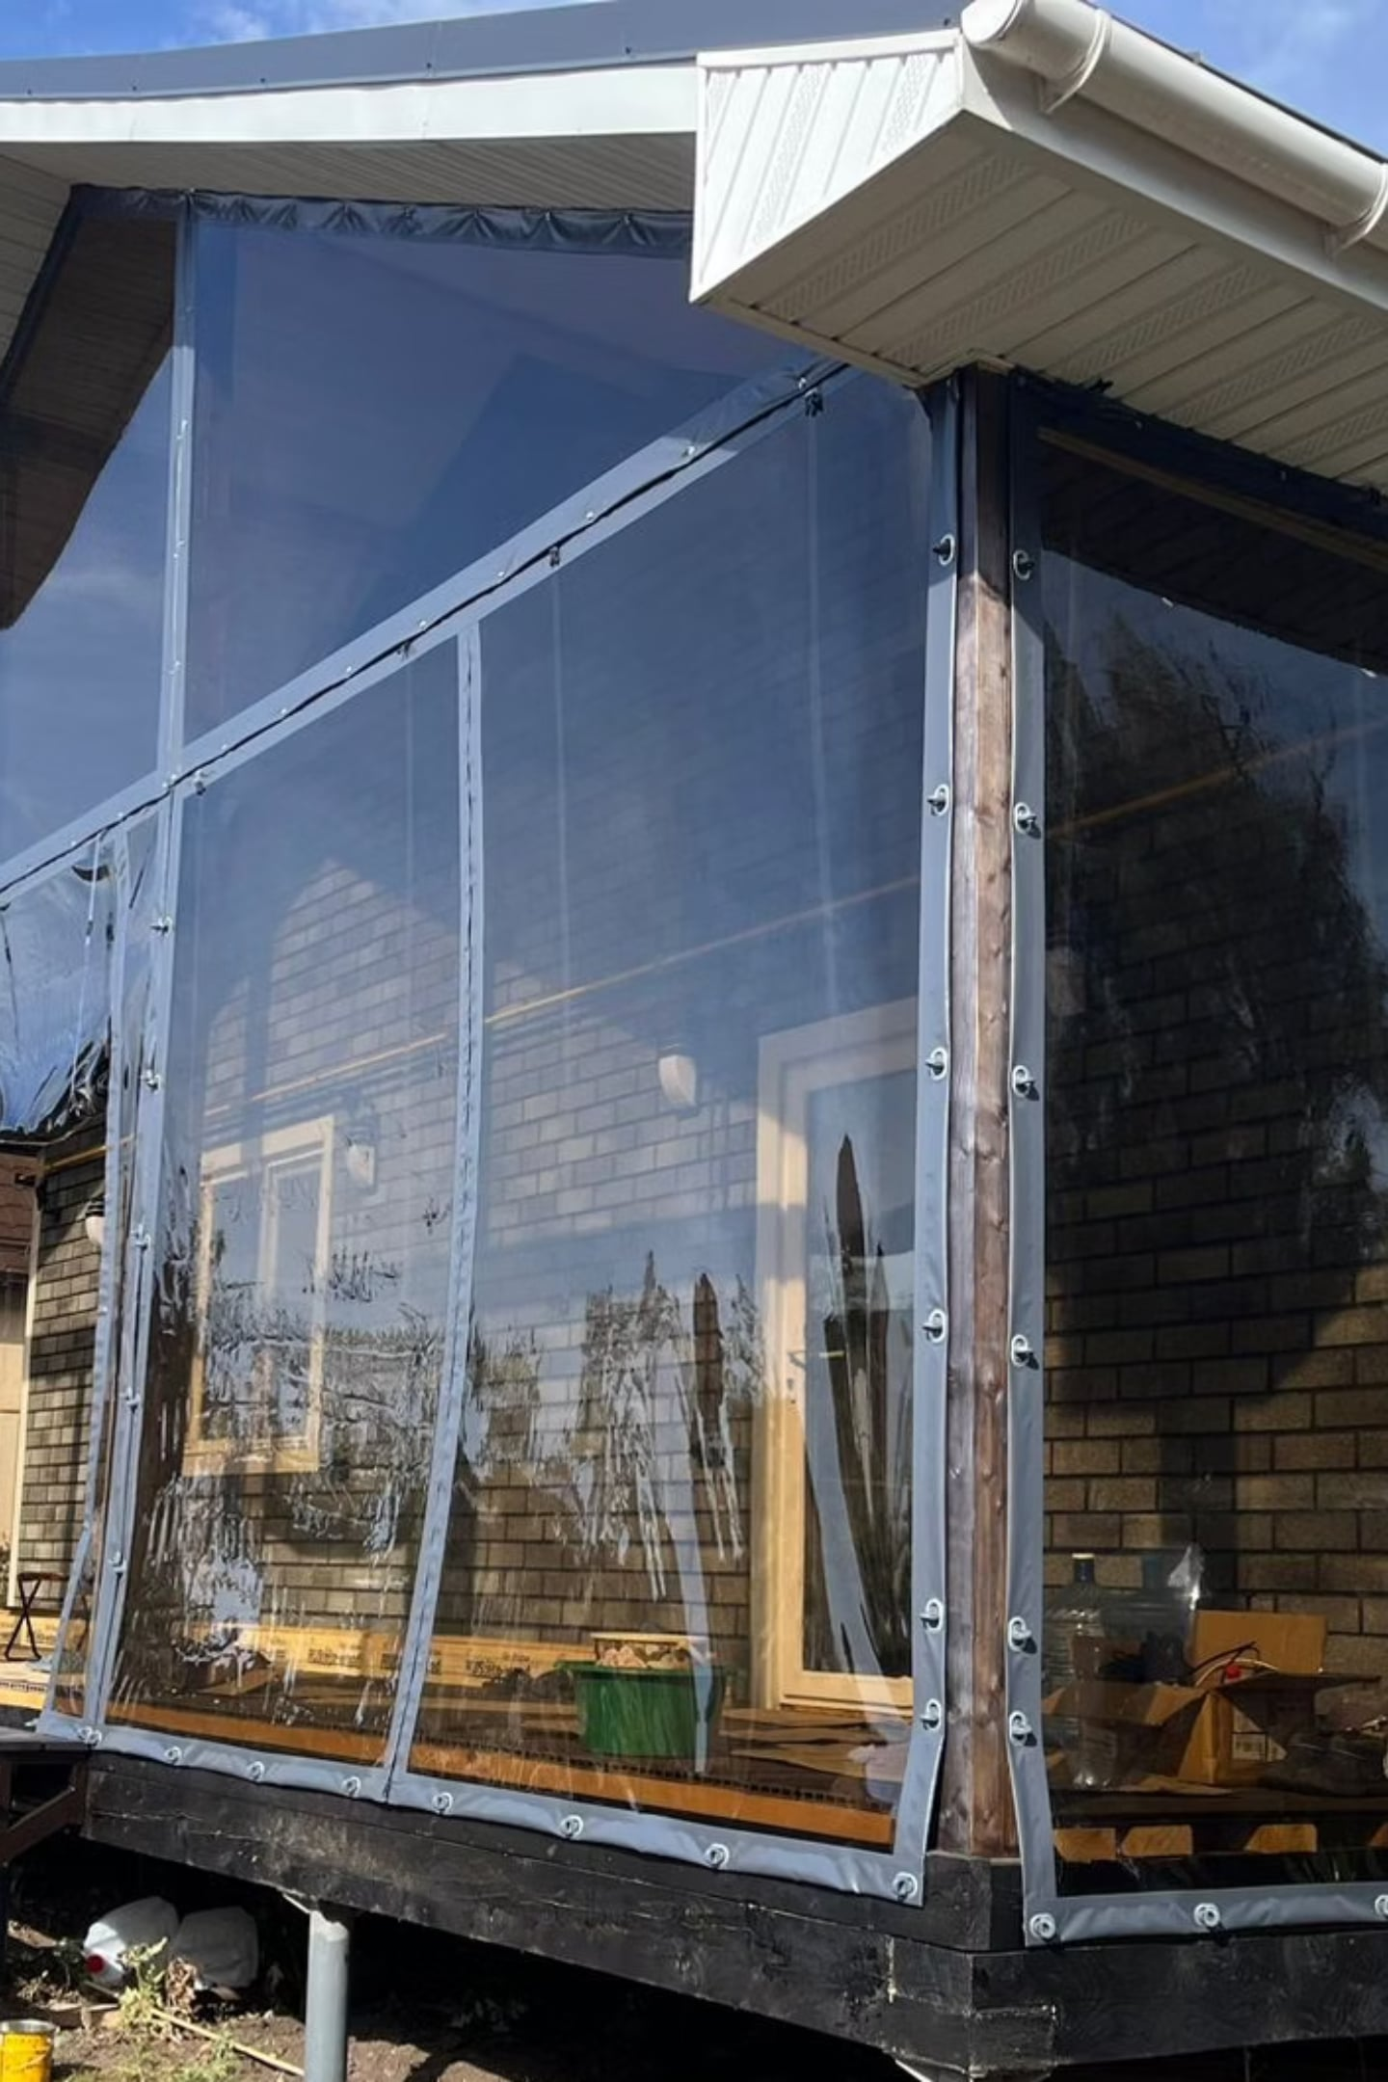
Soft Windows for Export
Reliable Russian-made PVC solutions for residential developers worldwide
EXPORT COLLECTION

Slide 2
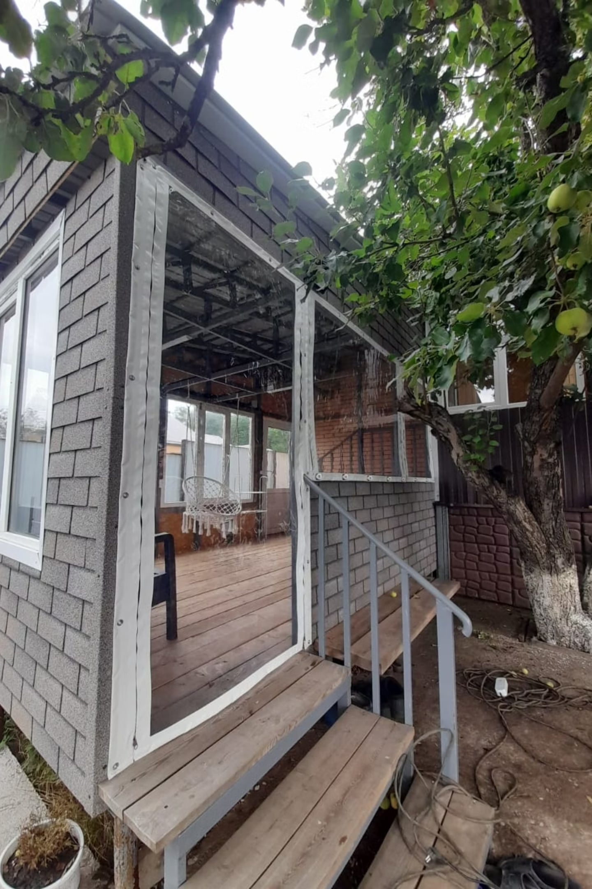
About Us
Manufacturing
Founded
A modern, skilled production facility. In-house welding lines. Quality control at every stage of production.
Over 3 years in the soft transparent structures market
Geographic Reach
Capacity
Deliveries to CIS countries, the Middle East, and Central Asia. Experience with international logistics chains and customs clearance is currently being developed.
Up to 2,000 sq. m. of finished product per year
Export
Active export shipments are planned.

Slide 3
Why Choose Us
Russian manufacturing means transparent pricing, direct communication, and high quality without middleman markups.
Parameter
Our Company
Chinese Alternatives
European Brands
Price
✅ Competitive
⚠️ Low, but unstable
❌ High
Lead Time
✅ 20–45 days
⚠️ 45–90 days
⚠️ 30–60 days
Custom Sizes
✅ Yes, no limitations
⚠️ Limited
✅ Yes
Technical Support in Russian/English
✅ Yes
❌ Limited
⚠️ Partial
Warranty
✅ 5 years
⚠️ 1–2 years
✅ 3–5 years

Slide 4
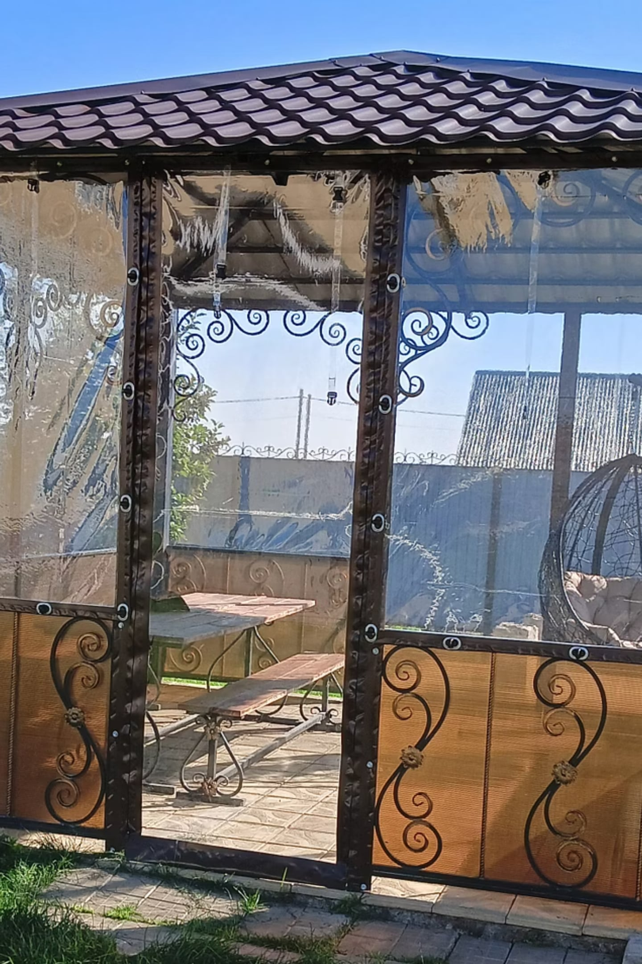



Product: Soft PVC Windows
Key Specifications
Applications
Terraces & Patios
Film thickness: 0.7 mm
Light transmittance: up to 95%
Temperature range: −40°C to +70°C
Resistant to UV, precipitation, and wind loads
Panel width: up to 2.2 m seamless
Glazing without load-bearing structures
Gazebos & Pergolas
Weather protection while preserving visibility and views
Our products meet international quality standards and have passed independent durability and wear-resistance testing.
Balconies & Loggias
Easy installation, competitive pricing

Slide 5
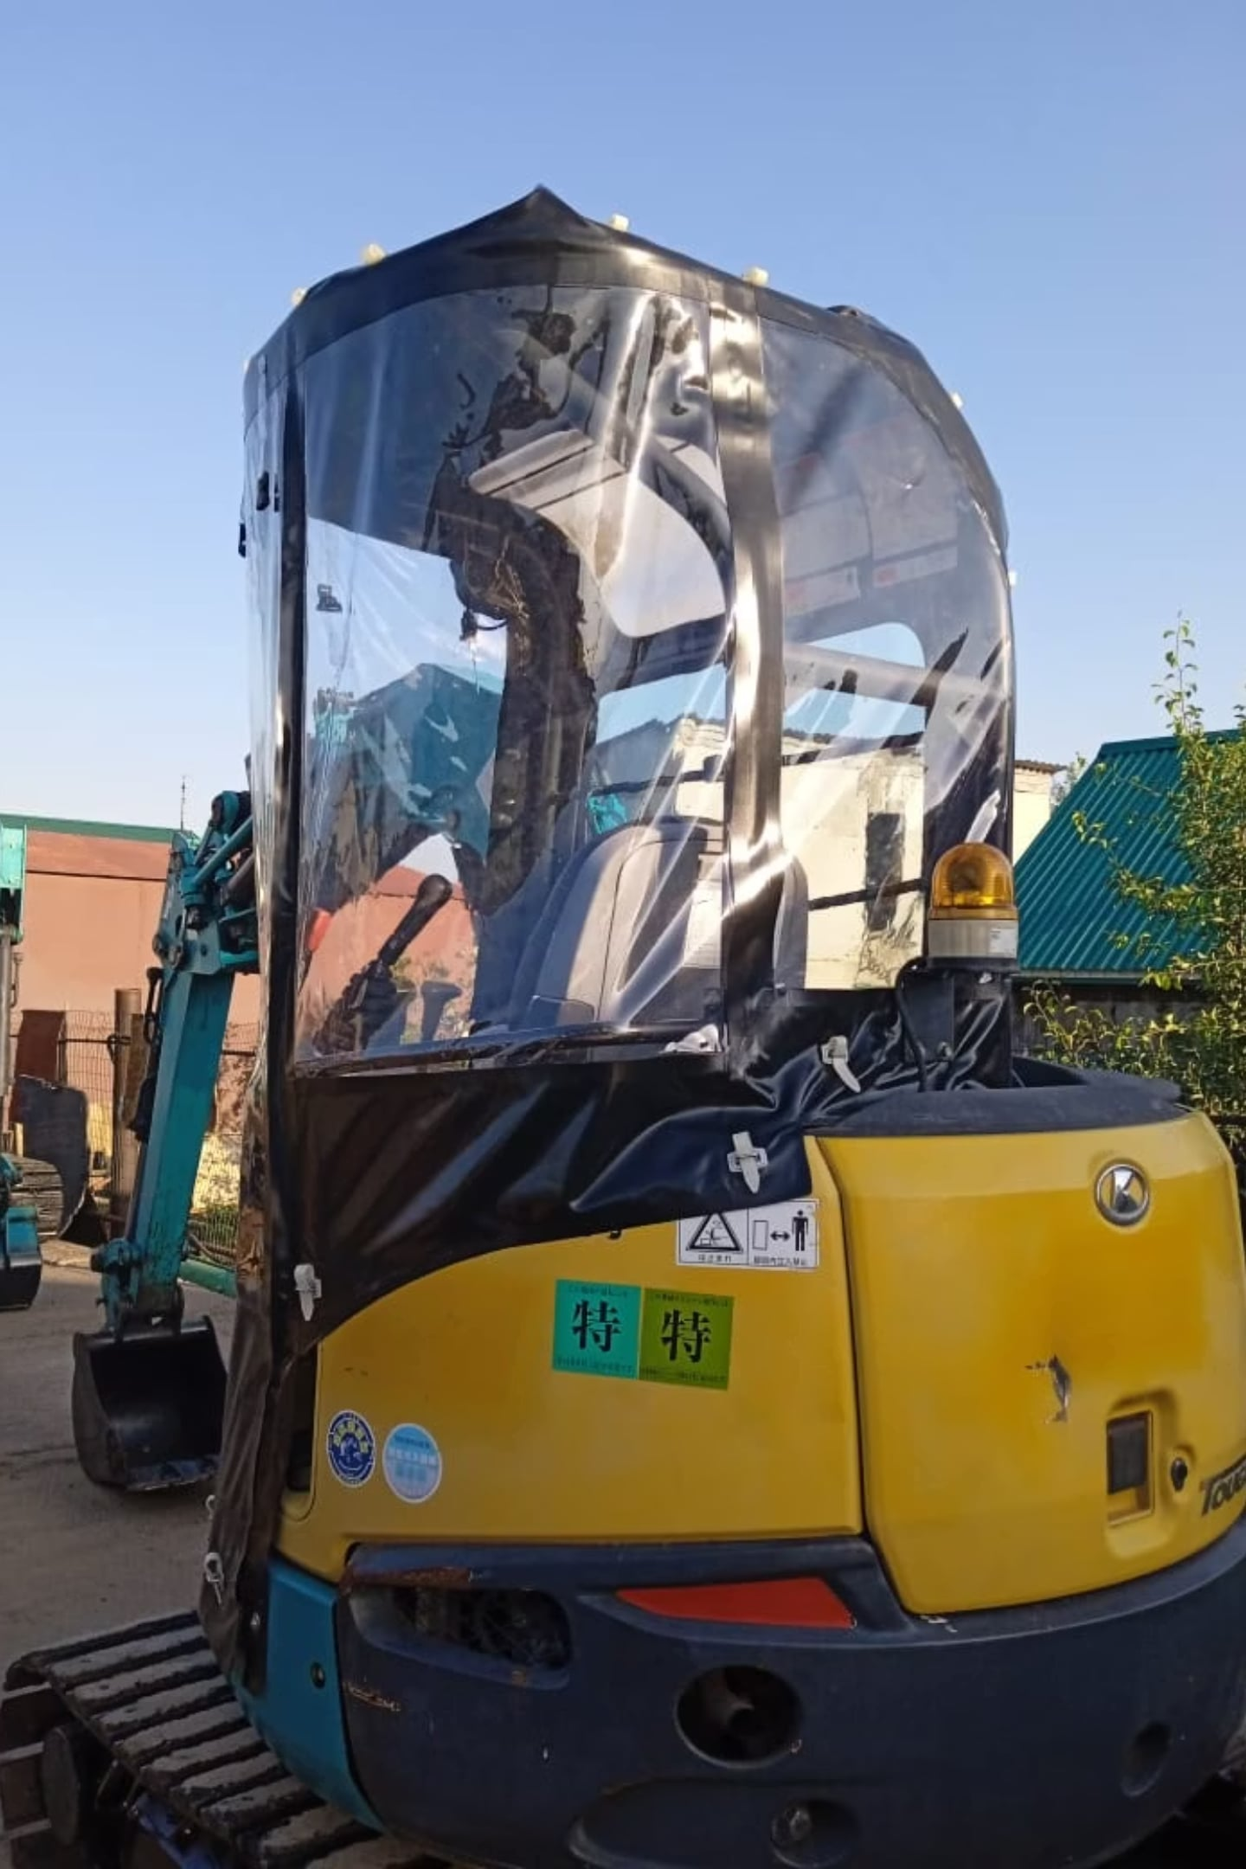
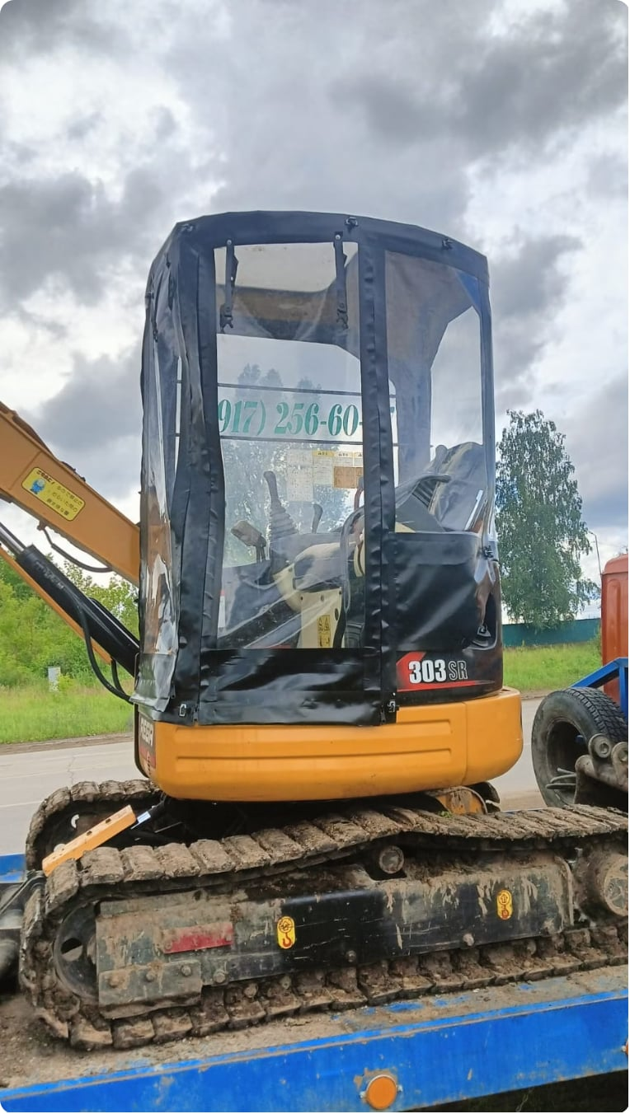
Technology & Know-How
UV Stabilization
Advanced anti-yellowing formula — optical clarity is maintained throughout the entire warranty period.
Custom-Size Manufacturing
Production tailored to any non-standard opening — with no minimum order requirements on dimensions.

Slide 6
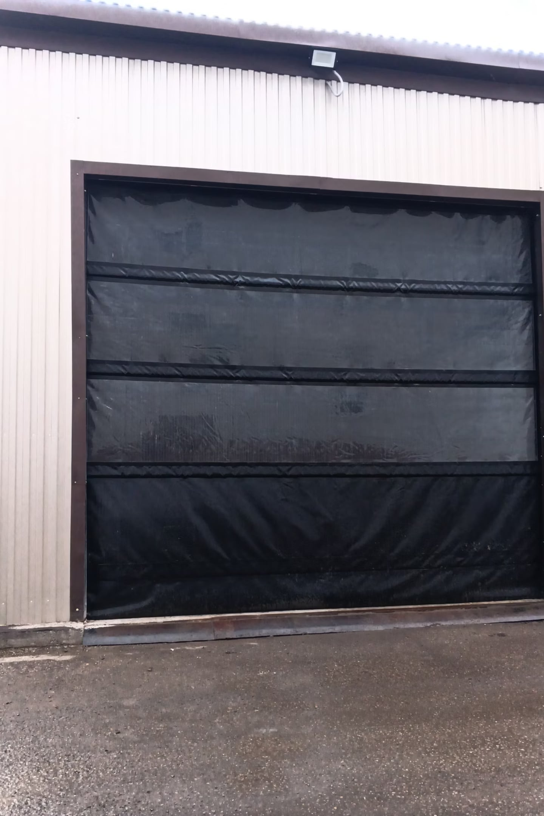


Warranty & Service
Our Commitments
5-Year Warranty
On all products, including hardware and film — under normal operating conditions.
Rapid Support
Manager response within 2 hours. Video consultations available for on-site installers.
Spare Parts
Parts warehouse with worldwide shipping within 24 hours.

Slide 7
Contact Us
Contact Information
Ready to discuss your project, provide a quote, and arrange a trial shipment.
✉ kamalievir@mail.ru
📞 +7 9061185558
📍 Russia, Republic of Tatarstan, Almetyevsky District, Nizhnyaya Maktama, Sovetskaya St., 3a
We respond within 2 business hours. We speak Russian and English.

