Slide 1

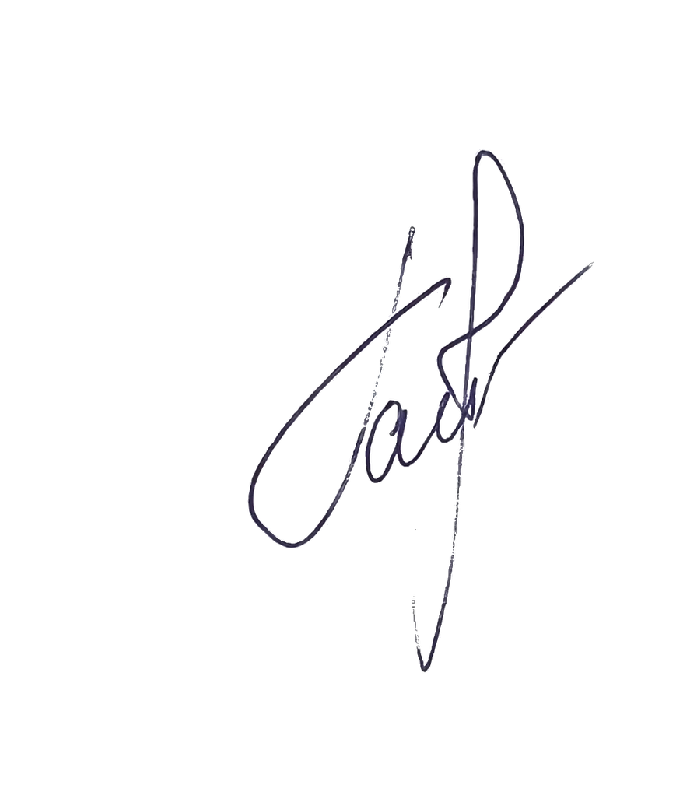
Daliya Gainanova
CEO
Larisa Voznesenskaya
Brand Ambassador
GTDRESS
INCLUSIVE FASHION:
ADAPTIVE APPAREL
FOR ALL AGES AND ABILITIES

Slide 2
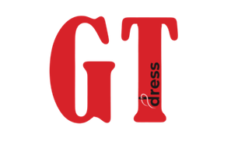
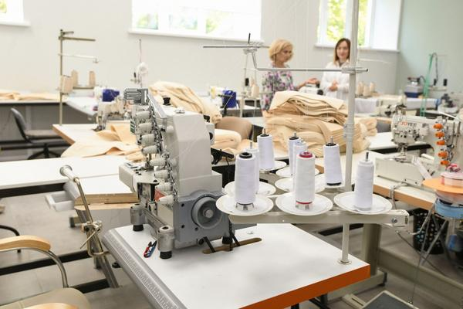
COMPANY HISTORY
1. Brand Origin
GT Dress is more than a clothing brand—it’s a mission born from personal experience and unconditional love. Founded by Daliya Gainanova,
a mother of a child with severe cerebral palsy, the brand was created
to solve everyday dressing challenges and improve the quality of life
for her son and families navigating фsimilar circumstances.
2. The Opportunity
To design adaptive clothing that seamlessly blends comfort, style, and accessibility—for children, teens, and adults with special needs.
3. How It Started
It began with a single bib — simple, purposeful, and thoughtfully designed. That first piece proved the concept and became the foundation for our full adaptive clothing line.
4. Our Evolution
GT Dress has grown into a social enterprise—going beyond adaptive apparel to provide comprehensive support for families of children with disabilities.
GT Dress — It’s comfortable to be yourself.
01

Slide 3
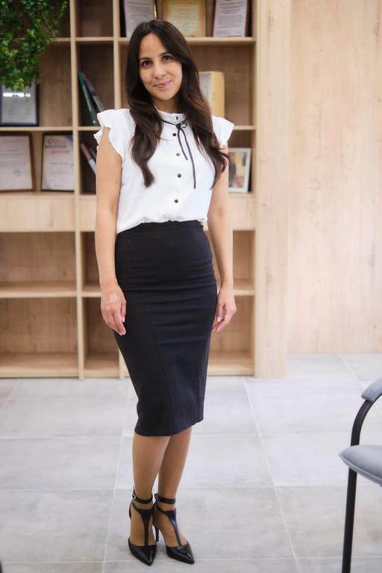
PROJECT
LEADERS
Daliya Gainanova
Founder & Visionary, GT Dress
A mother of a special child who turned a personal story into
a powerful social project.
The journey of GT Dress began with the very first batch
of custom-made bibs for her son with a severe form
of cerebral palsy (CP)
Daliya did not only create an adaptive clothing brand, but also founded the "I Am Happiness" support club for mothers.
Her mission extends beyond adaptive apparel—to restore mothers’
well-being and empower them to thrive.
Happy child = happy Mother.
02

Slide 4
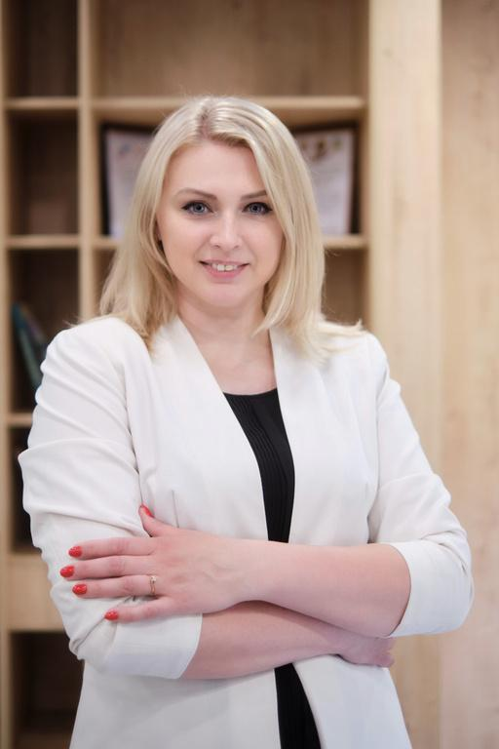
PROJECT
LEADERS
Larisa Voznesenskaya
Development Director & Strategic Partner, GT Dress
Social entrepreneur & inclusion strategist — expert
in building accessible, systemic solutions
Scaled GT Dress — introduced structured processes and expanded partnerships with NGOs and foundations
Leads strategic growth — project development, brand promotion, and ecosystem building
Bridges mission and impact — transforming inclusive values into measurable results
Our team is a union of heart and strategy.
03

Slide 5
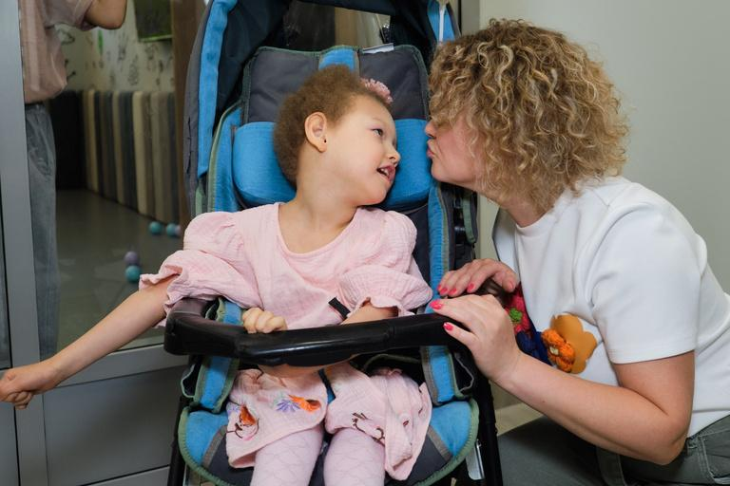
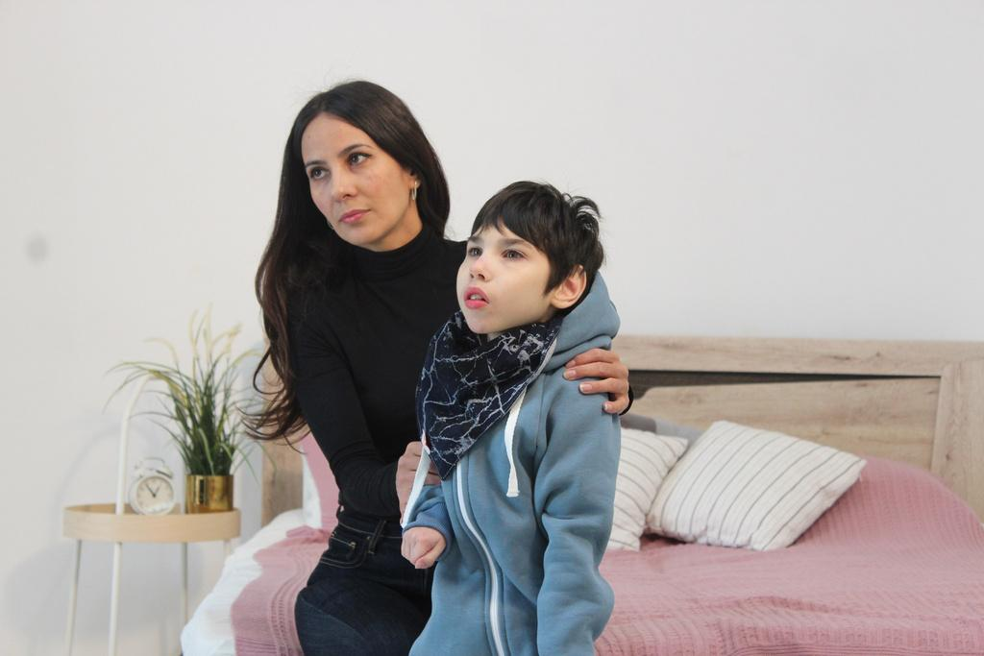
BRAND DESCRIPTION
Who We Are
GT stands for Gainanov Timur — the founder's son, whose life with severe cerebral palsy became the heart of our mission.
Where We Came From
A Russian adaptive fashion brand, proudly designed and produced in Kazan, Republic of Tatarstan.
What We Believe In
We're not just a clothing manufacturer. We're an ecosystem of care — where adaptive apparel, community support, and inclusion work together for families navigating disability.
Our Mission
To create adaptive clothing that improves quality of life — delivering comfort, confidence, and true inclusion. We believe fashion and innovation should be accessible to everyone, regardless of ability.
GT Dress is not just a name. It is a symbol of love, strength, and the belief that every person deserves to live with comfort and dignity.
04

Slide 6
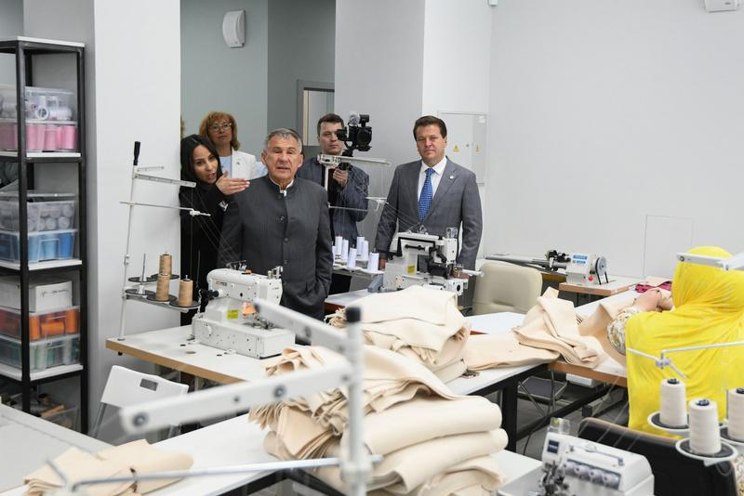
CLOTHING DESCRIPTION
GT Dress Is:
  Thoughtfully adaptive: Clothing designed around real needs — saving time, reducing stress, and preserving energy for what matters
  Function first: Adaptive closures, sensory-friendly fabrics, ergonomic patterns, and custom tailoring for everyday ease
  Style with purpose: Because aesthetics is a form of respect — fashion that celebrates individuality, not compromises it
  Community-driven: Supporting families through charitable initiatives, resources, and peer-to-peer programs
  Inclusively made: People with disabilities are actively involved in our design and production process
We Believe Clothing Is More Than Just Fabric and Cut.
It’s a language of care.
A foundation for confidence.
A step toward everyday independence.
GT Dress — for those who love and live in a special way.
05

Slide 7
TARGET AUDIENCE
GT Dress designs adaptive clothing that unites comfort, function, and style — for children, teens, and adults with disabilities.
People with Disabilities (Ages 0–18)
People with cerebral palsy (CP), autism, genetic and neurological conditions.
The clothing accommodates the presence of gastrostomy and tracheostomy tubes, spasticity, the needs of wheelchair users, and other features.
Parents of Children with Disabilities
Mainly mothers who are in constant care. For them, the comfort, practicality, and aesthetics of clothing that eases daily life are essential.
For Rehabilitation
People with limited mobility or after injuries, the post-operative period, people with dementia, or after a stroke. The clothing simplifies dressing, does not restrict movement, and fits over orthoses, prosthetics, casts, Ilizarov apparatus, and splints.
Social and
Rehabilitation Institutions
Kindergartens, schools, boarding schools, rehabilitation centers, orphanages, and nursing homes value convenience, high quality, and ease of care.
Charitable Foundations and NGOs
Partners who purchase clothing for distribution to families. They choose
GT Dress for its social mission and transparent approach.
06

Slide 8
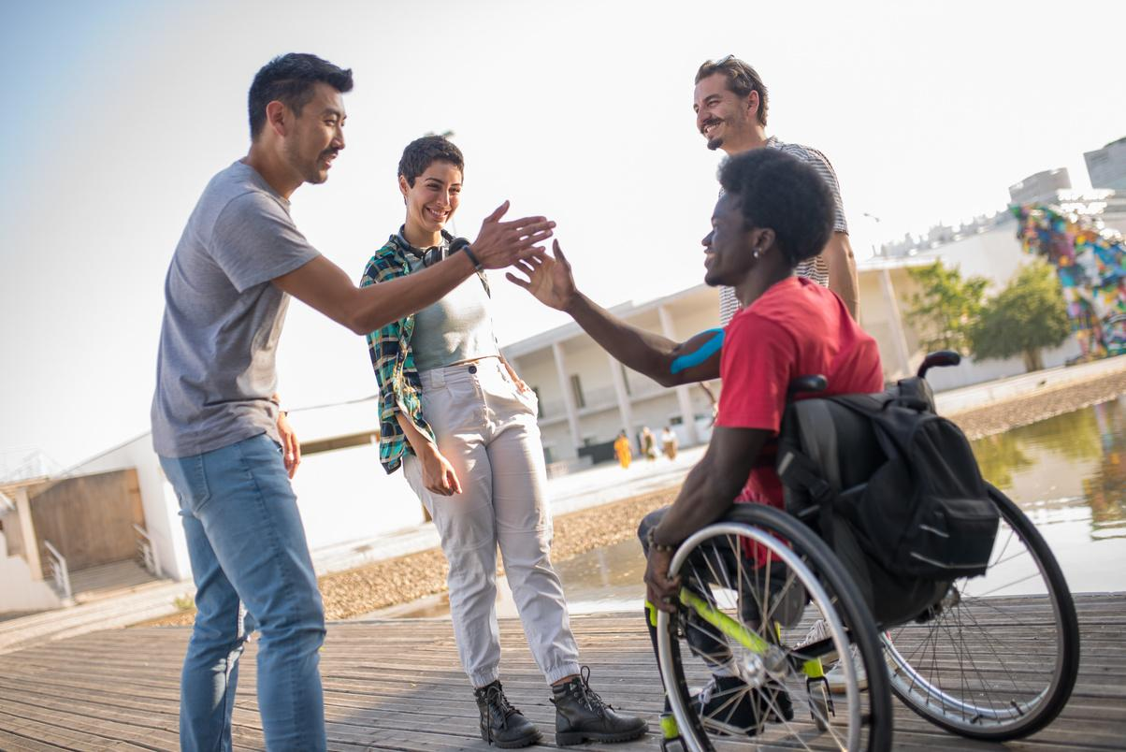
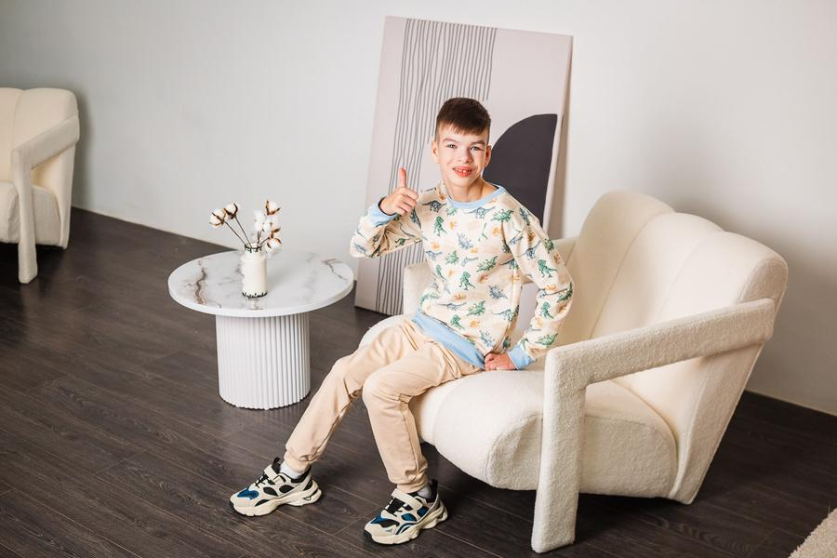
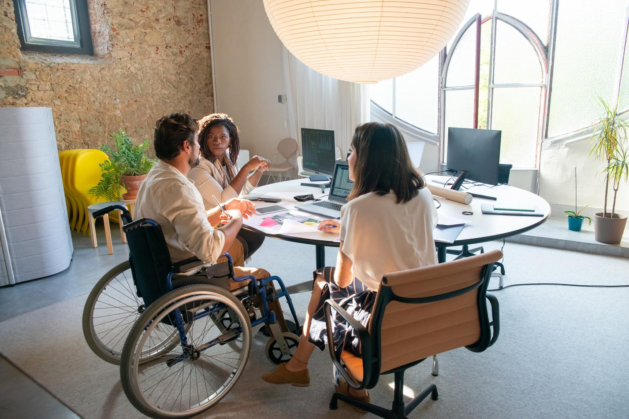
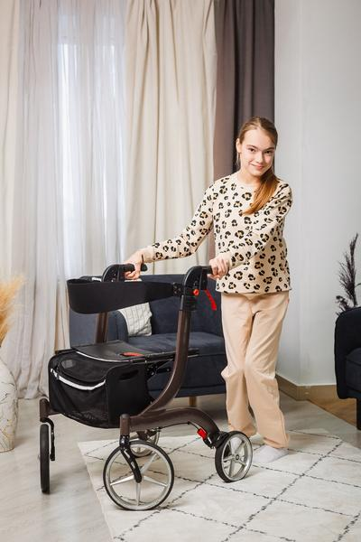
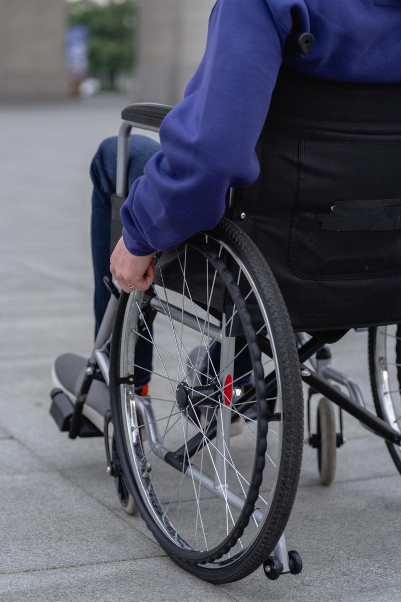
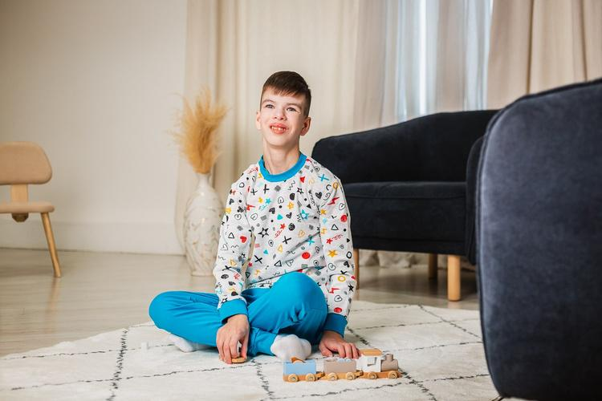
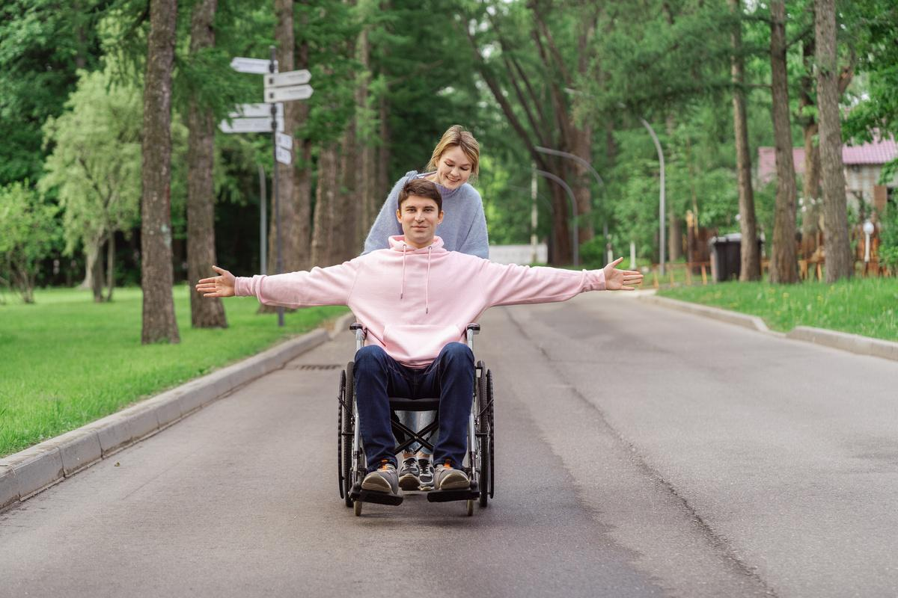
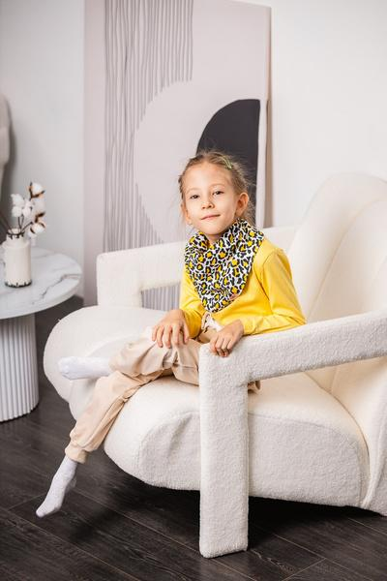
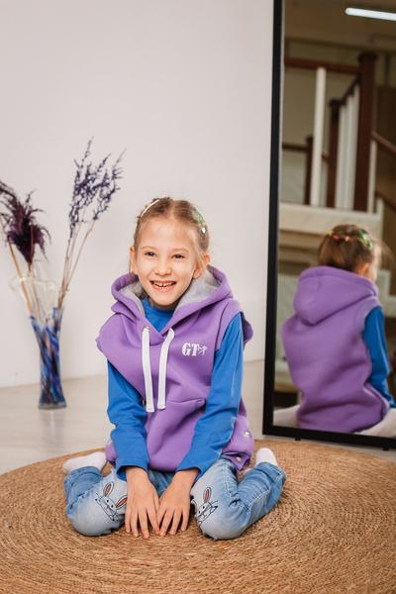
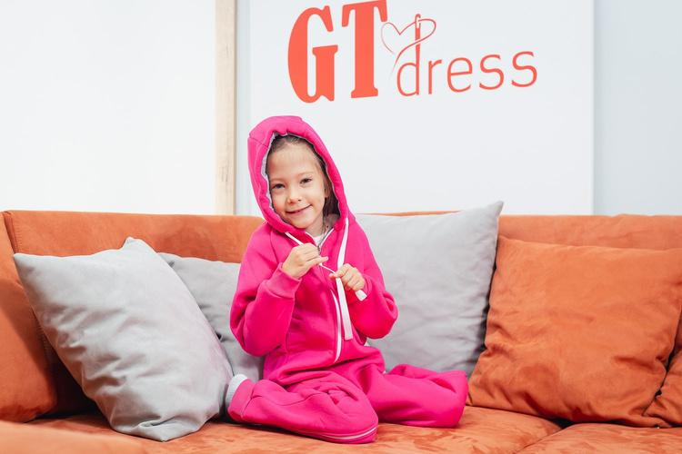
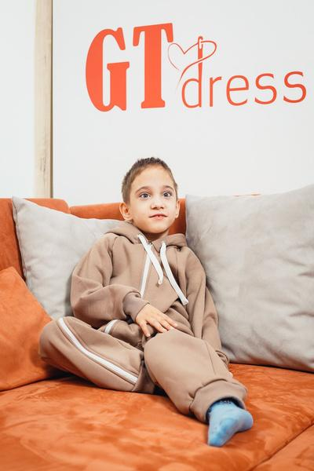
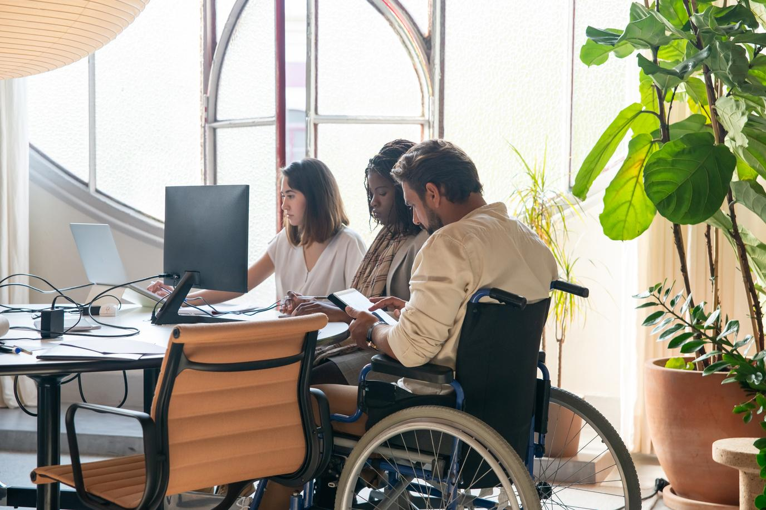
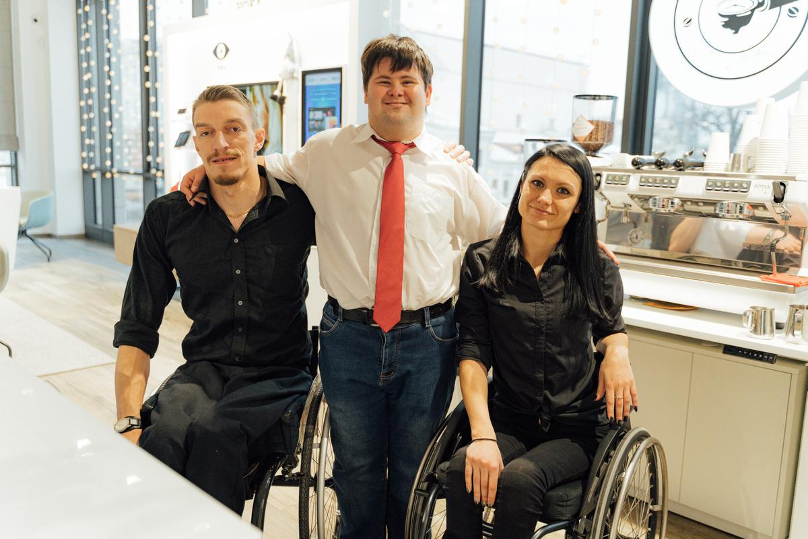
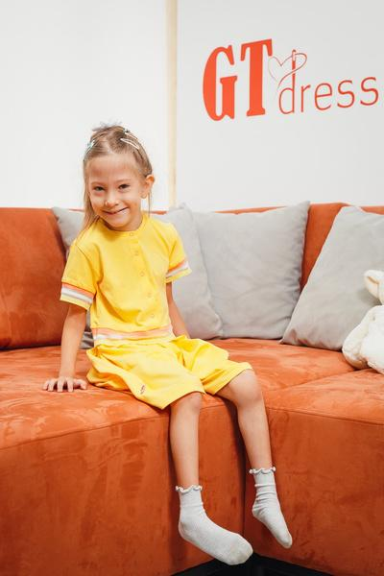

Slide 9
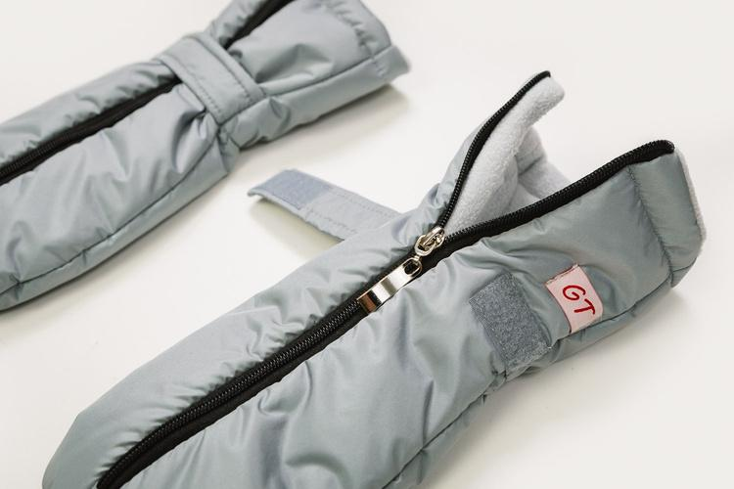
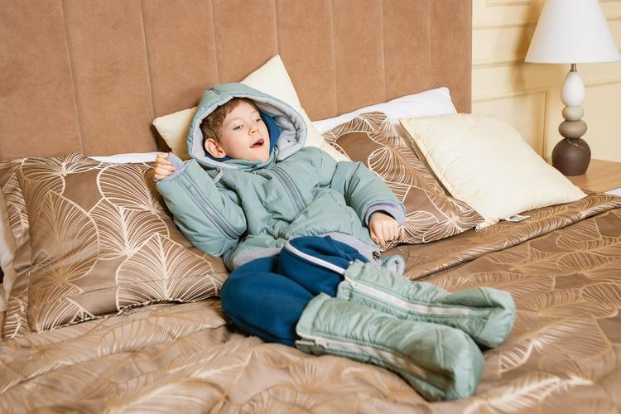
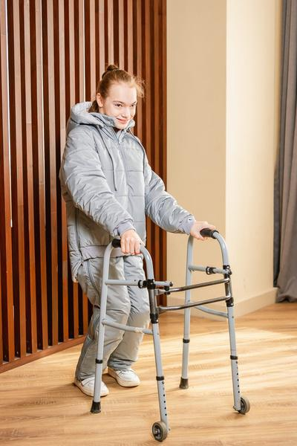
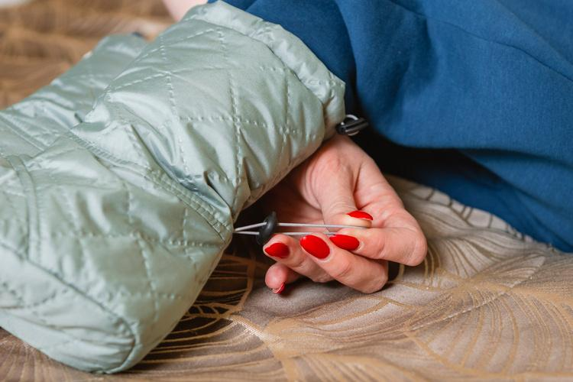
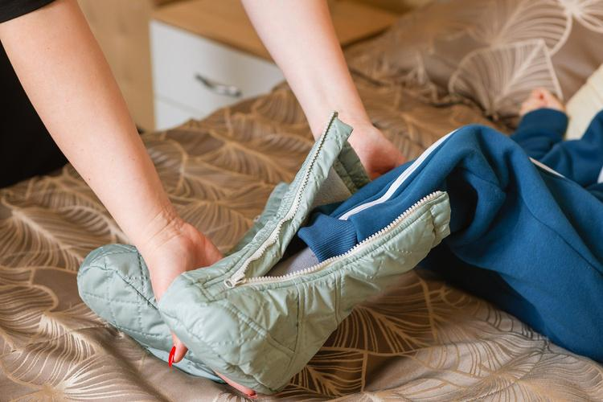
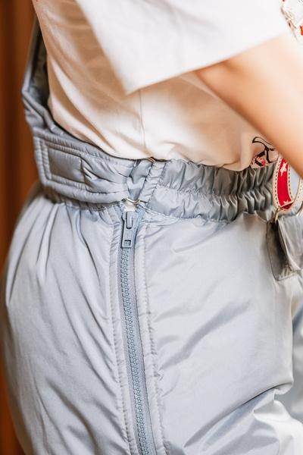
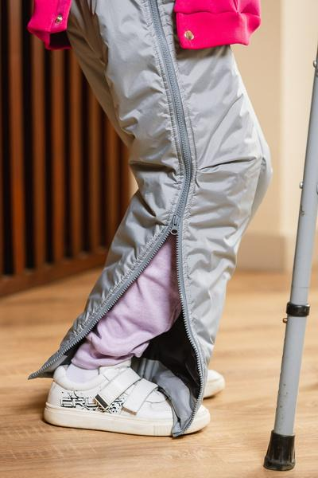

Slide 10
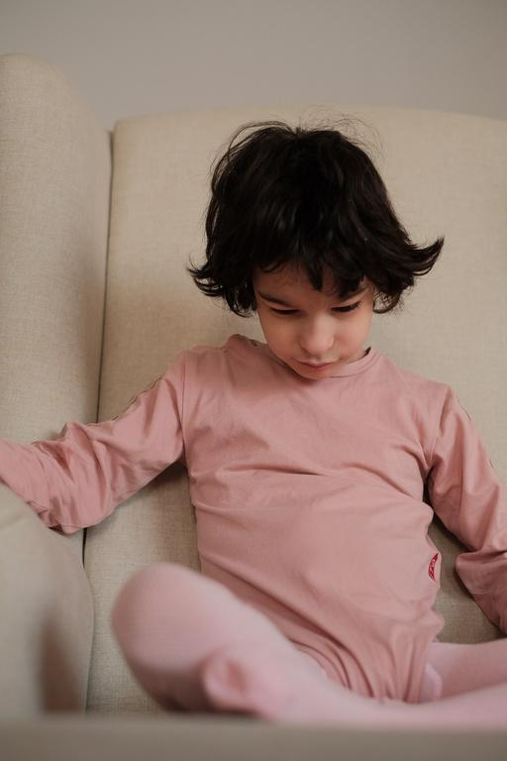
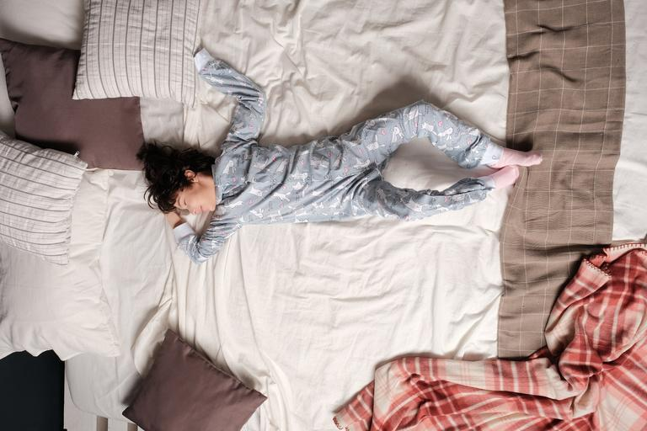
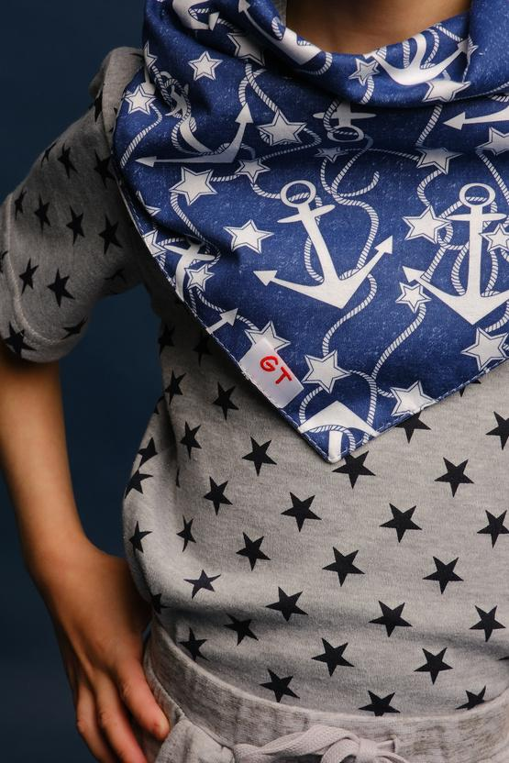
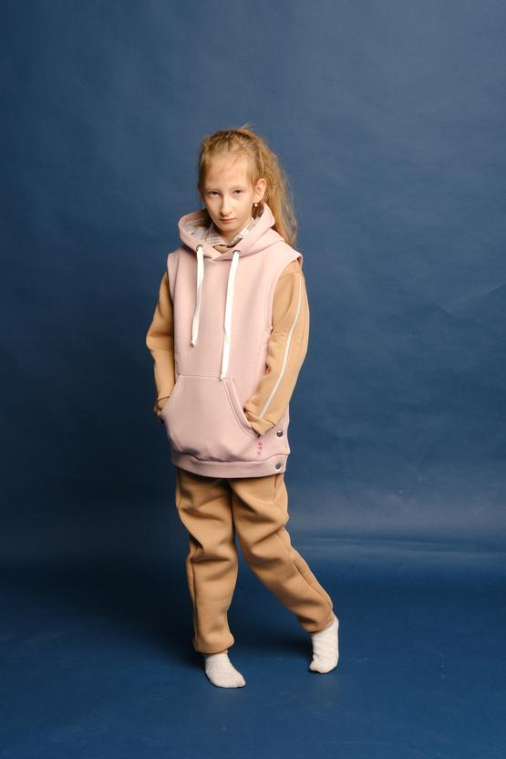
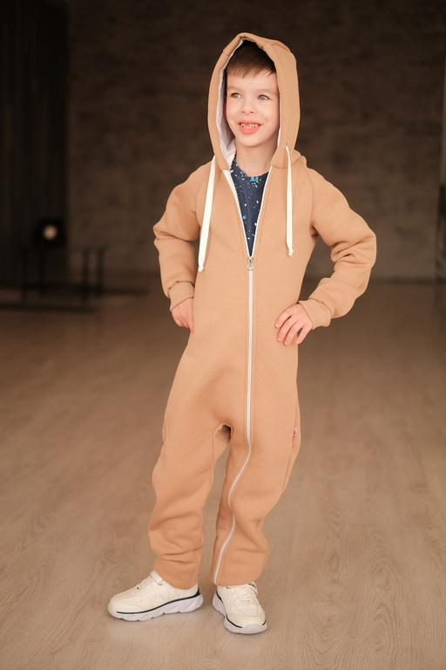
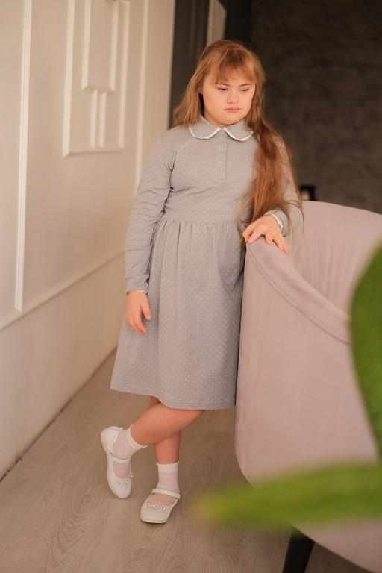

Slide 11
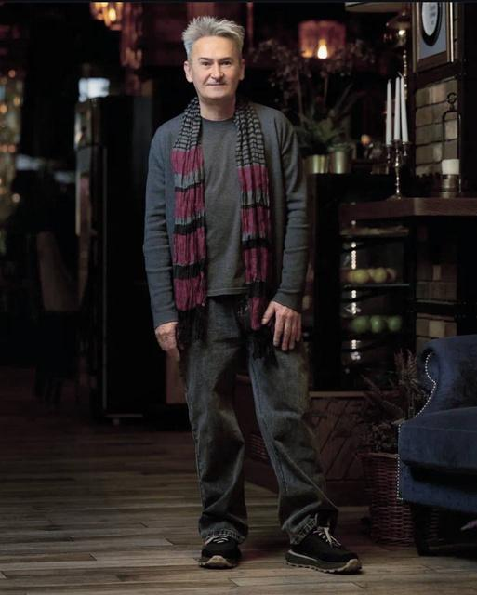
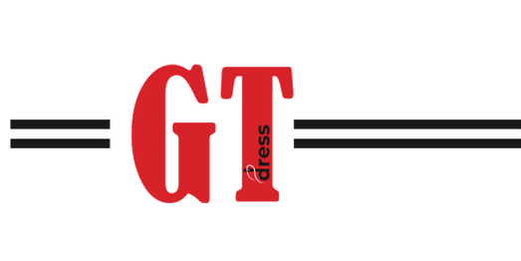
GT DRESS COLLABORATIONS
GT Dress × Rustem Iskhakov (2022)
In 2022, we partnered with acclaimed Kazan artist and designer Rustem Iskhakov to launch a limited-edition adaptive collection featuring his signature bold prints.
More than a design experiment, this collaboration became
a cultural statement: inclusion is beautiful, fashion-forward, and runway-worthy.
The collection resonated deeply with teenagers with disabilities and their families, fostering self-acceptance, confidence, and body positivity.
10

Slide 12
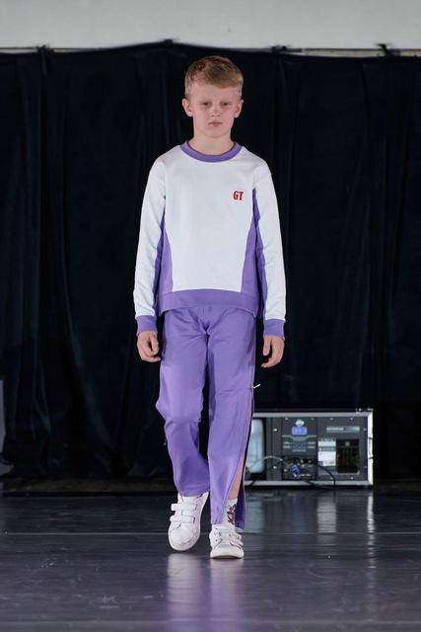
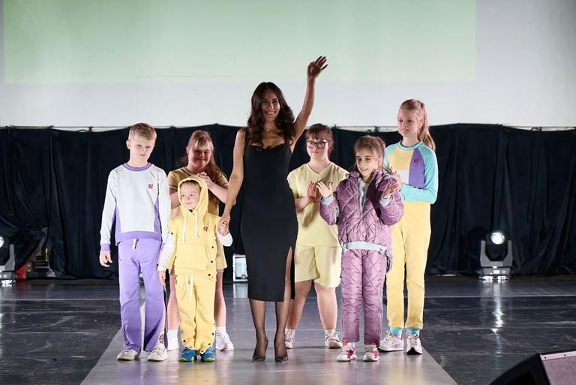
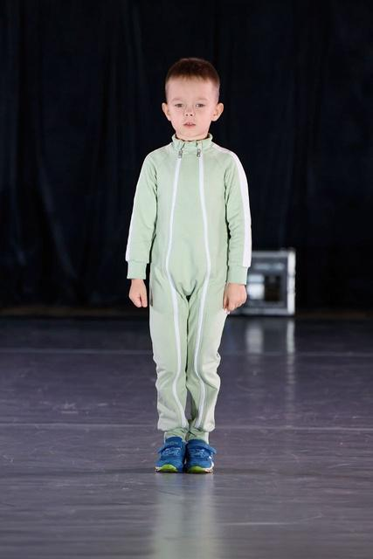
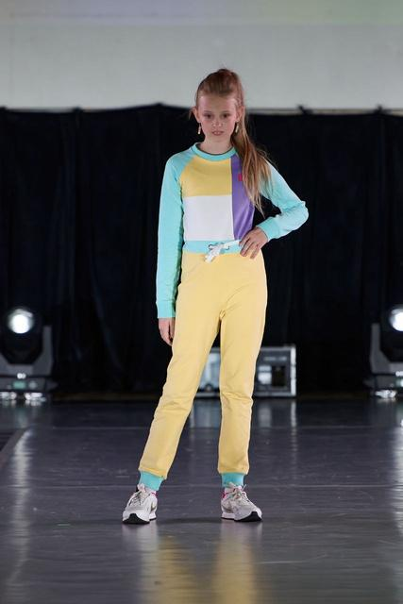
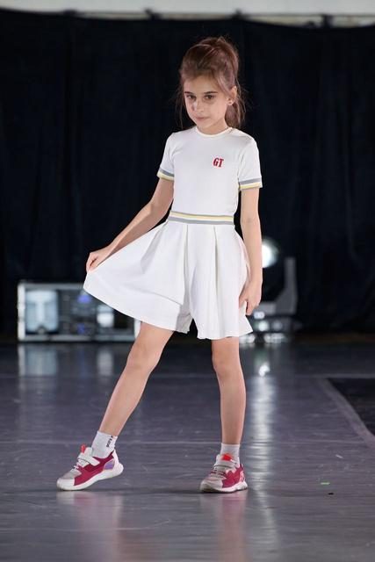
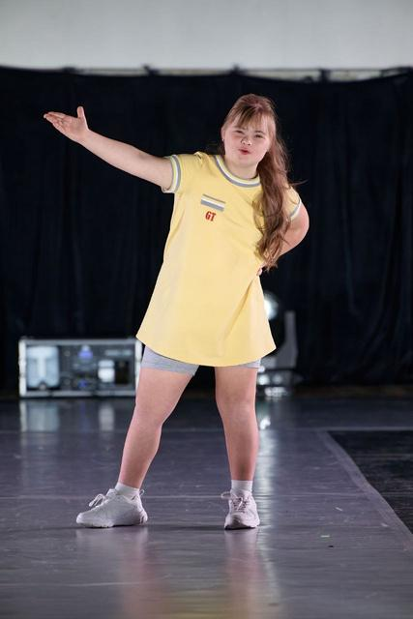

Slide 13
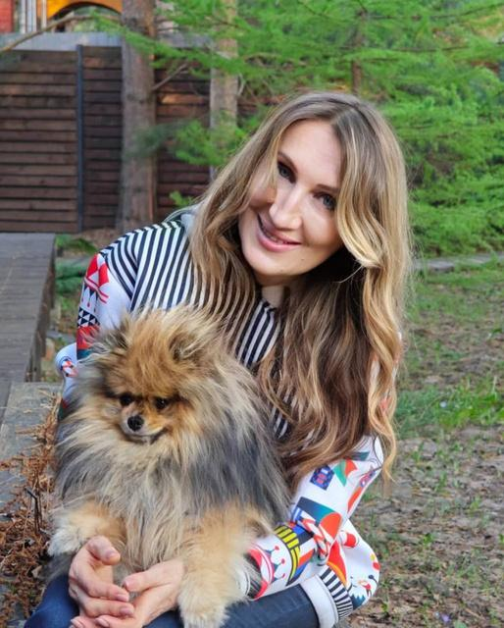
GT DRESS COLLABORATIONS
GT Dress × Katya Borisova
(2025)
In 2025, GT Dress partnered with acclaimed fashion designer Katya Borisova, known for her presence
at Russia’s leading fashion weeks.
The vision: To elevate adaptive clothing to a new standard — fully functional, deeply inclusive, and undeniably runway-ready.
The collection debuted at the St. Petersburg International Economic Forum (SPIEF) as part
of the “On Wings” competition, establishing
GT Dress as a cultural ambassador for Kazan and
the Republic of Tatarstan.
In every product, there is a piece of my soul. I personally oversee every single item.
12

Slide 14
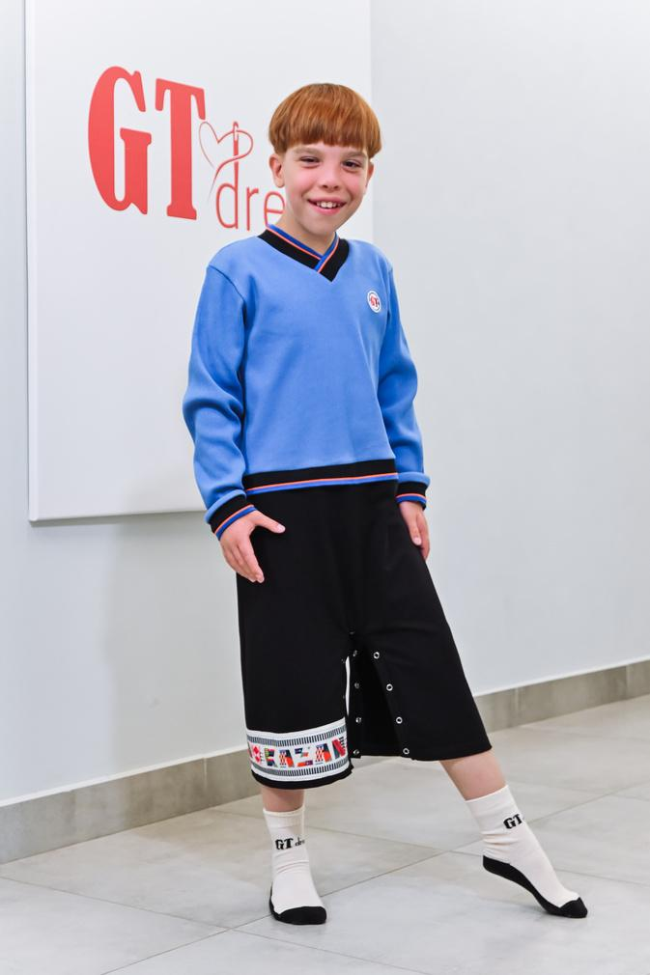
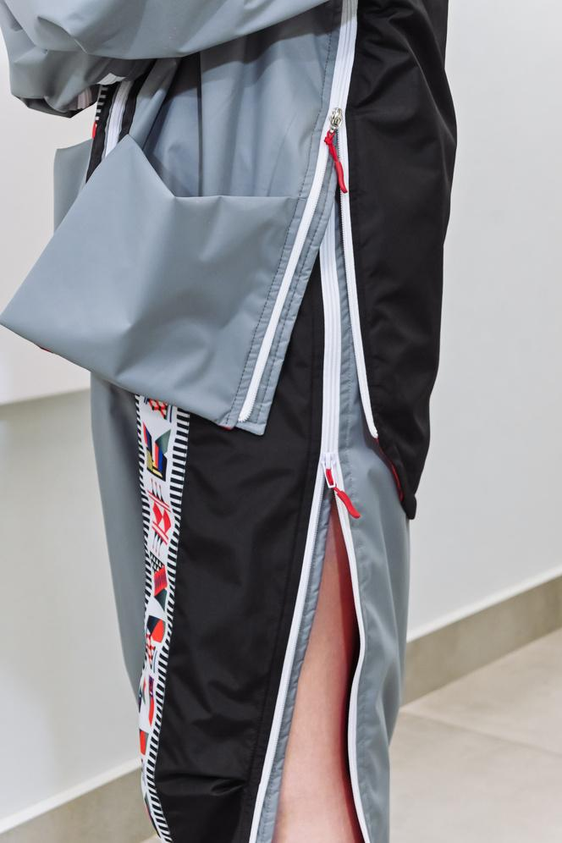
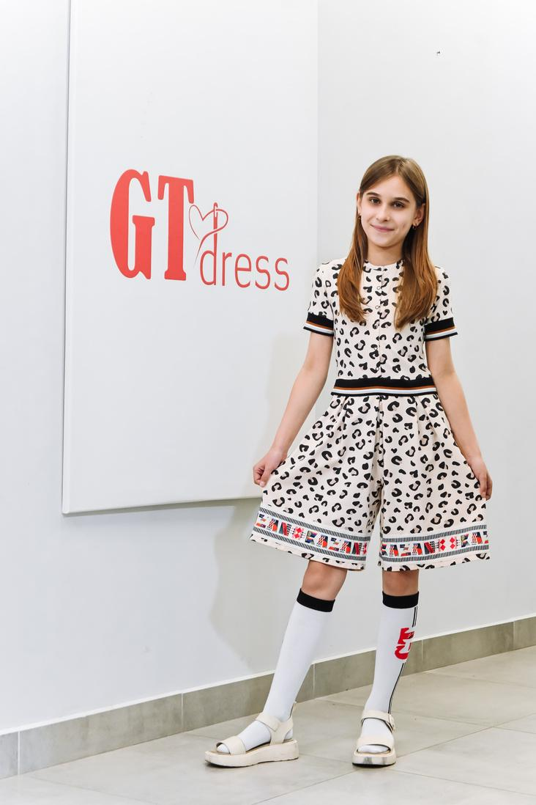
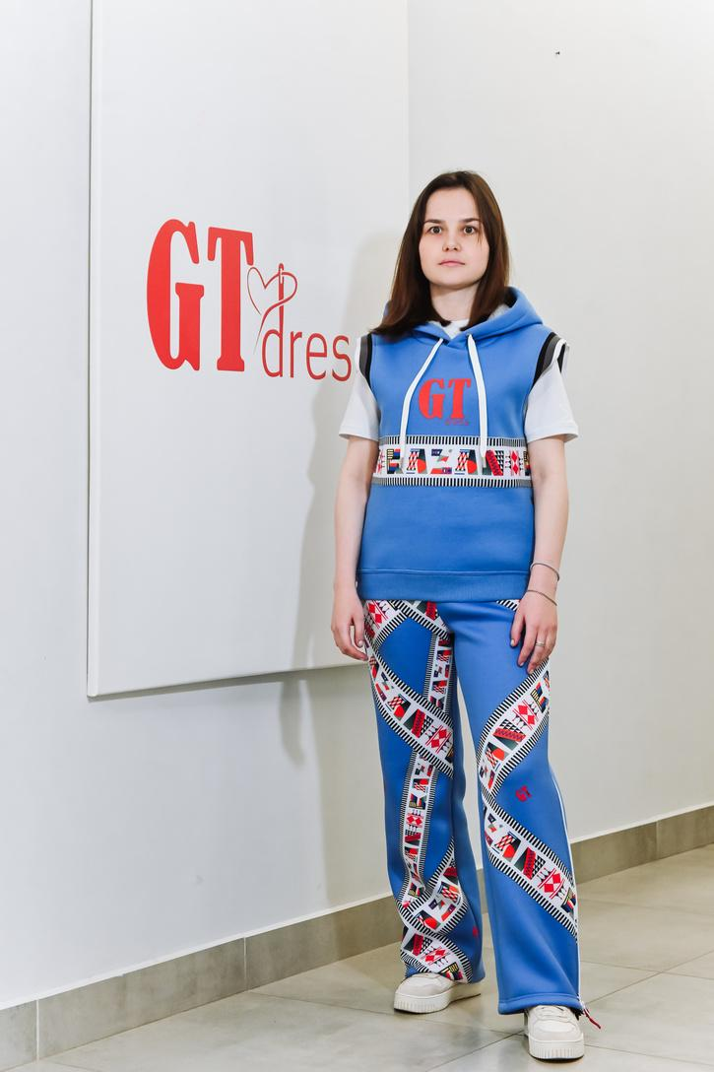
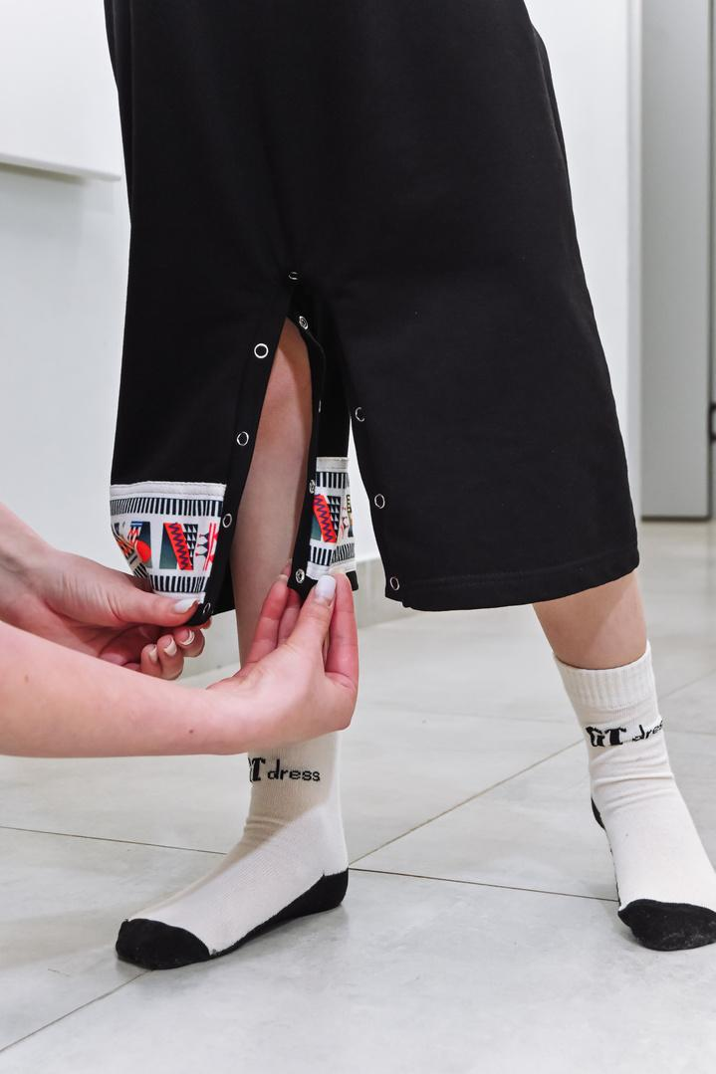
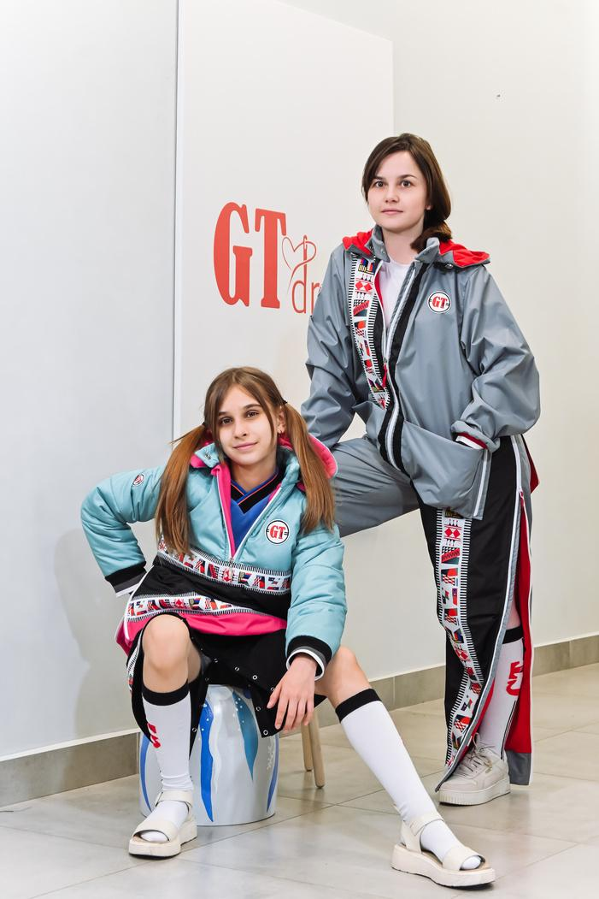



Slide 15








Slide 16
ADDITIONAL SERVICES & CUSTOM PRODUCTION
GT Dress offers full-cycle garment manufacturing for partners — from pattern development to branded,
ready-to-sell products. We work with your materials (CMT/tolling) or source fabrics ourselves, delivering flexible, high-quality solutions for your brand.
What We Sew:
  T-shirts
  Tank Tops
  Sweatshirts
  Hoodies
  Vests
  Tracksuits
  Uniforms (for schools, camps, NGOs, etc.)
Additional Options:
  Embroidery: Logos, lettering, and design elements.
  Printing: Application of drawings and prints.
  Finishing: Appliqués, heat transfers, and custom branding.
We are open to cooperation with companies, schools, foundations, and private clients. GT Dress
is a reliable manufacturing partner with a social mission.
GT Dress — always innovative, stylish, and comfortable!
14

Slide 17







Slide 18







Slide 19







Slide 20
PHILANTHROPY AND SOCIAL MISSION
More Than a Brand — A Social Mission
GT Dress exists to support families raising children with disabilities and improve their quality of life.
We provide adaptive clothing free of charge to families in need across Russia and the CIS.
Impact to date: 15,000+ adaptive clothing sets delivered to children and teens with disabilities.
How It Works:
  Free Distribution: Clothing is provided free of charge through charitable foundations and directly to parents upon request.
  Social Engagement: We participate in social events, festivals, and forums, where we provide participants with our products.
  Supportive Partnerships: We support the initiatives of charitable organizations and regional NGOs.
Every garment is not just clothing, but care, attention, and respect for those for whom it is especially important to feel dignified and comfortable.
GT Dress — A brand where clothing = care.
Being special is easy. GT Dress is by your side.
18

Slide 21

PARTNERSHIP: GT DRESS
AND ALL FOR
CHILDREN NGO
GT Dress is not only an adaptive clothing brand but also a part of a large social project created in close partnership with the ANO "All for Children." The non-profit organization ANO "All for Children" is a resource center for supporting families raising children with health limitations (disabilities).
Together, we implement programs aimed at:
  Charitable gifting of adaptive clothing to families in need across all of Russia and the CIS;
  Psychological and educational support for parents through
  the "I Am Happiness" club;
  Conducting creative workshops and charitable initiatives;
  Developing an inclusive environment and improving the quality of life
  for children with disabilities.
GT Dress and ANO
"All for Children" share one mission —
to make the lives
of such families easier, brighter, and more dignified.
We don’t just create clothing — we create support, community, and opportunity.
19

Slide 22





Slide 23





Slide 24




Certification
19

Slide 25

WANT TO SUPPORT US?
If you share our values and want to contribute to the development of inclusion and support mothers and children with health limitations — you can make a charitable donation using these details:
All for Children NGO
TIN (INN): 1656110520
KPP: 166001001
PSRN (OGRN): 1191690090437
Acc: 40703810429070000113
Bank: "Nizhny Novgorod" branch of AO "Alfa-Bank"
Corr. Acc: 30101810200000000824
BIC: 042202824
Purpose of Payment: Charitable Donation
Website:
https://всёдлядетей.рф/
VK:
https://vk.com/nkovsedlyadetei
Telegram:
https://t.me/anovsedlyadetei
SCAN THE QR CODE
22

Slide 26

GT DRESS CONTACTS
Address:
28 Sibirsky Trakt, Kazan (entrance via "Dobraya Kazan")
Sales Department Phone:
+7 (919) 690-00-50 (Russia)
Partnerships & Cooperation Phone:
+7 (917) 854-48-18 (Russia)
Email:
gtdress1@gmail.com
Business Hours:
Mon–Fri, 09:00 AM to 05:00 PM
FIND US ONLINE
Website:
gtdress.ru
VK:
https://vk.com/gtdress
Telegram:
https://t.me/gtdress
SCAN THE QR CODE
TO VISIT OUR WEBSITE
23

